Slide 1



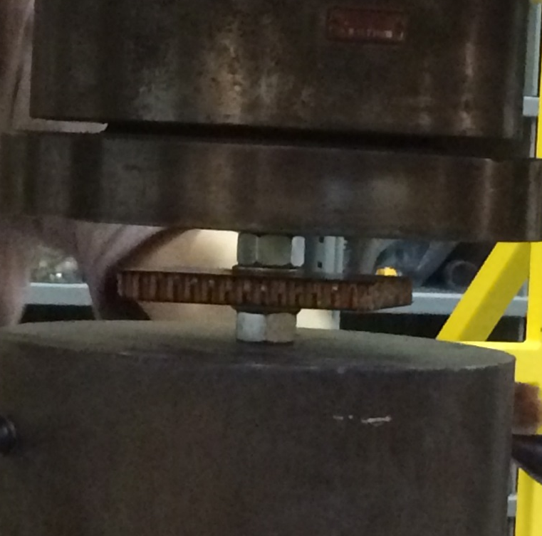
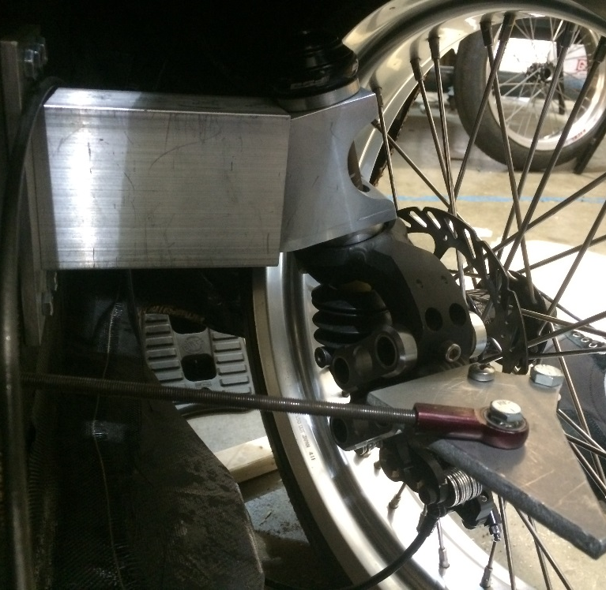
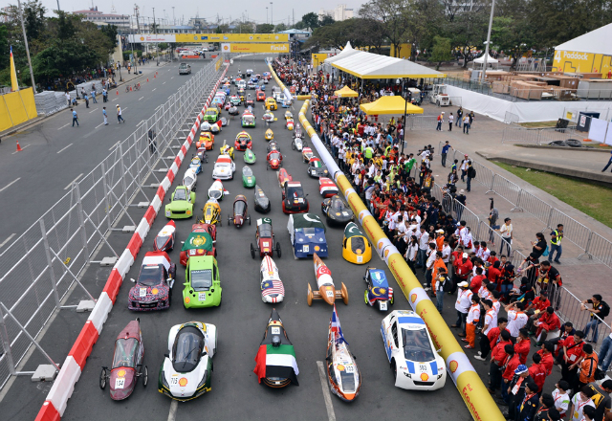
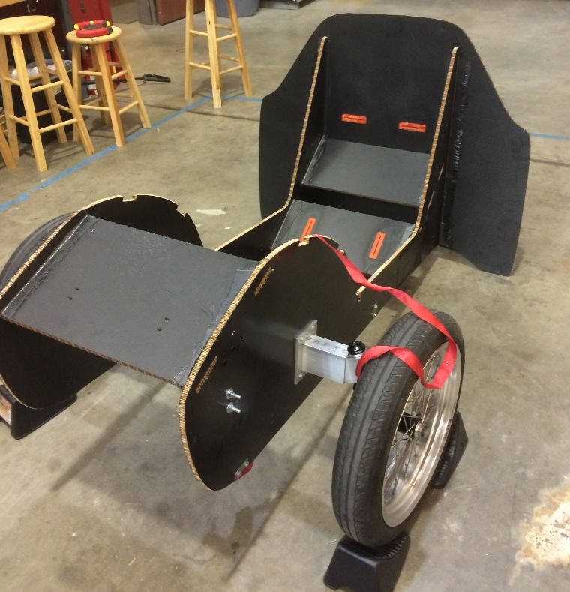
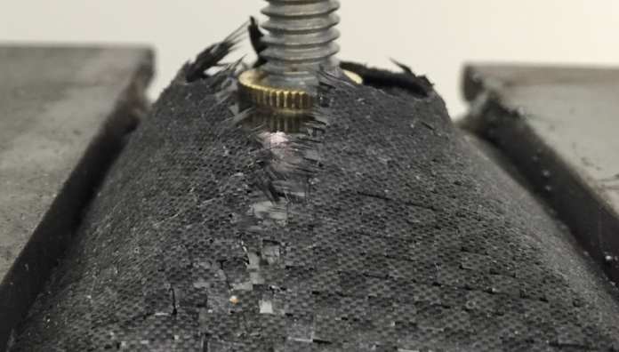
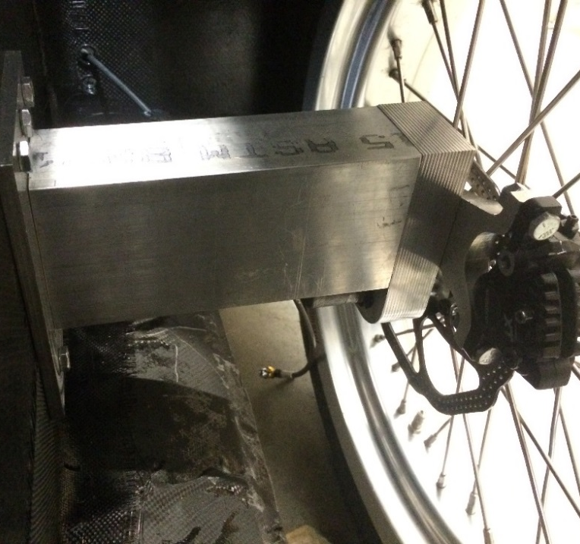
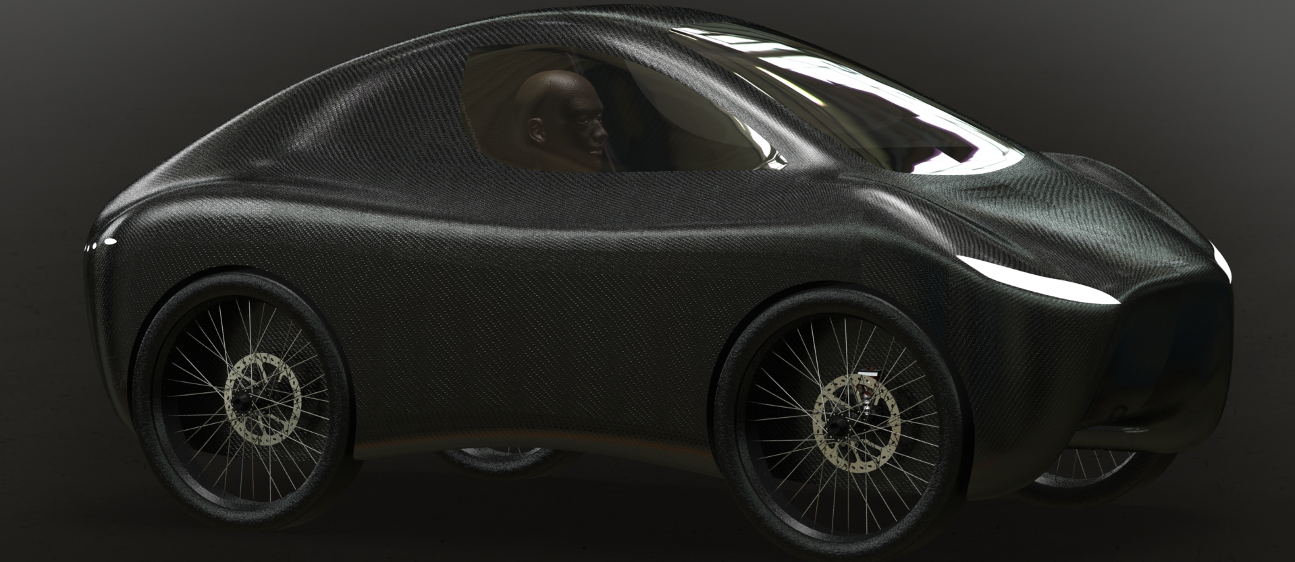
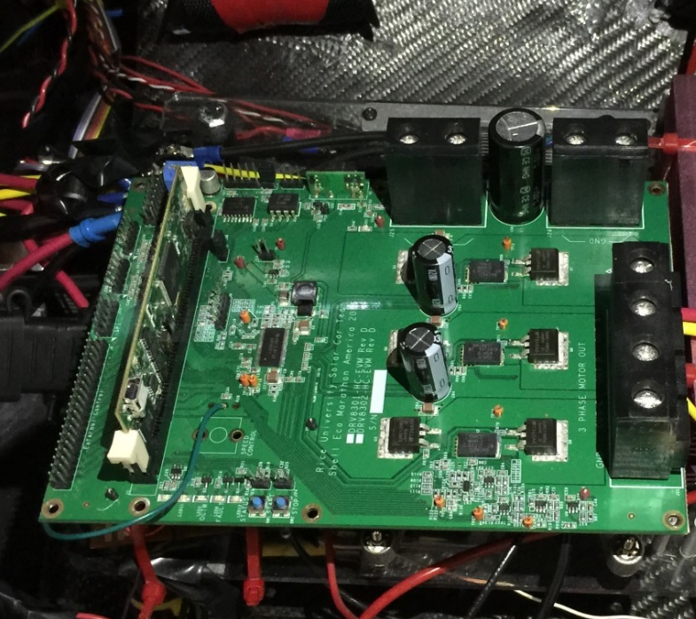
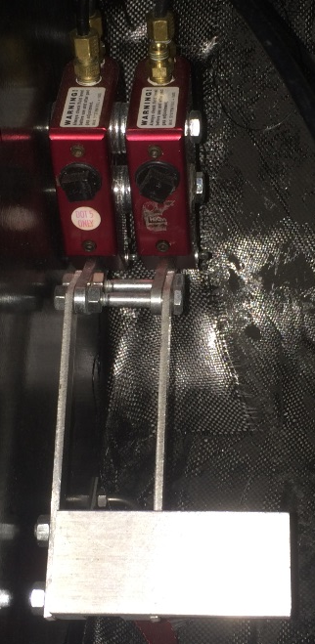
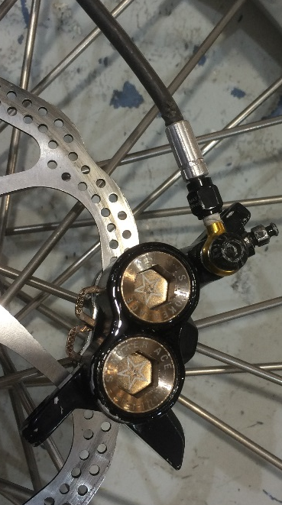
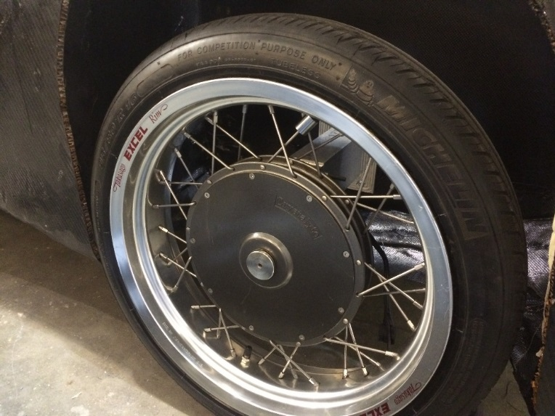
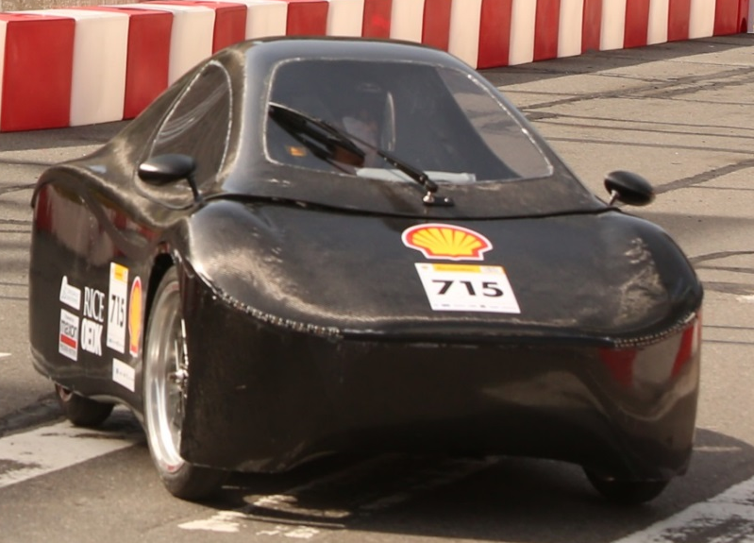
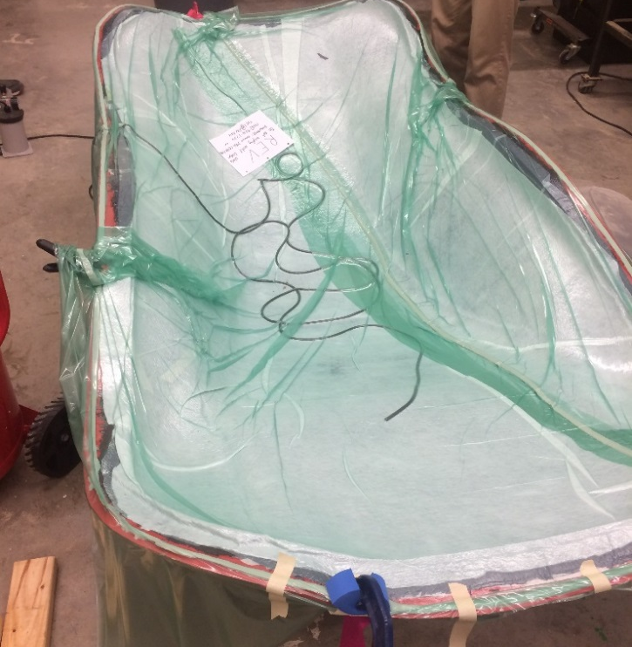






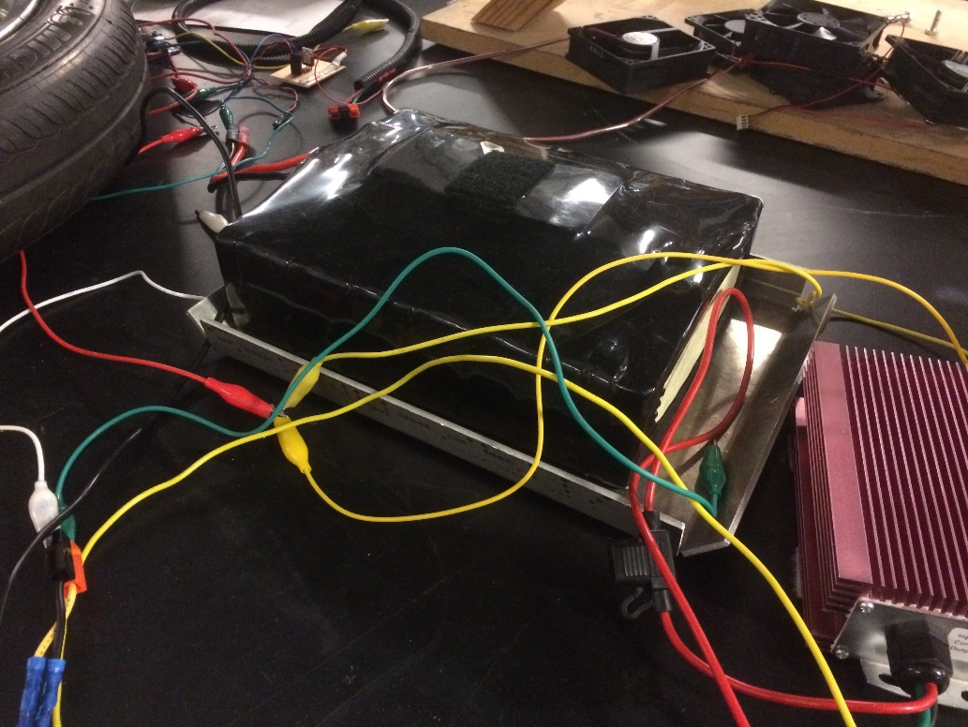
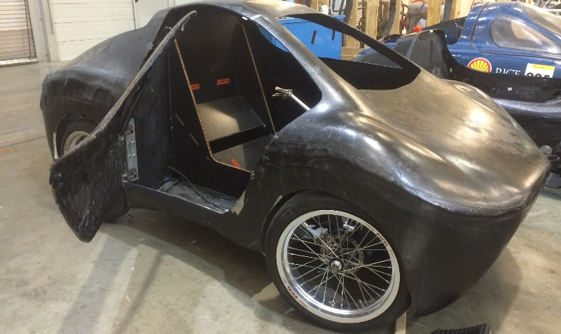
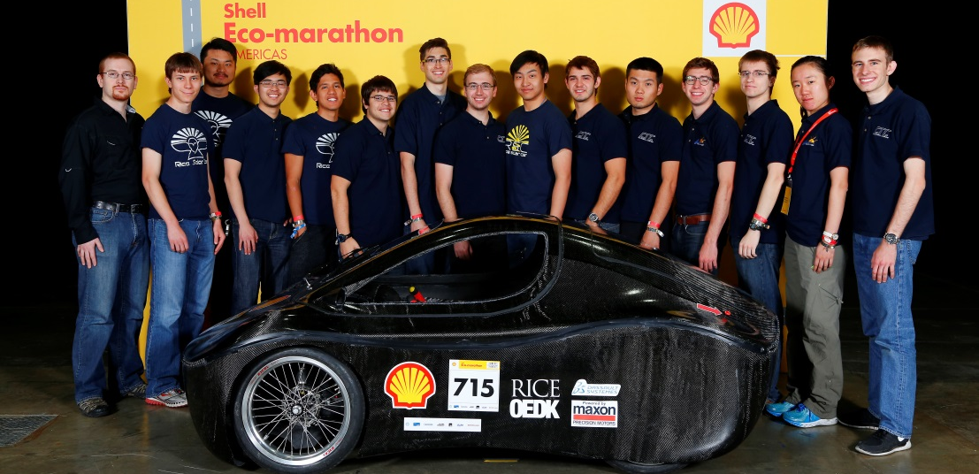
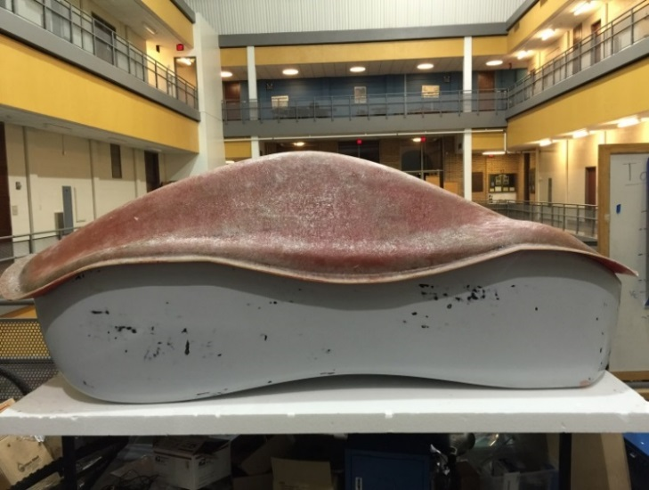
High-Efficiency Electric Vehicle
Rice Electric Vehicle
Joshua Cohen, Luke Daniels, Clark Zha, Vicram Rajapolan, Nicholas Sepulvada
Mechanical Engineering – Fall 2016 – REV.Rice.edu
Project Objective
Chassis
Front Suspension
Design, Build, and Race High-Efficiency Vehicle for the Shell Eco Marathon
Carbon Fiber Panels
Three layers of twill weave
Honeycomb Nomex core
Manufacturing
Core CNC Milled
Prefab panels for easy assembly
Bonded with carbon fiber strips and epoxy
Panel Testing
Compression testing on chassis panels
Determined best method of bolting to carbon fiber-Nomex
Double shear test to analyze layer thickness for layup
Confirmed strength of carbon fiber Nomex panels
Prefab System
Elastomer dampers
Chassis Integration
Aluminum truss and adapter assembly
Simple steering assembly
Target Specifications
Urban Concept
Road ready vehicle, consumer features
Zero Emissions
Battery electric
High Efficiency
Lowest energy over 6.3 miles
Rear Suspension
Aluminum Truss
Easy to change for different designs
Rigid structure reduces flex
Simple construction
Easy maintenance
Constraints | Target Values
Weight | < 250 lbs
Max Dimensions | 134 x 50 x 50 in
Trunk Space | 8 x 16 x 20 in
Driver Egress | < 10 sec
Brakes
Motor Controller
Hydraulic Disk Brakes
Separate line for each wheel
Two master cylinders on one pedal
DOT4 brake fluid
System Board
Brushless control using TI technology
Custom designed and fabricated
Fully programmable
Drivetrain
Body
Acknowledgements
Hub Motor
600-1200W motor
High efficiency
Weight: 30 lbs
Battery
12S LiPo
48V nominal voltage
Easily charged
Powers entire car
Weight: 15 lbs
Aerodynamic Shell
3 Layers, 5.7 oz carbon fiber
Honeycomb Nomex reinforcement
Two halves joined with extra Nomex and carbon fiber
Door and trunk cut from final shell
Weight: 30 lbs
Mold Preparation
Positive plug CNC machined from EPS
Fiberglass negative mold used for layup
Wet Layup
Epoxy resin applied to each layer which is then placed in mold
Vacuum applied to press layers together
Notes:
General feedback:
• The poster looks very nice! I like the big picture of your car in the middle.
• I think you need your names below the title.
• I don’t understand the two charts you included. What are they telling me? The charts need to “stand on their own”. (If someone walks up and reads your poster while you’re busy and can’t explain, they should still understand it.)
• Charts are very small. Could someone really read it form 3ft away?
• Your text is also too small for a poster. I think it’s bad to go below 24pt.
• You have too many design details, and not enough testing/result information. I would delete some of the design details to make room to explain how you tested the car, and your results.
• I think it’s a very bad idea to present this poster with no results included!

