Slide 1


WELCOME TO ENGINEERING AT RICE!

Slide 2
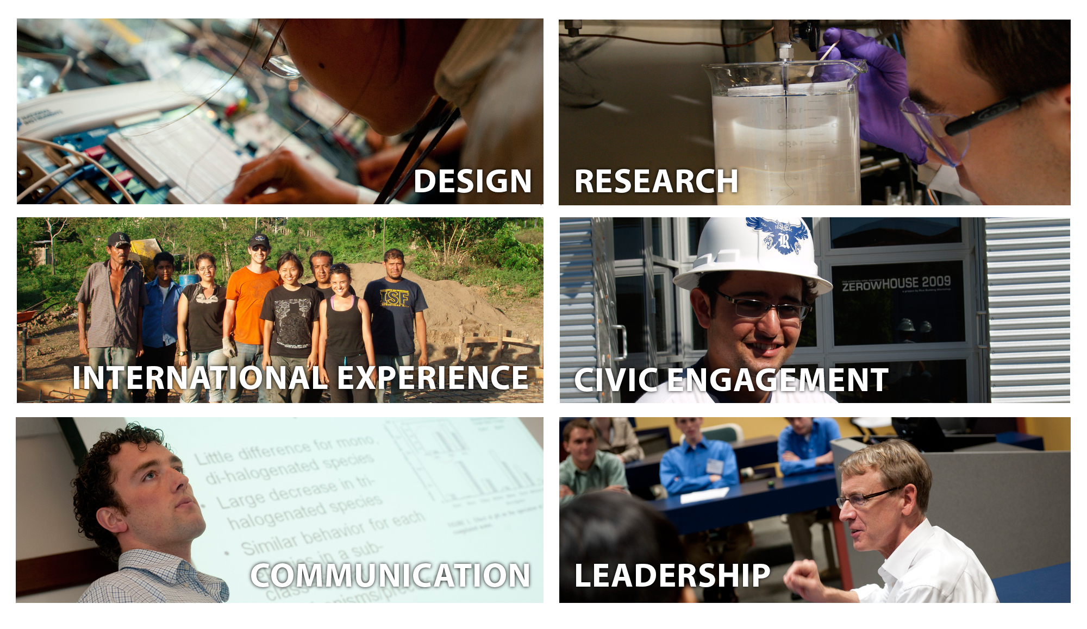
Why Rice Engineering?
Notes:
This slide seems to be serving two purposes.
The heading and the primary bullet contribute to the thesis, which isn’t completely articulated.
The sub-bullets announce the presentation agenda. You could collapse Comm and Leadership into RCEL.

Slide 3
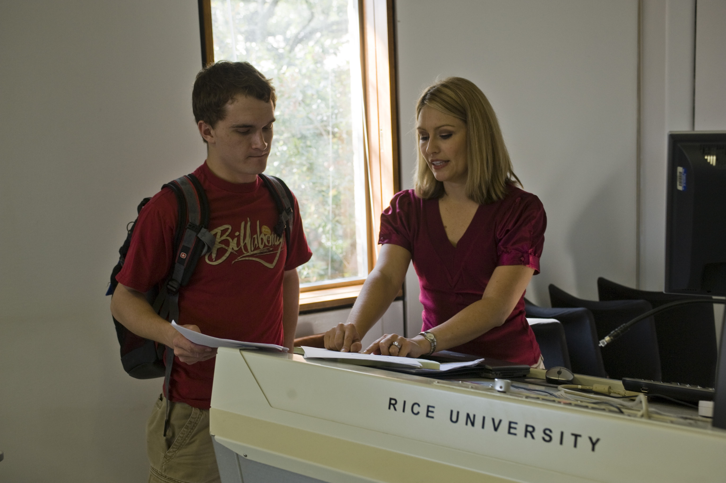
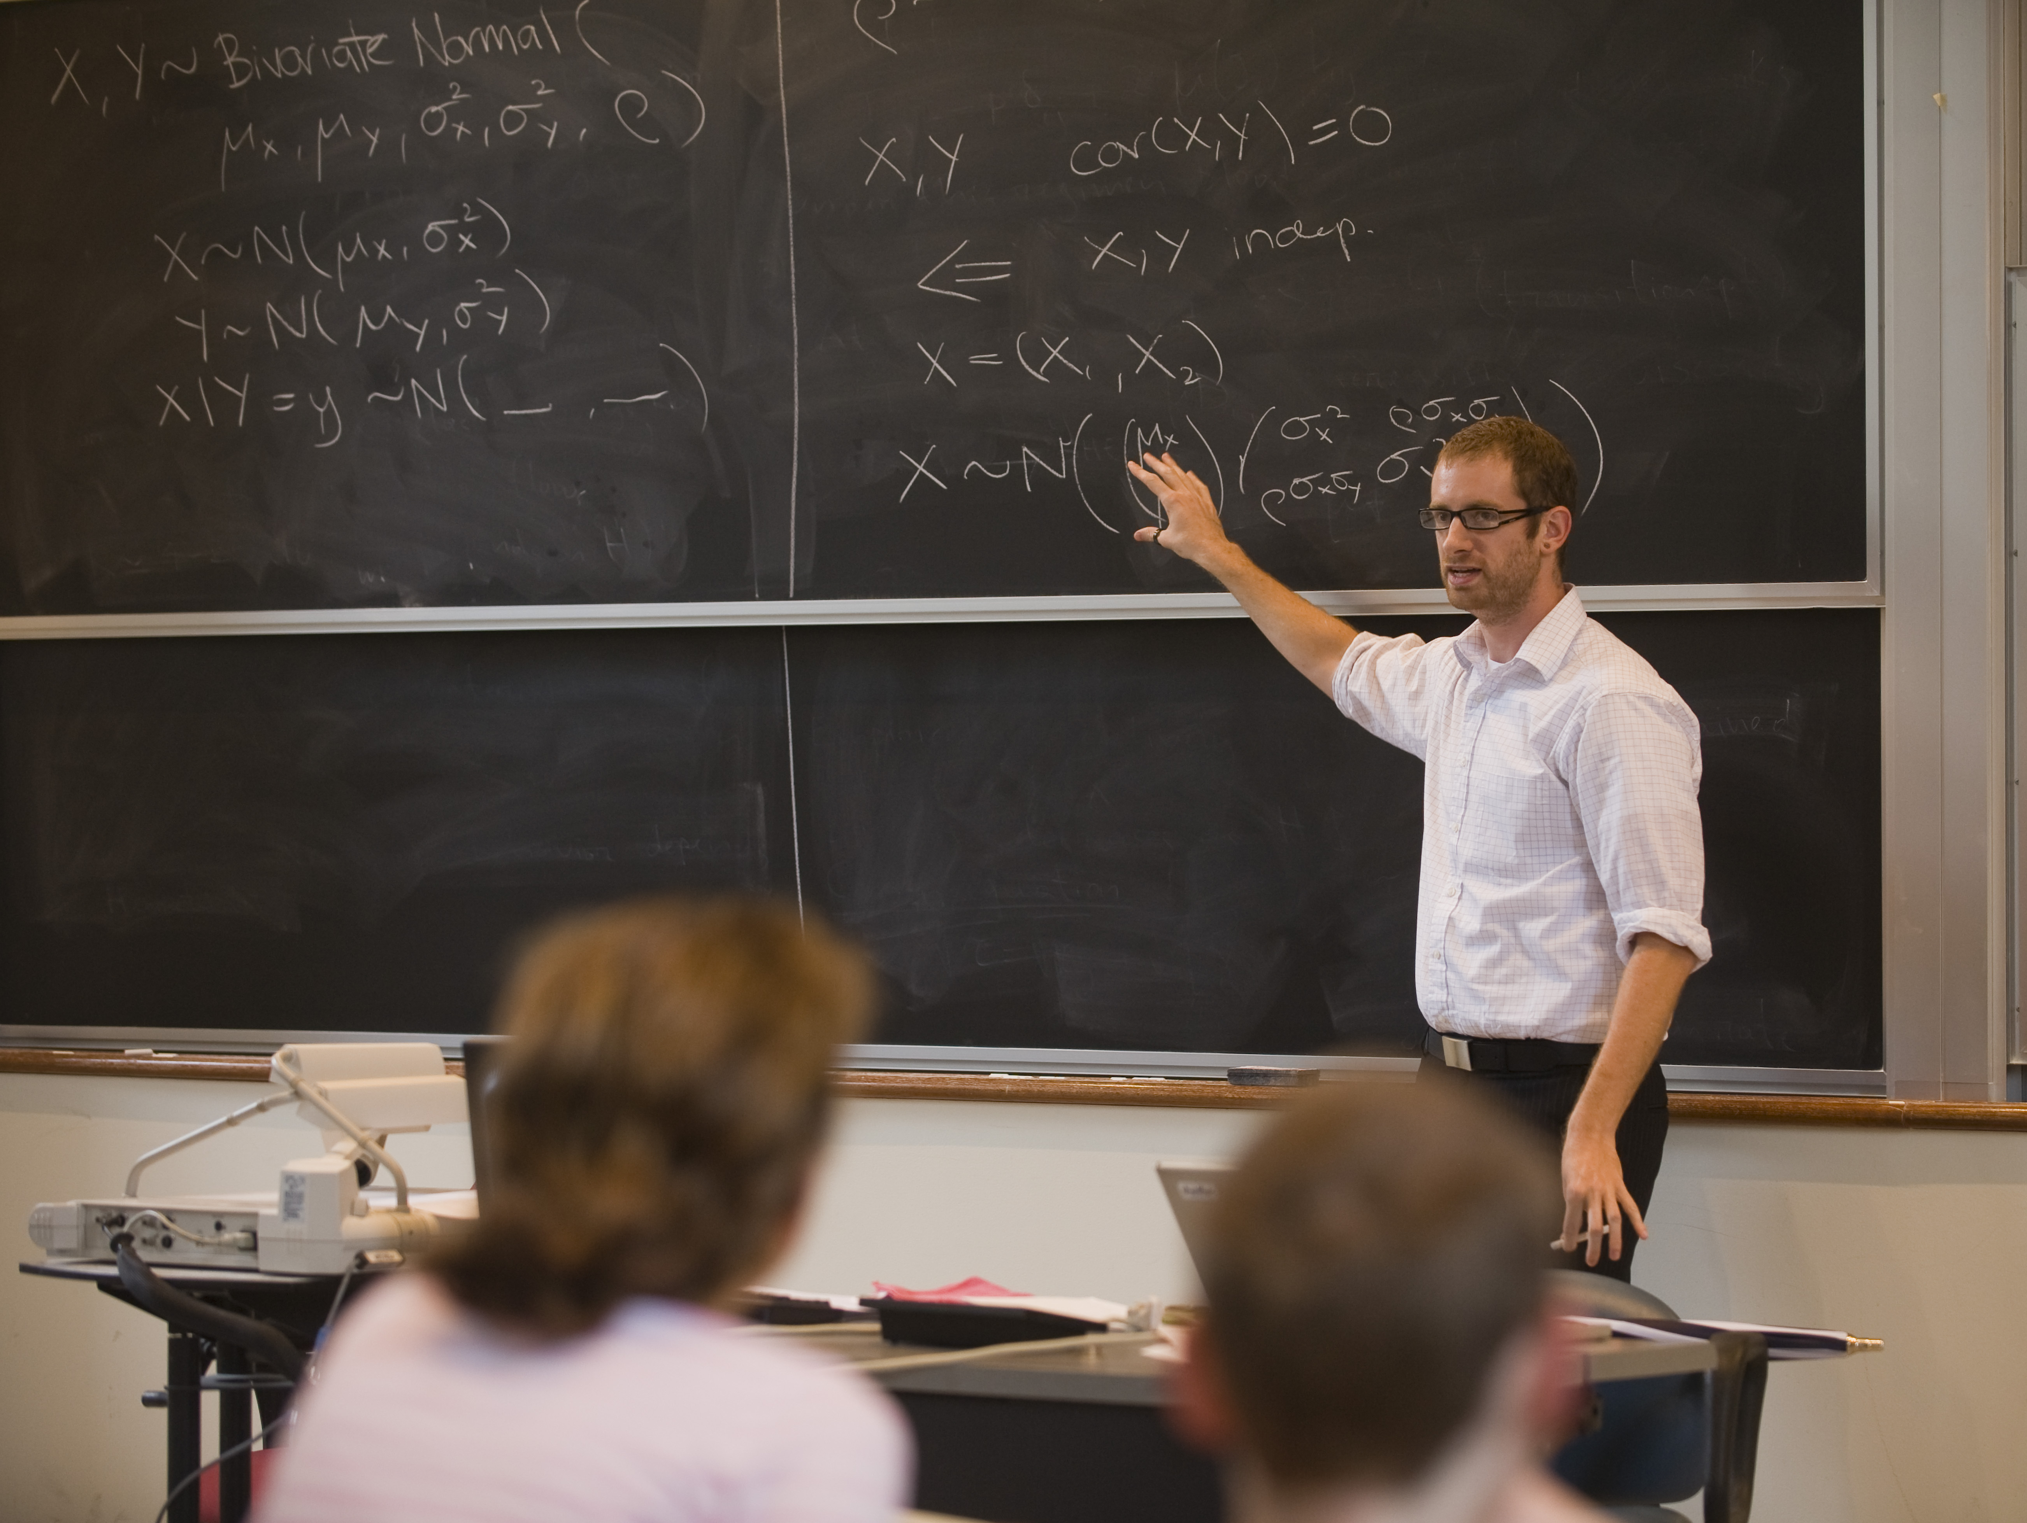
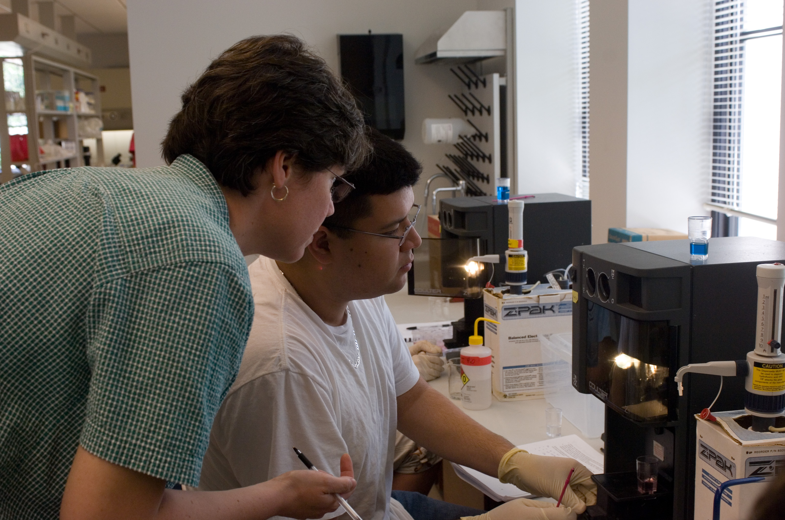
FUNDAMENTALS
DEPARTMENTS
BIOENGINEERING
COMPUTATIONAL AND APPLIED MATHEMATICS
CHEMICAL AND BIOMOLECULAR ENGINEERING
CIVIL AND ENVIRONMENTAL ENGINEERING
COMPUTER SCIENCE
ELECTRICAL AND COMPUTER ENGINEERING
MECHANICAL ENGINEEERING AND MATERIALS SCIENCE
STATISTICS

Slide 4
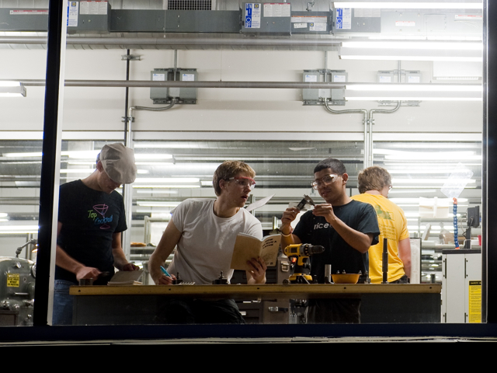
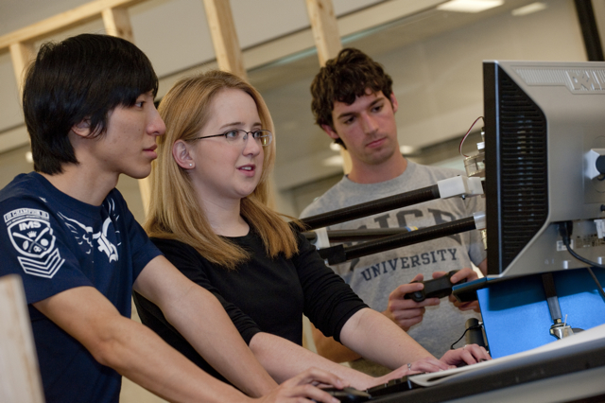
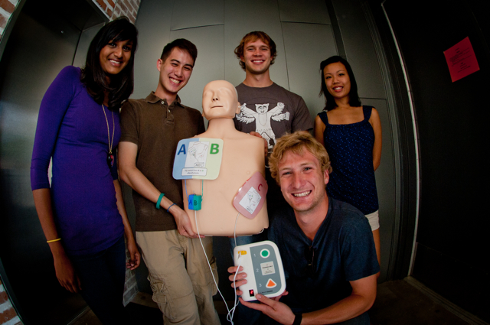

DESIGN

Slide 5
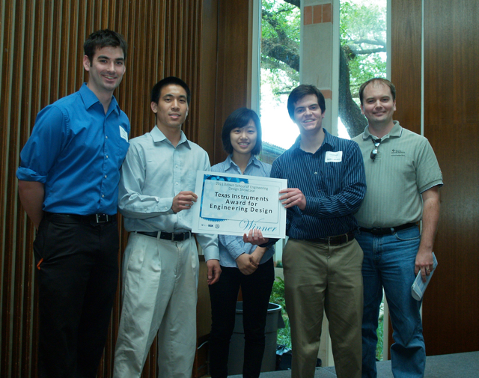
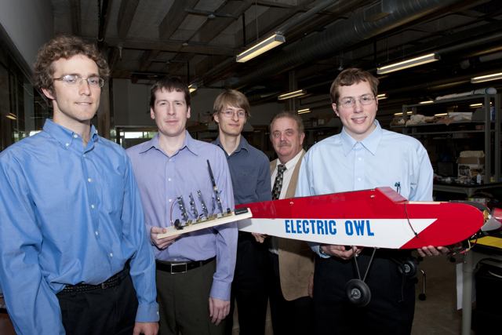
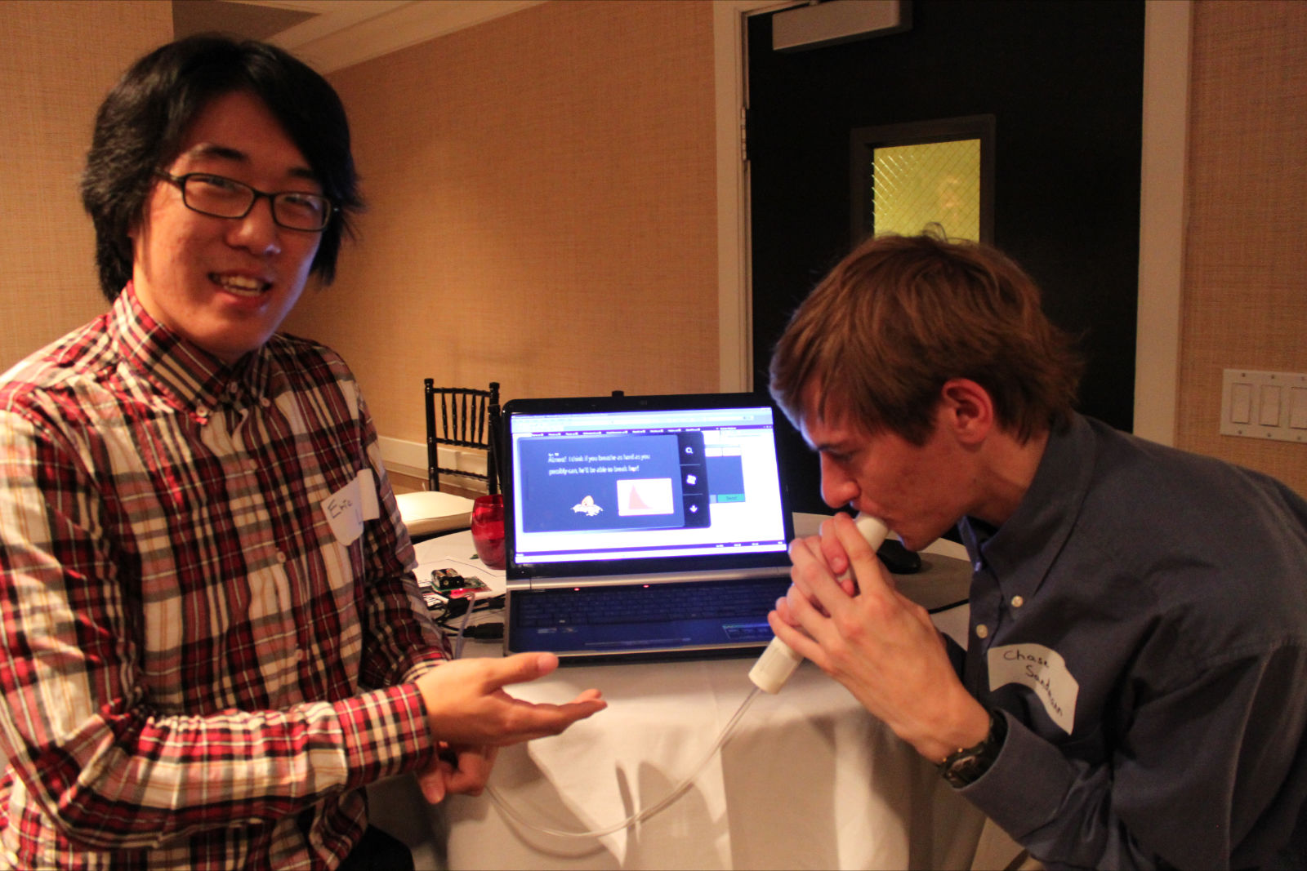
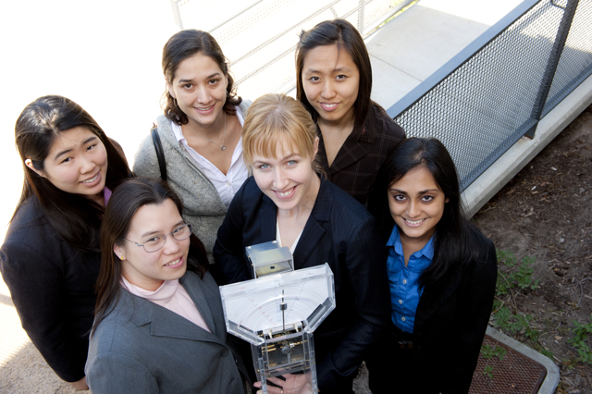
COMPETITION WINNERS
CardiOwl/Electric Owl
1st Place NASA/TSGC Competition
Electric Owl
Texas Instruments’ Engibous Prize - $10K
Azmo the Dragon
2011 Microsoft Imagine Cup Competition
3rd Place for Mobile Game Design - $3K
Zikomo
ASME Ishow
2nd Place - $7K

Slide 6

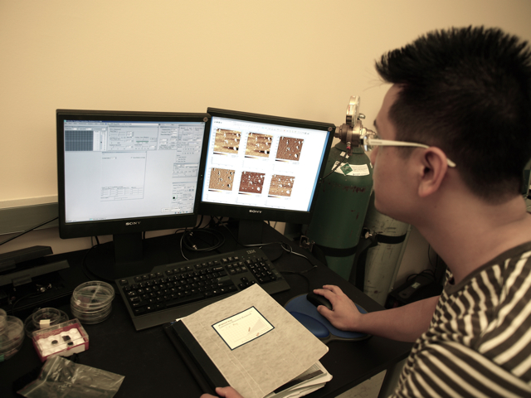
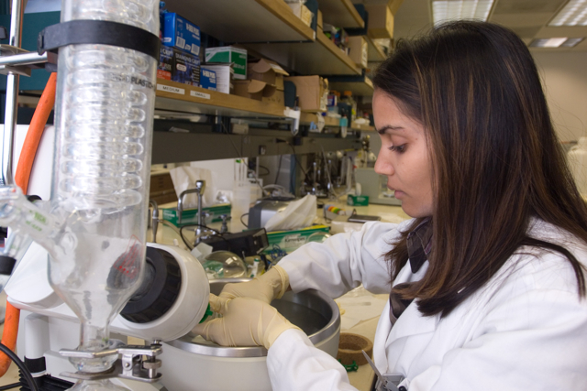
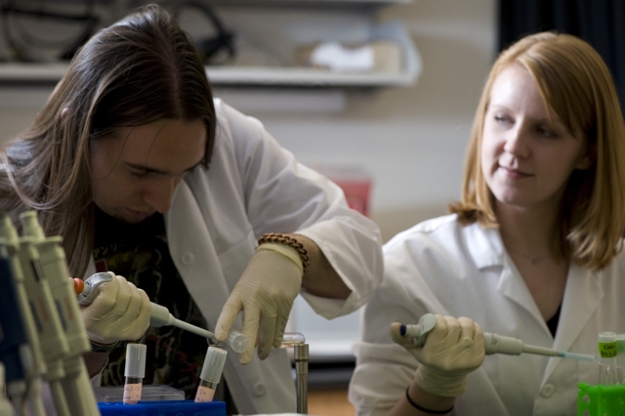
RESEARCH

Slide 7
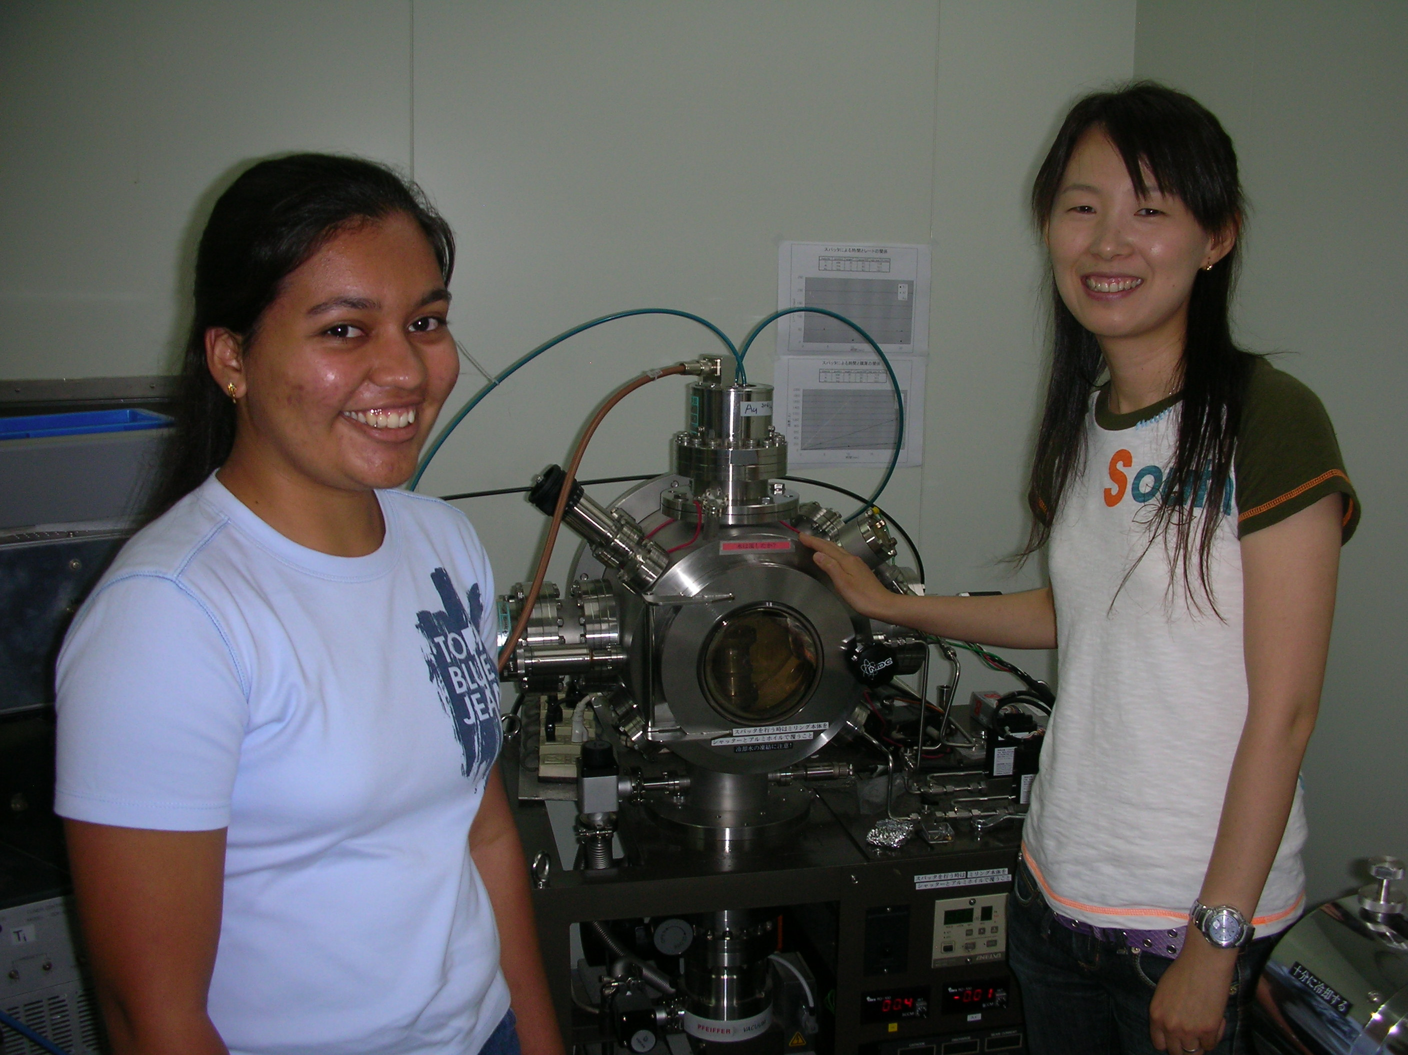

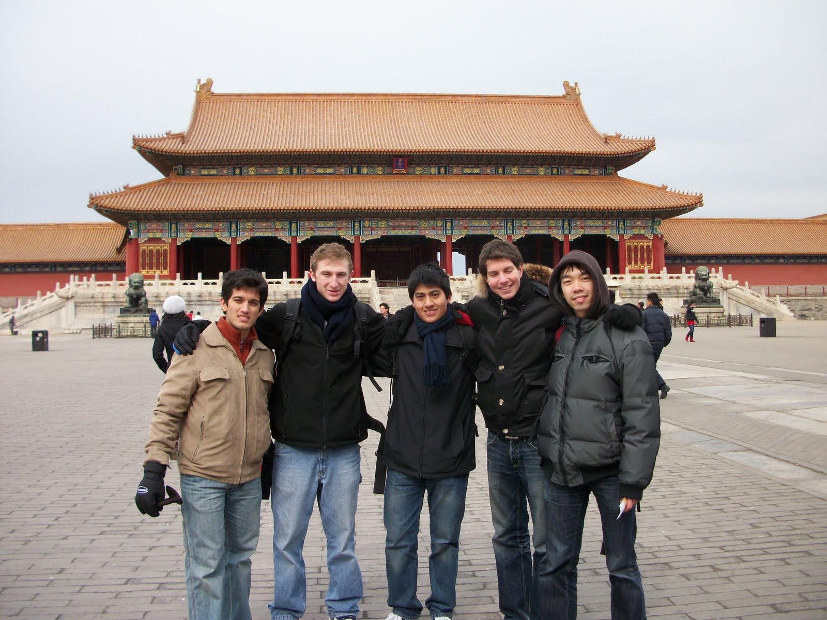
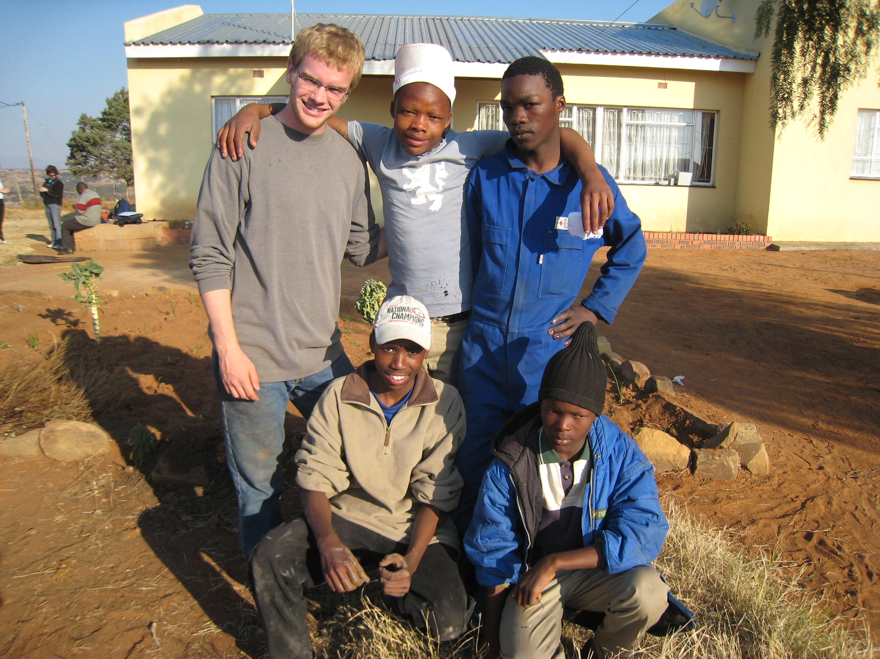
INTERNATIONAL

Slide 8


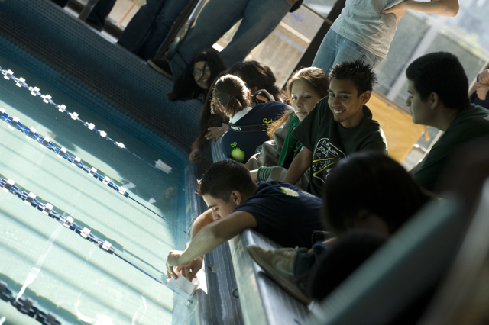
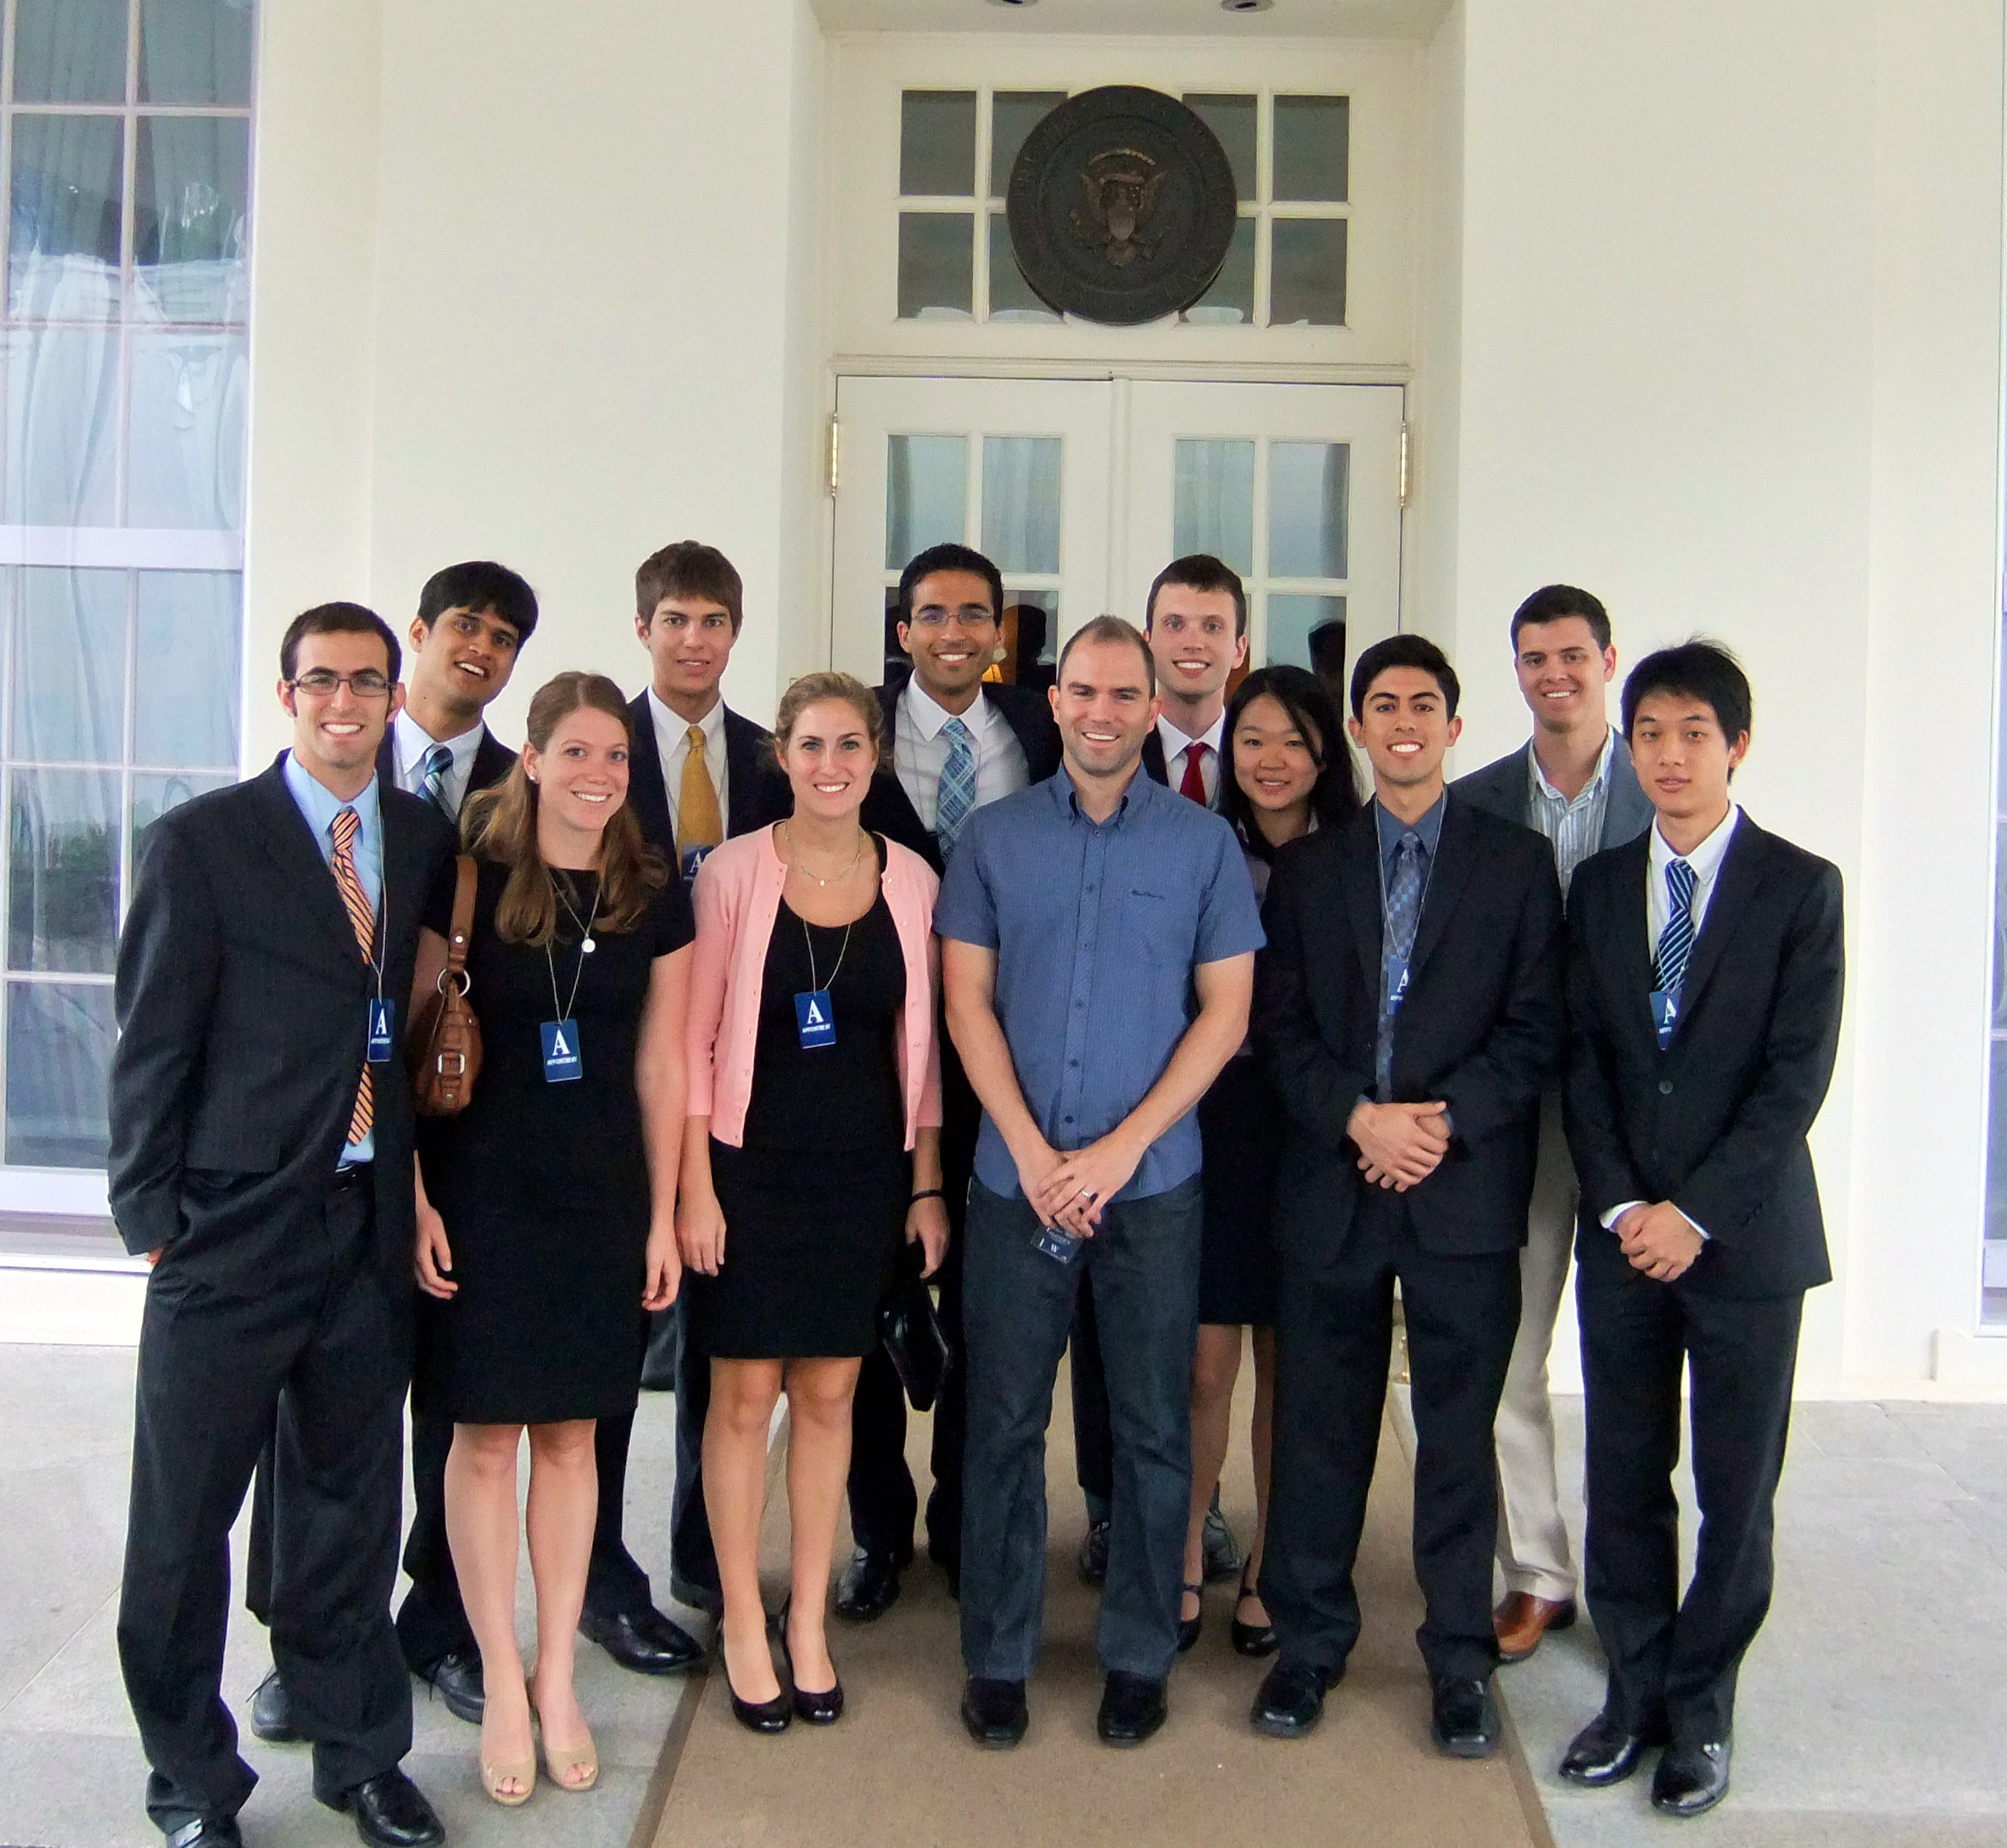
CIVIC ENGAGEMENT
Engineers Without Borders in Nicaragua
Wireless access in Pecan Park
DREAM Project
Washington D.C. Interns 2011

Slide 9
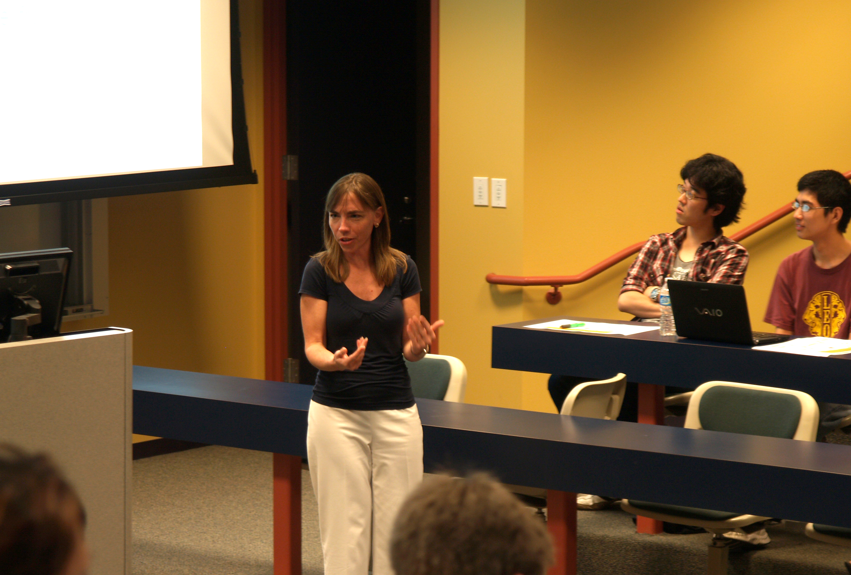
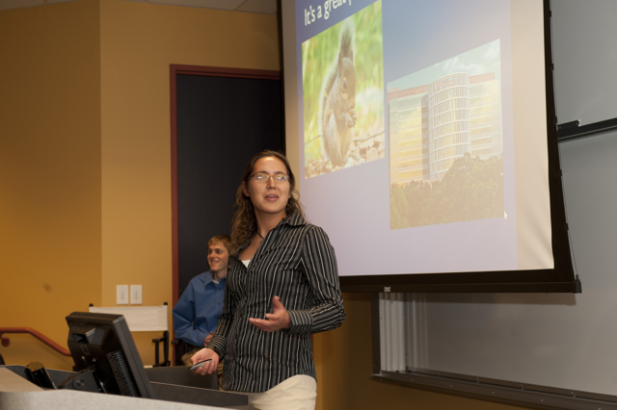

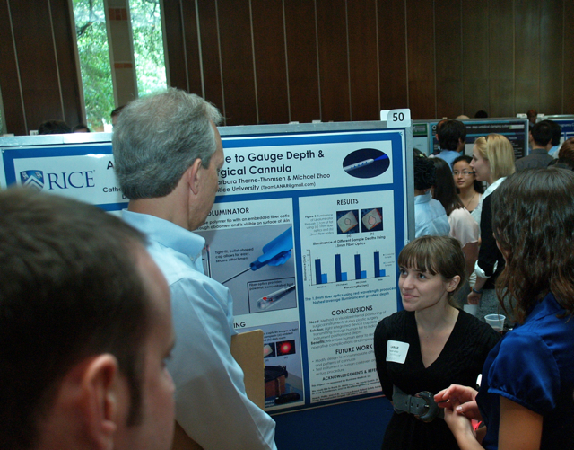
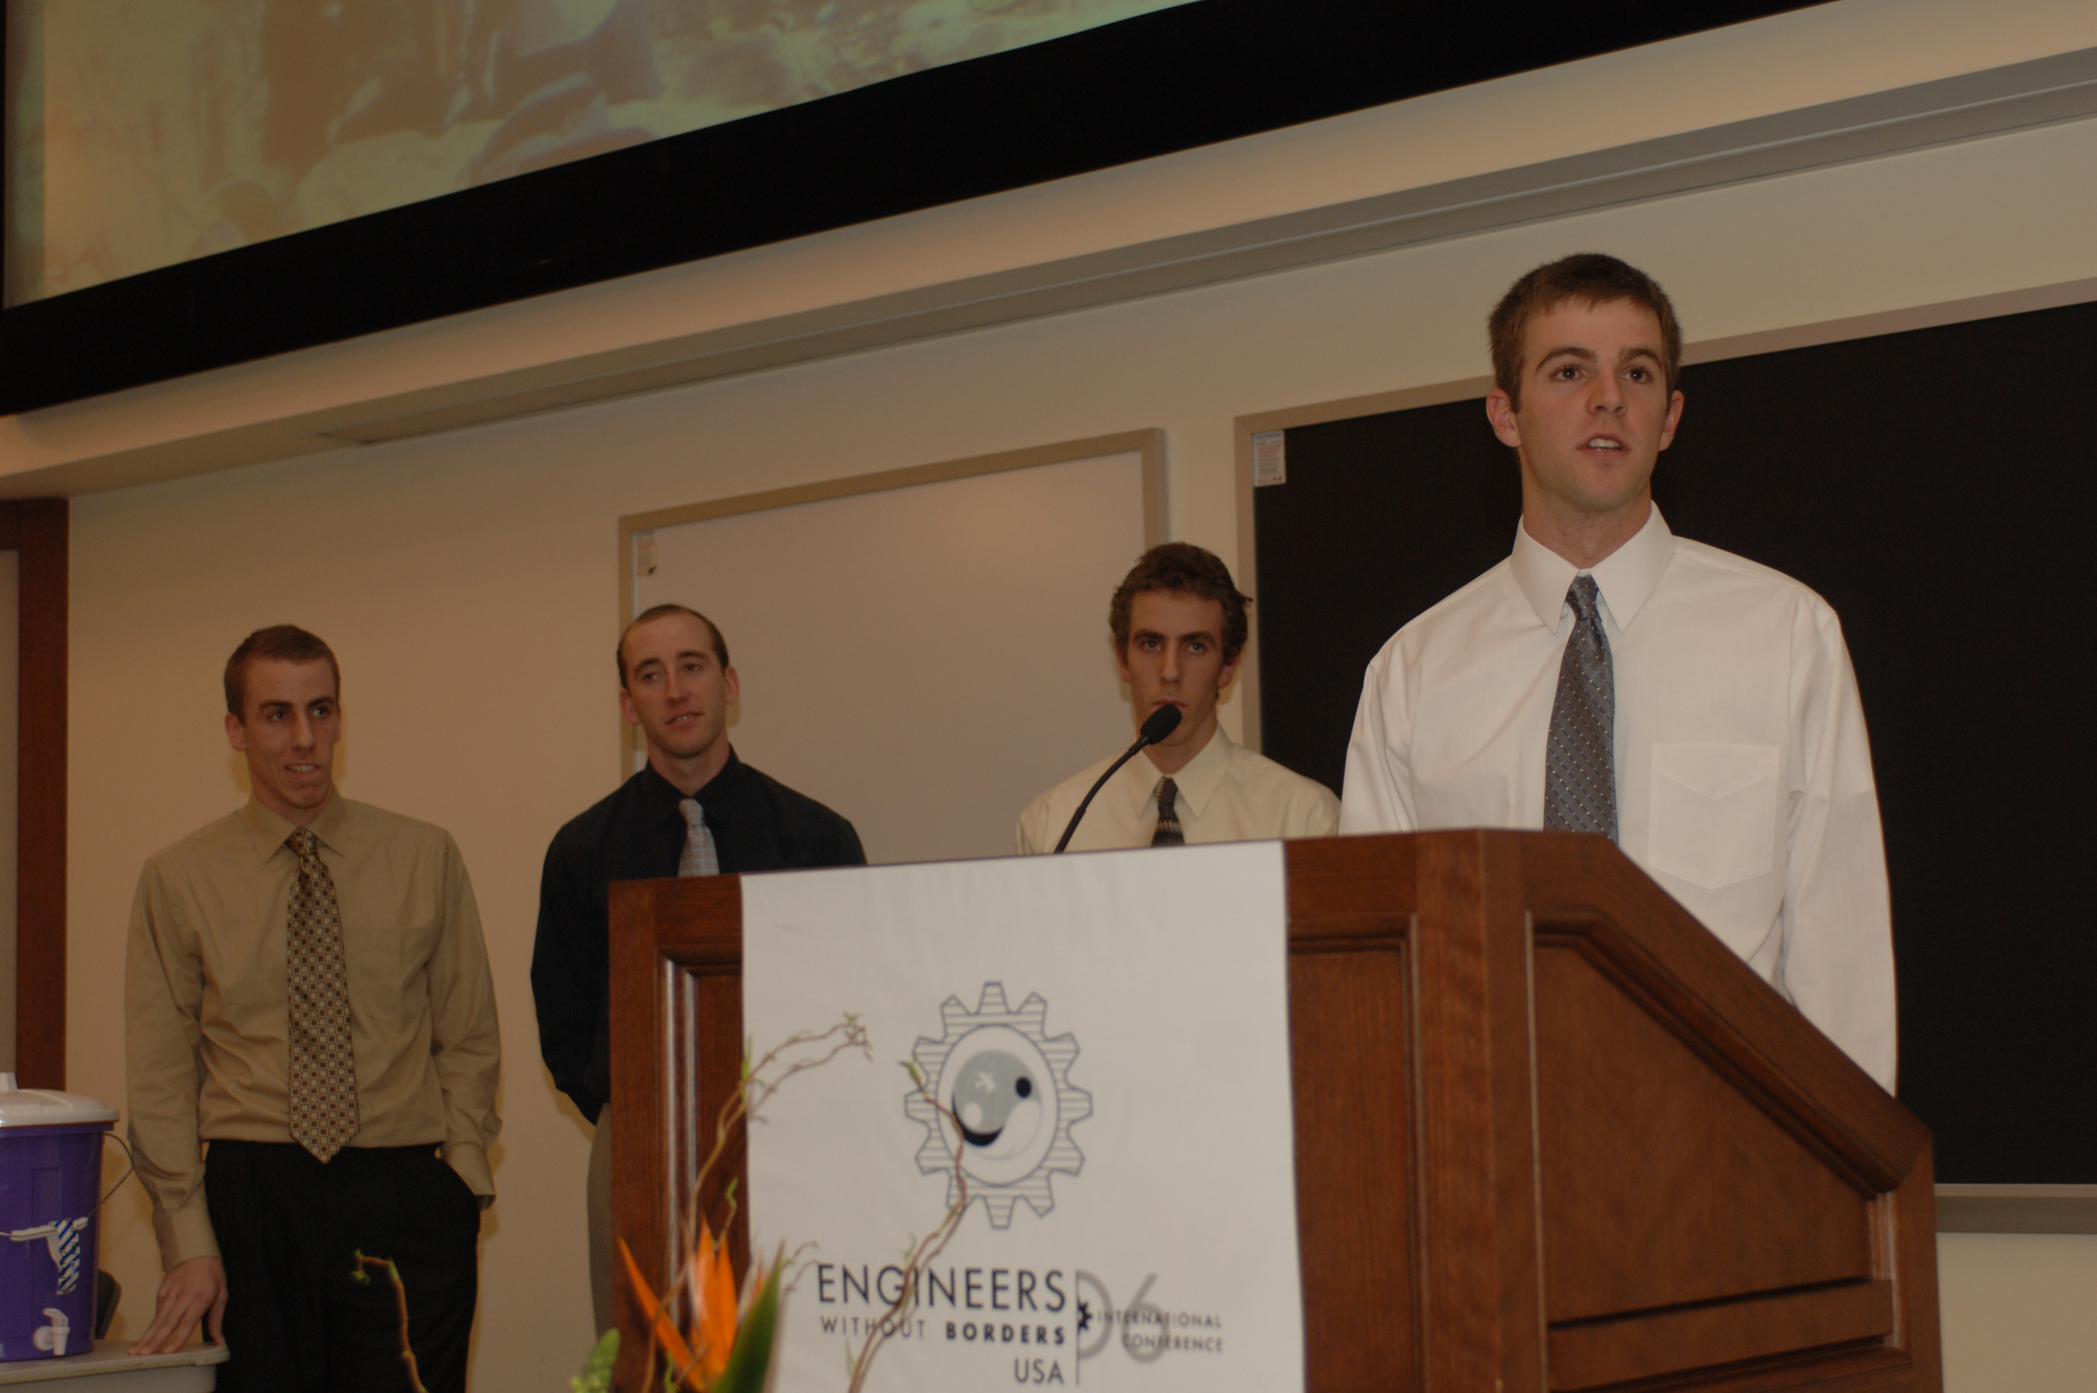
COMMUNICATION
Oral Presentation Coaching
Classroom Presentations
EWB National Conference
Poster Sessions

Slide 10

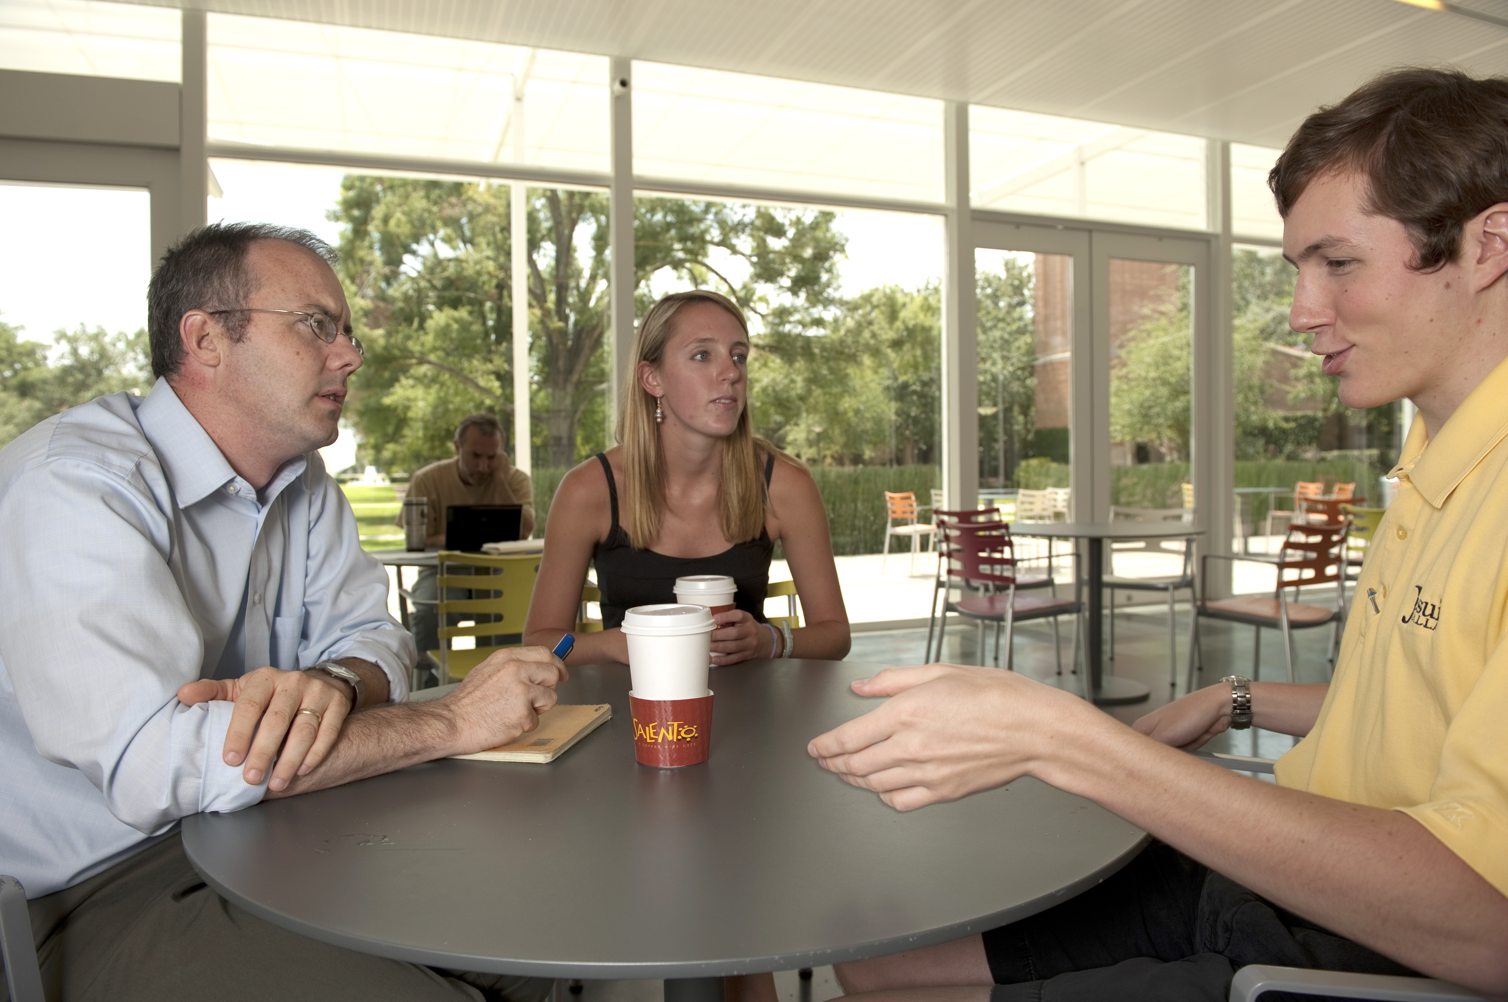

Rice Center for Engineering Leadership
Mission: Graduate engineers who will be
leaders in engineering, research, business
and public policy.
rcel.rice.edu
Notes:
I would change some of the content on this slide based on audience.
Launched in 2010 (so audience knows its new)
Established with $15M gift from alumni John and Ann Doerr
List 2-3 RCEL activities; for example, this might be an appropriate place to mention the new freshman design course
I would cut the bullet about Mark. I mean no disrespect to him, but it’s a detail the audience won’t be invested in. Bart will mention Mark’s title verbally when he introduces the clip, and Mark’s name appears in the clip.

Slide 11
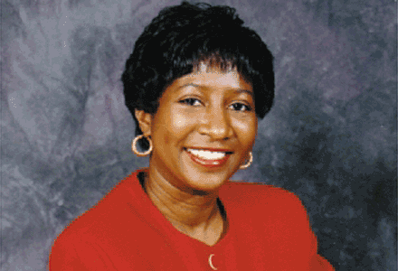
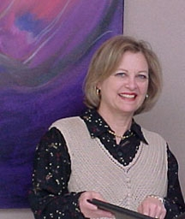
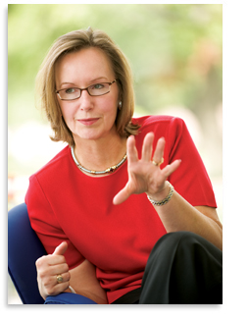
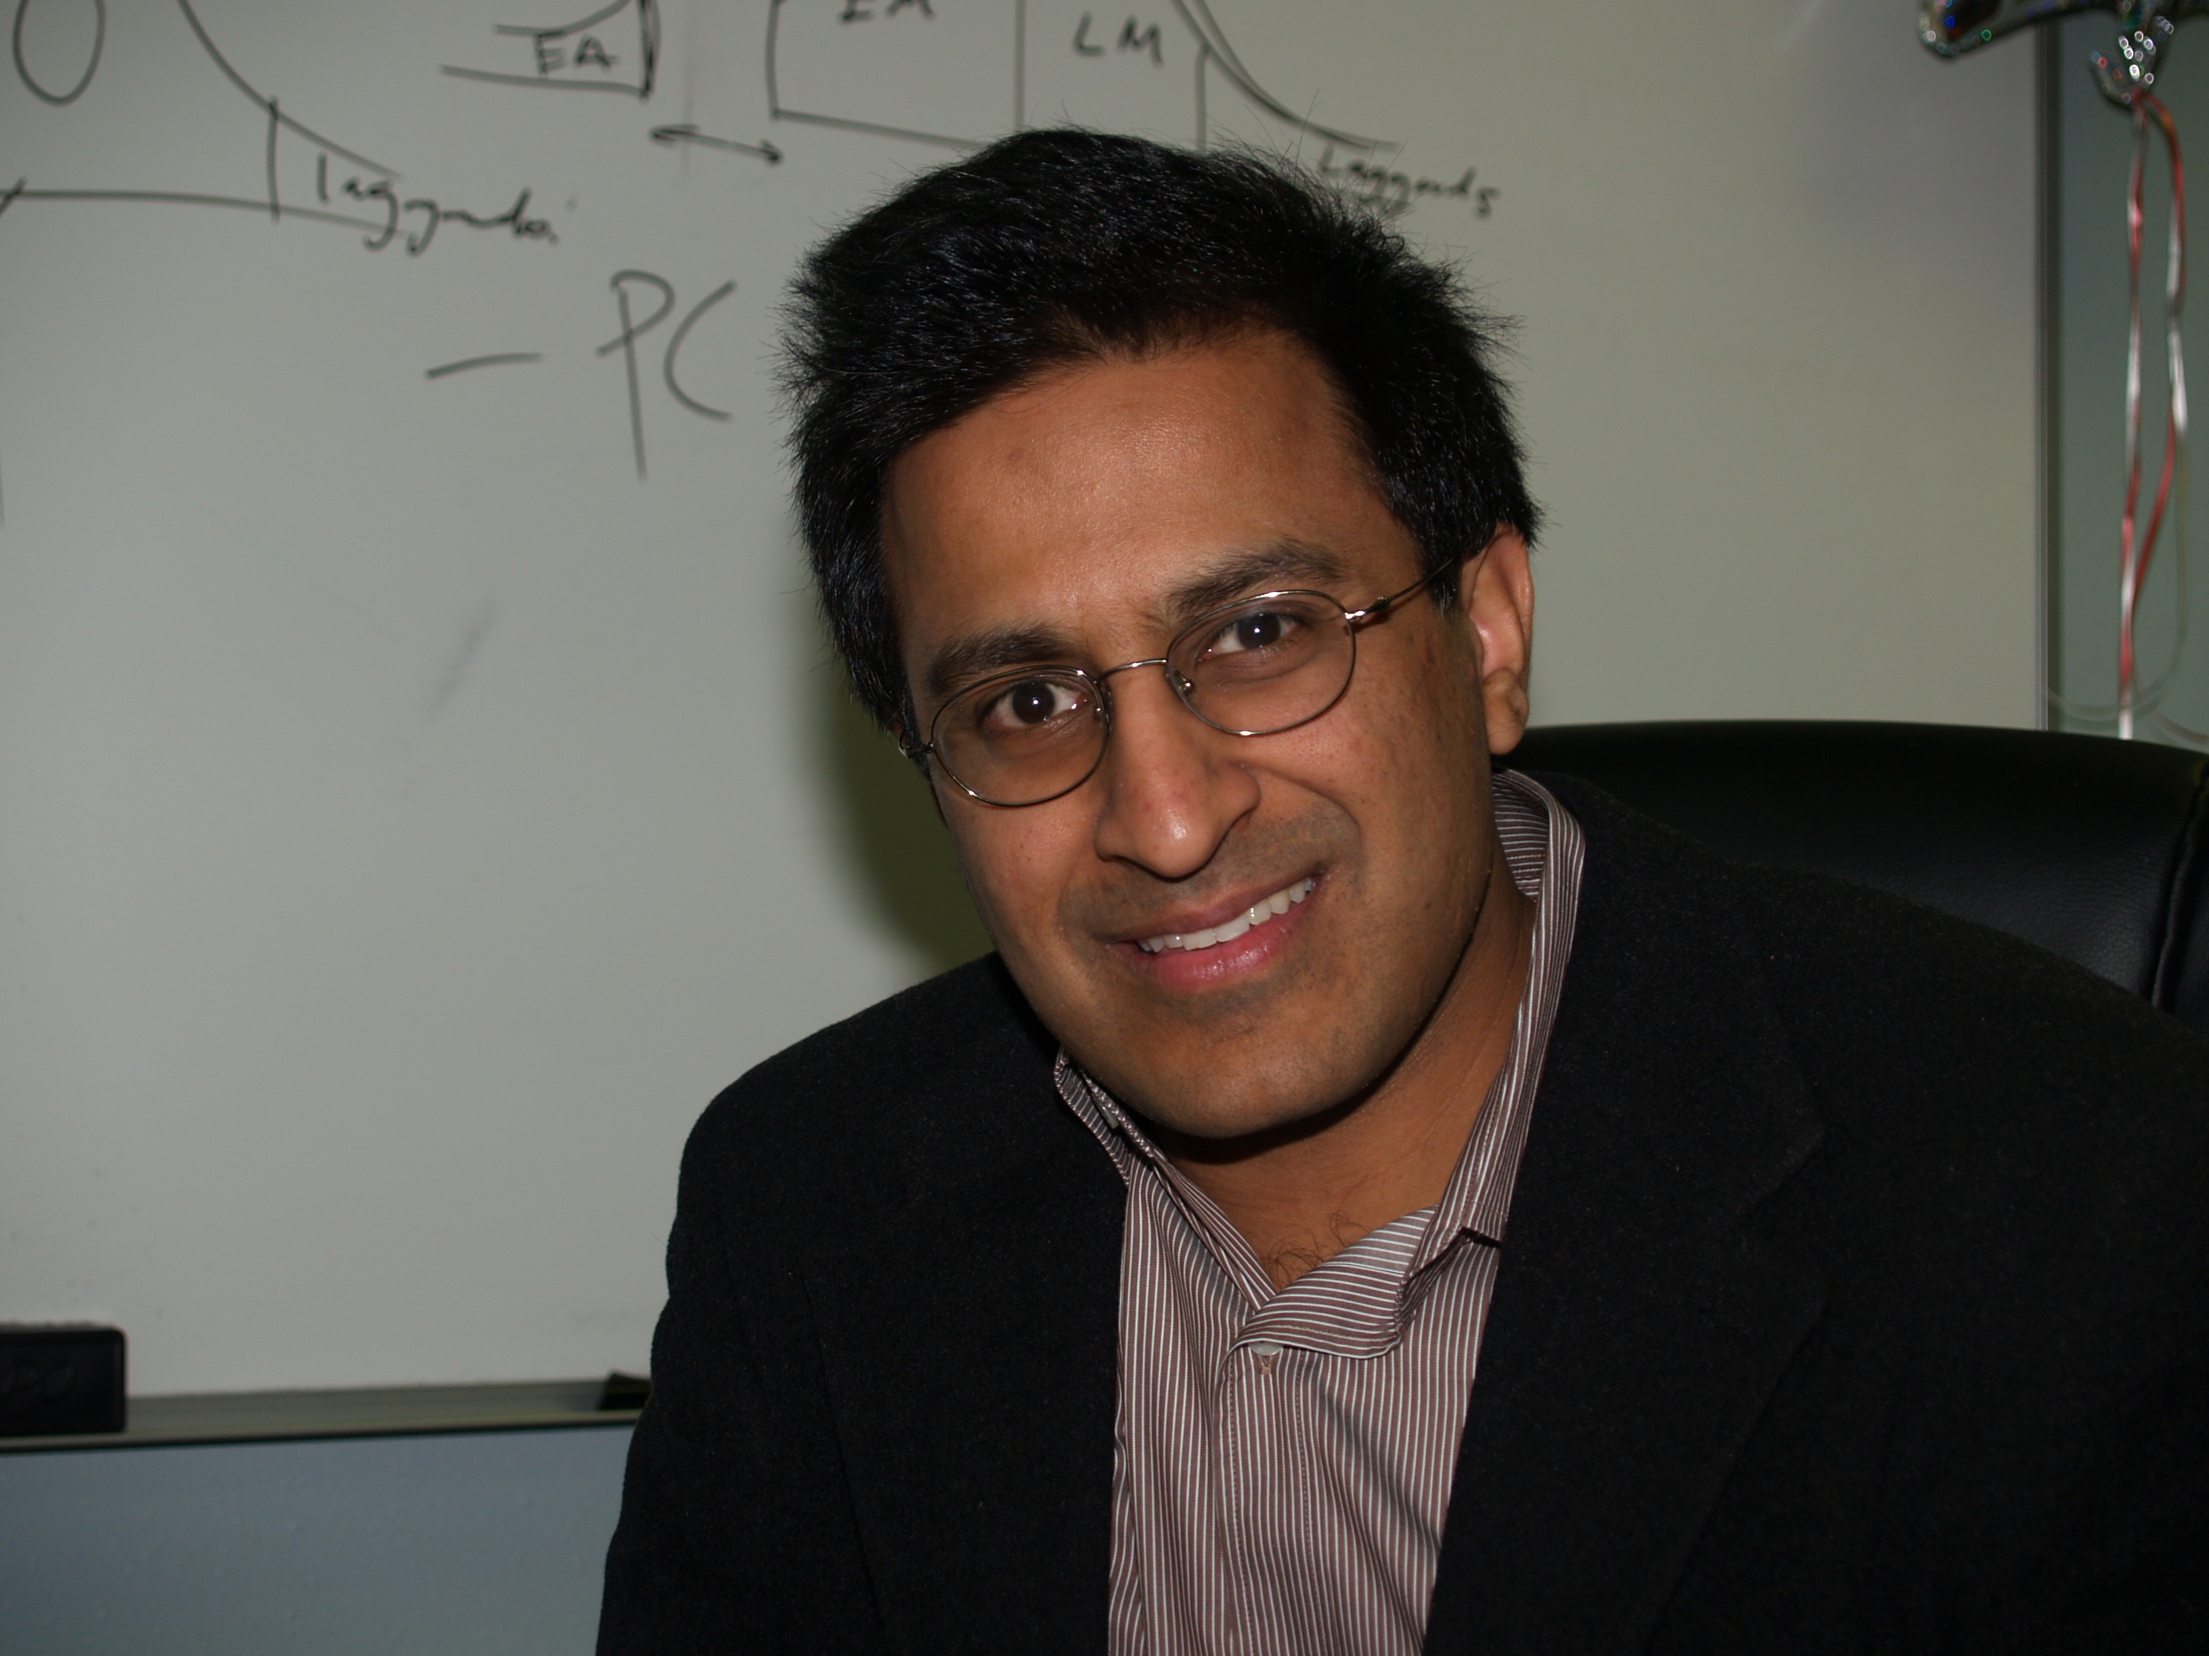

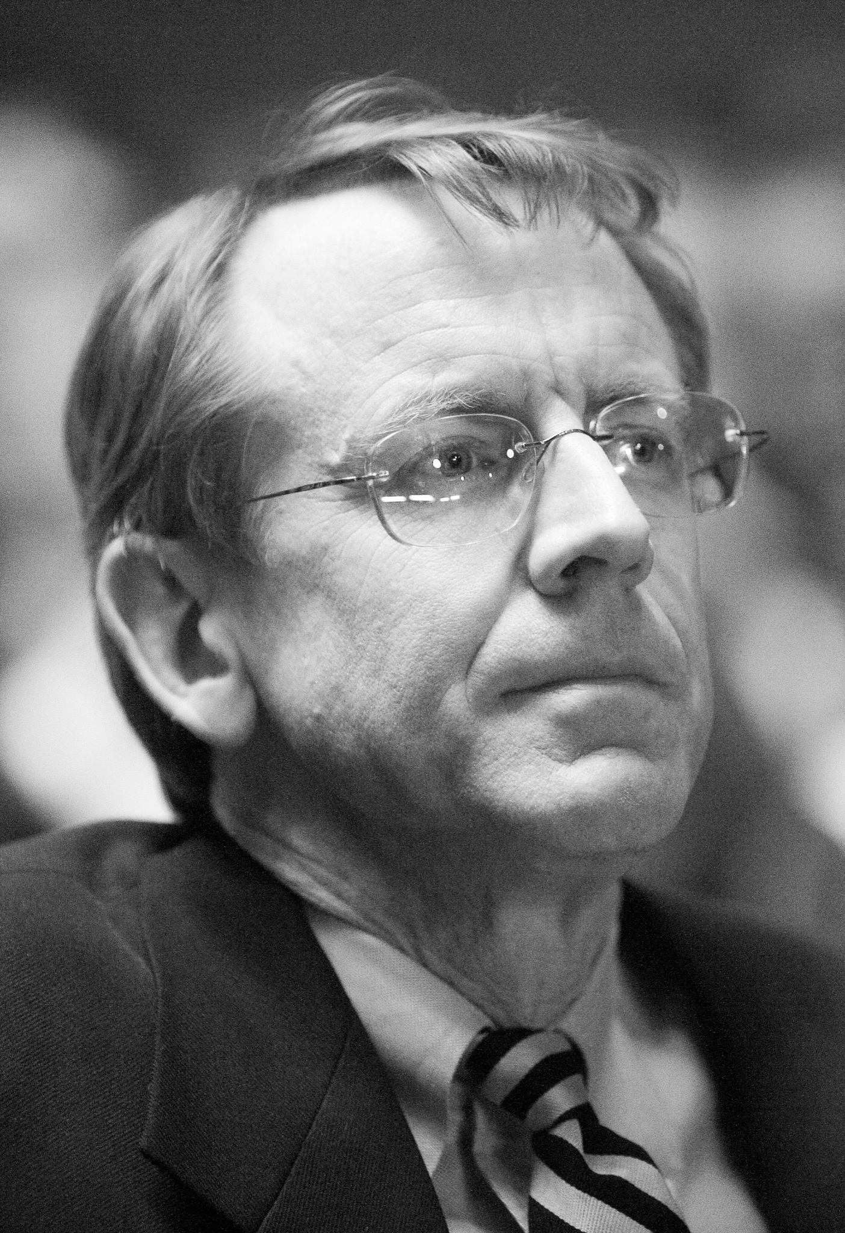
ALUMNI
Sandra Johnson Baylor
Manager, IBM Linux Technology Center
Christine Ehlig-Economides
A.B.Stevens Endowed Professorship, Texas A&M; Member NAE
Lynn Elsenhans
CEO, Sunoco
Rakesh Agarwal
CEO, Snapstream
Mark Hall
Consultant
Former technical director, Sony Pictures
John Doerr
Venture Capitalist
Lotus, Sun, Compaq, Amazon, Netscape,Google

Slide 12
Rice Engineering Experience
Prepares you for your future
Learn how to learn
Develop leadership abilities
Develop communications skills
Design systems and devices to solve real-world problems
Understand engineering in global/social context
Create new knowledge through research
Notes:
You might add:
Design systems and devices to solve real-world problems
Create new knowledge through research
List them in the same order as the topics occur in the talk or list them in terms of importance/priority

