Slide 1
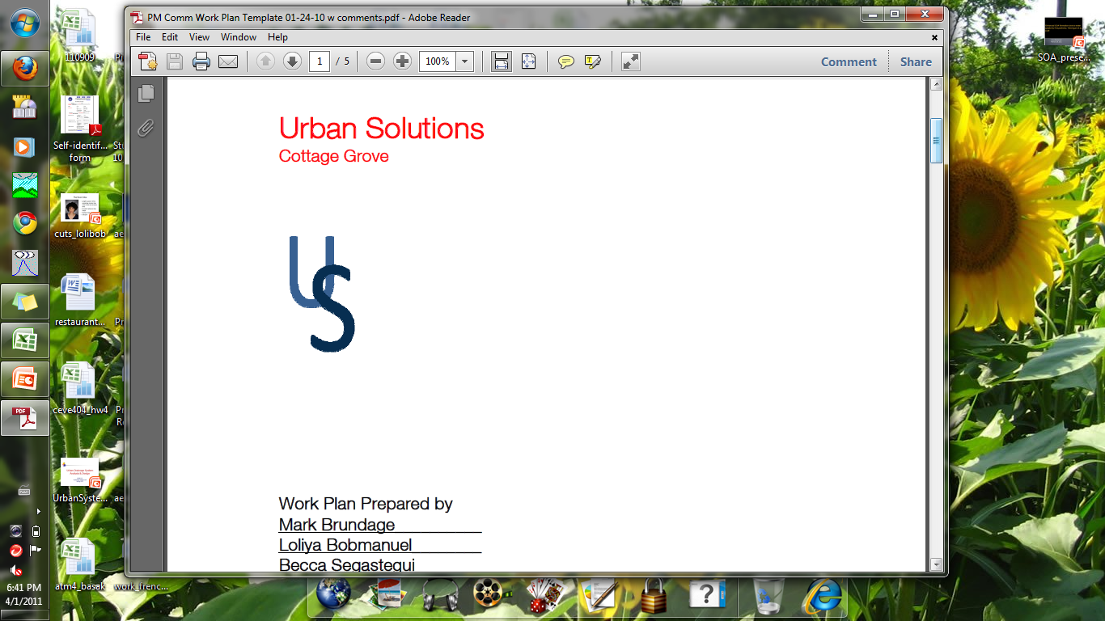

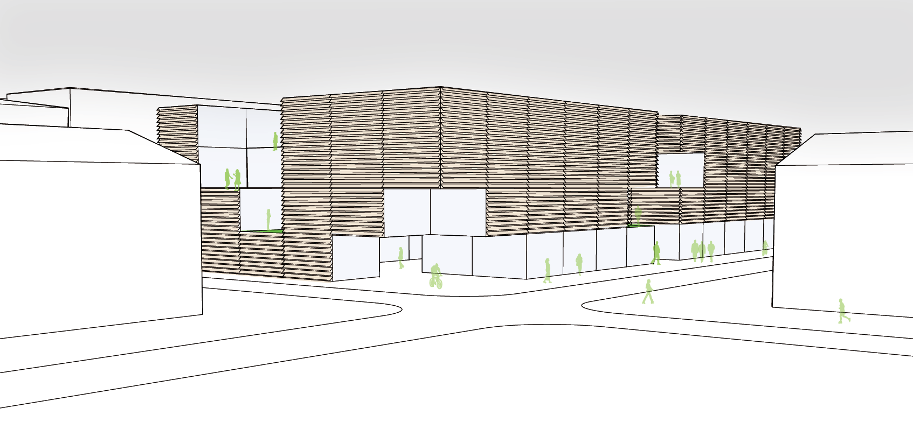
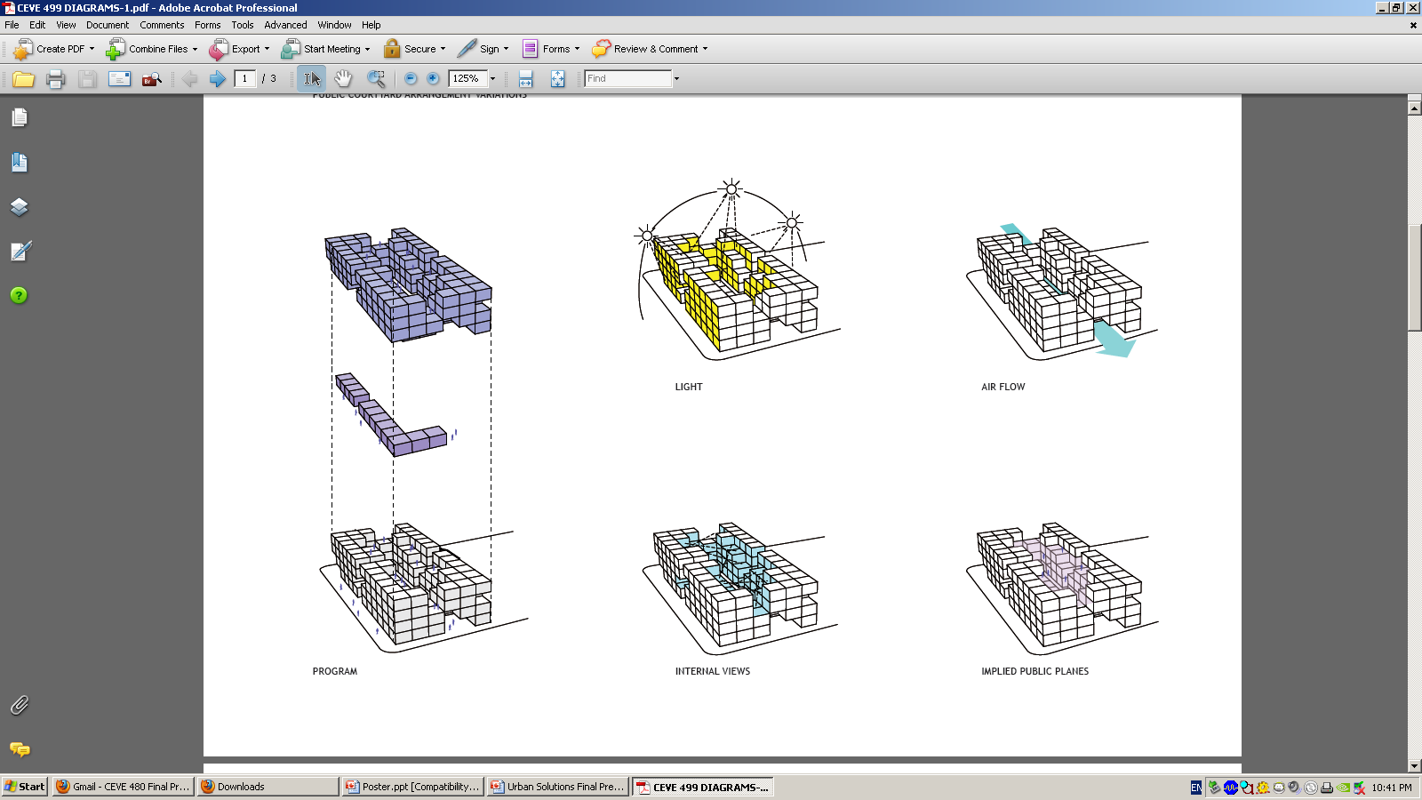
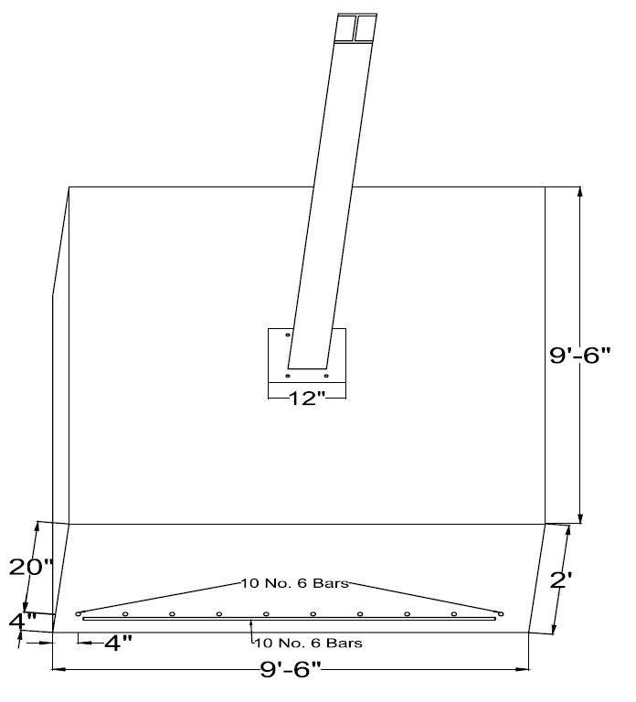
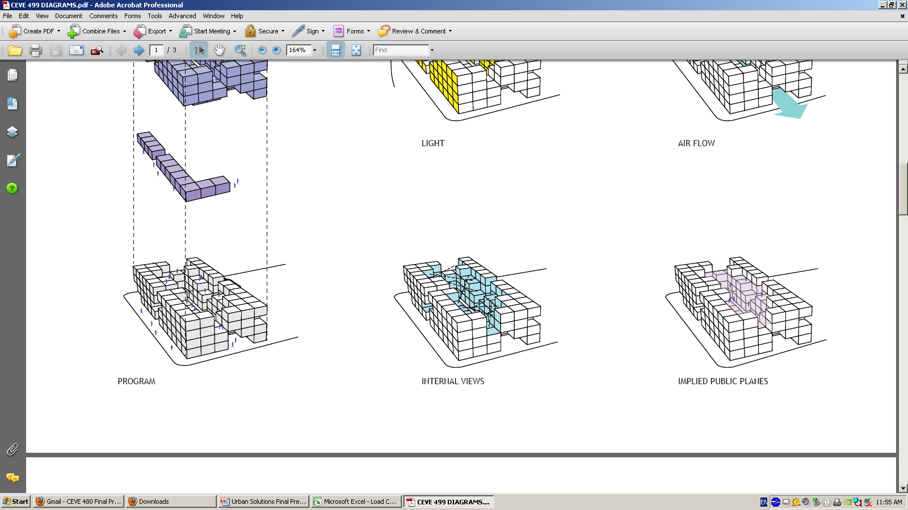
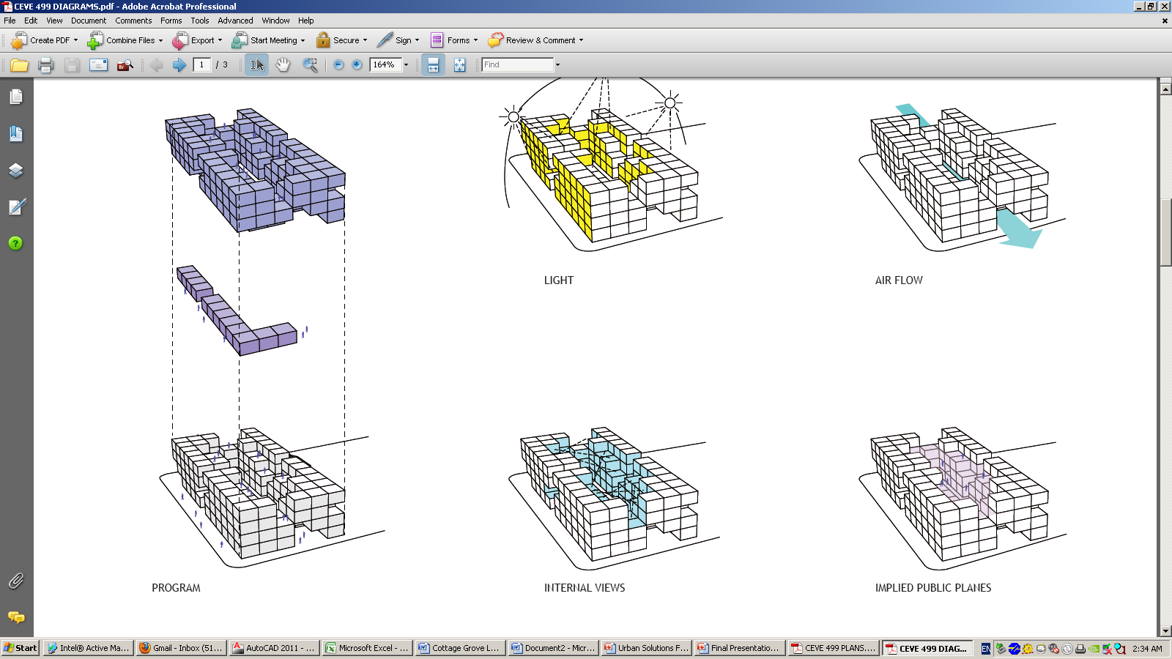
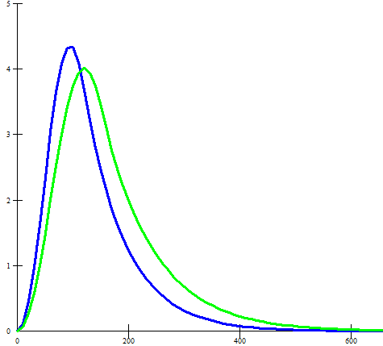
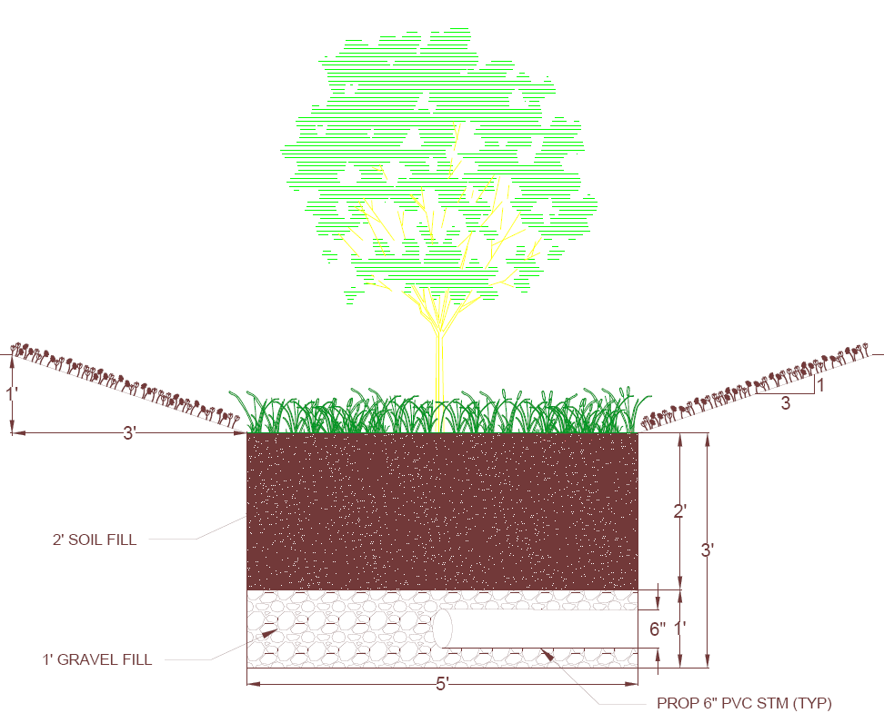
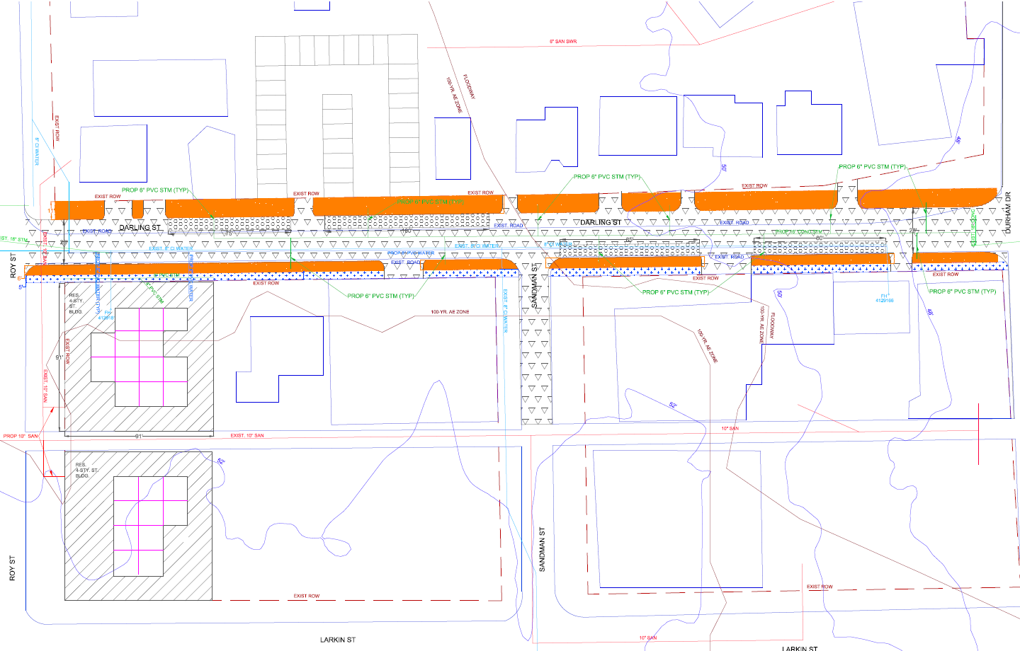
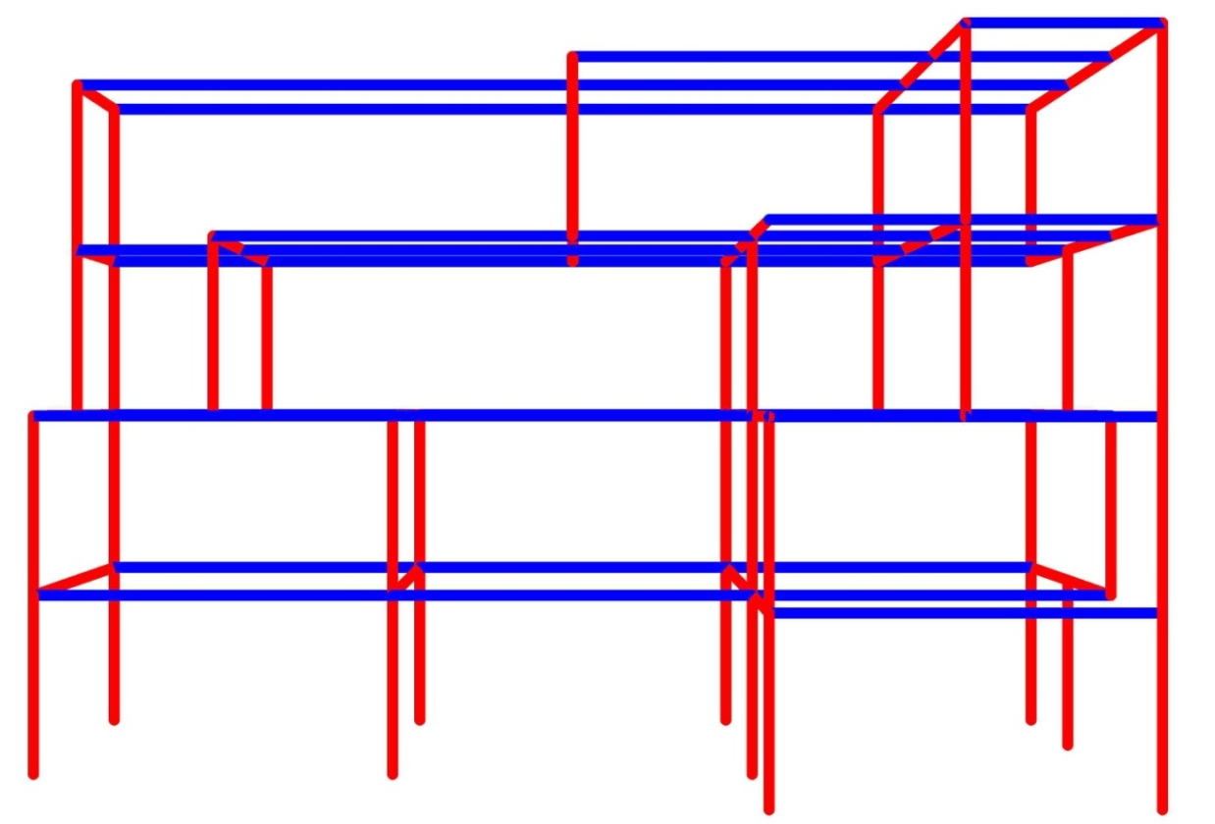
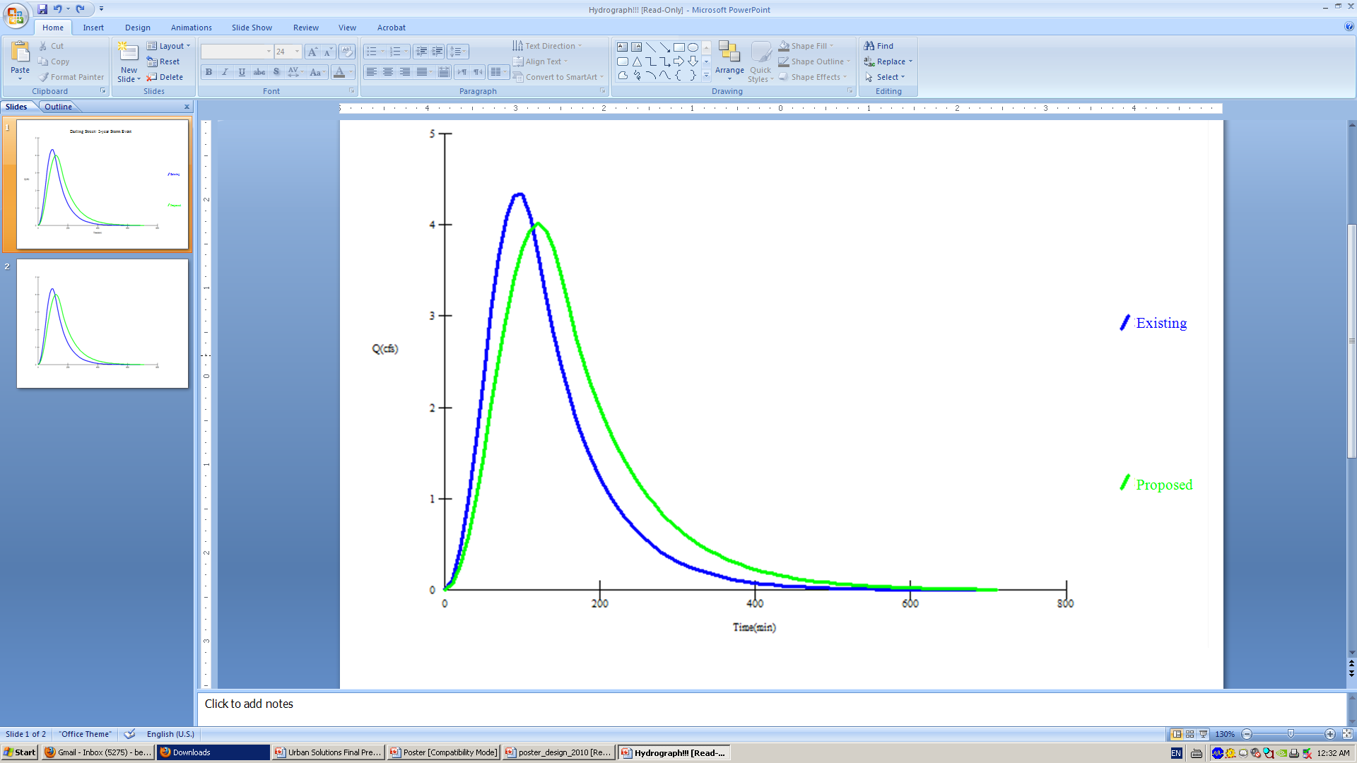
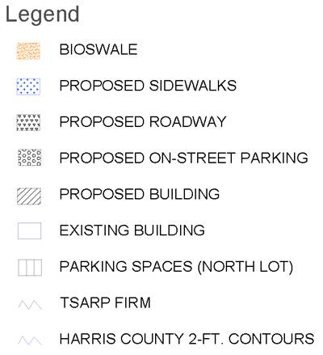

Cottage Grove: Darling Street Development
Urban Solutions Team: Loliya Bobmanuel, Mark Brundage, Becca Sagastegui, Alex Tehranian (Architect)
Department of Civil and Environmental Engineering, Rice University, Houston, TX, 2010-2011
The Challenge
Architectural Vision
Environmental Remediation
Darling Street is a typical residential street in the Cottage Grove subdivision north of Interstate-10 within the 610 loop. Currently there are very narrow streets that inhibit on-street parking, no sidewalks, deep ditches and culverts on both sides of the street, and old utilities (circa 1962). The project involves the design of new apartments and sufficient parking in addition to increasing the width of the road and incorporating low impact development. The entire design is confined to a 50 foot right of way.
There are unhealthy levels of lead and arsenic in the historic fill (2’ below ground level) on the site. In situ solidification and stabilization will be used to remediate the soil. The process involves a cement-based binder (ash, silicates, aluminoferrites) that is injected into the soil and reacts with the metals to form less mobile forms (such as metal hydroxides). These forms will remain in the soil but will not cause harm. A benefit of the vegetation in the bioswales is that the complex root systems can effectively filter nitrogen, potassium, and phosphorus from fertilizer, thus degrading water pollutants in the runoff.
Low Impact Development (LID)
LID has two purposes: 1) to manage storm water and imitate natural hydrologic patterns, and 2) to use and conserve natural features of the site. A 15’ x 15’ rainwater catchment tank, green roof, vegetated bioswales, and permeable pavement for parking are utilized to meet these goals.
The apartment complex includes 24 units and was designed to attract young professionals given its proximity to downtown Houston. The central courtyard creates internal public space with rooftop balconies and green roof gardens. The glass façade and louvers provide enhanced aesthetics .
Structural Design
A standard isolated footing embedded to a depth of 3’ was designed to take advantage of the bearing capacity of the soil. Because the site is located within the 100-year floodplain, the bottom elevation of the building is raised 12 inches above base flood elevation (BFE). The backfill is a silty clay to inhibit water infiltration to the highly expansive clays beneath the foundation.
Q
Darling Street: 2-year Storm Event
Bioswale Cross Section
The Site Plan
Time (min)
The four-story structure has a steel frame with enough capacity to support both the green roof and the multiple cantilevered units. The components include W21x83 beams with 15’ spacing and W24x146 girders with 30’ spacing.
Leadership in Energy & Environmental Design (LEED)
LEED for New Construction is a green building certification system that incorporates strategies to improve building performance, including energy and water usage, indoor environmental air quality, CO2 reduction, and stewardship of resources. The apartment complex achieves LEED Silver certification with the following breakdown:
Acknowledgements and References
ASCE 7-05
City of Houston Code of Ordinances
City of Houston Infrastructure Design Manual
Harris County Flood Control District Procedure Manual
International Building Code
Texas Administrative Code (Texas Commission on Environmental Quality)
Tropical Storm Allison Recovery Project (TSARP) Flood Insurance Rate Map
Special thanks to Dr. Philip Bedient (and research group),
Mr. Charles Penland, Dr. Calvin H. Ward, Alex Tehranian, and the Oshman Engineering Design Kitchen.
Sustainable Sites: 21/26
Water Efficiency: 8/10
Energy & Atmosphere: 3/35
Materials & Resources: 5/14
Indoor Environmental Quality: 11/15
Regional Priority Credits: 4/4
Total points: 52
The road will be widened from the existing 18’ to 28’ as well as provide on-street parking. The north lot will accommodate 1.5 spaces per unit for the apartment residents. On both sides of the street bioswales (11’ and 6’ wide) filter runoff and retain storm water. An under drain system provides additional capacity for storm events greater than the 2-year intensity.

