Slide 1



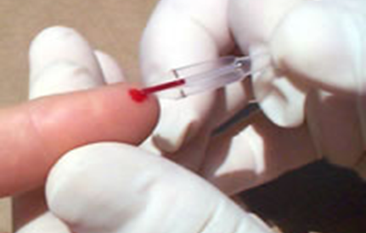
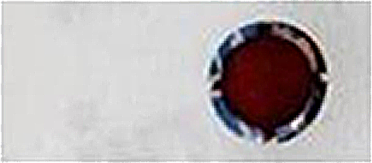
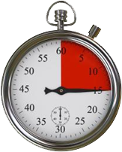
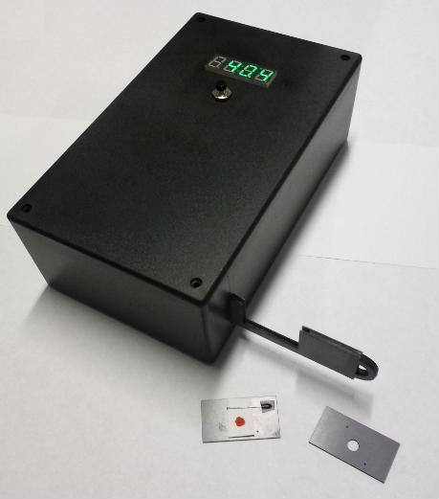
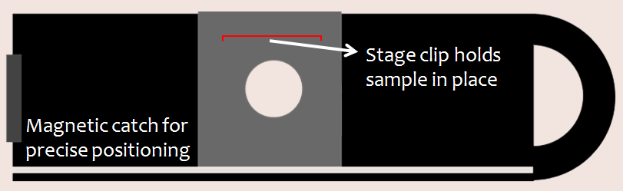
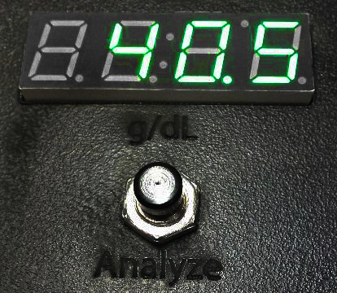
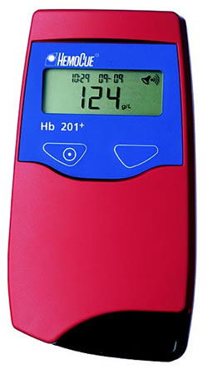
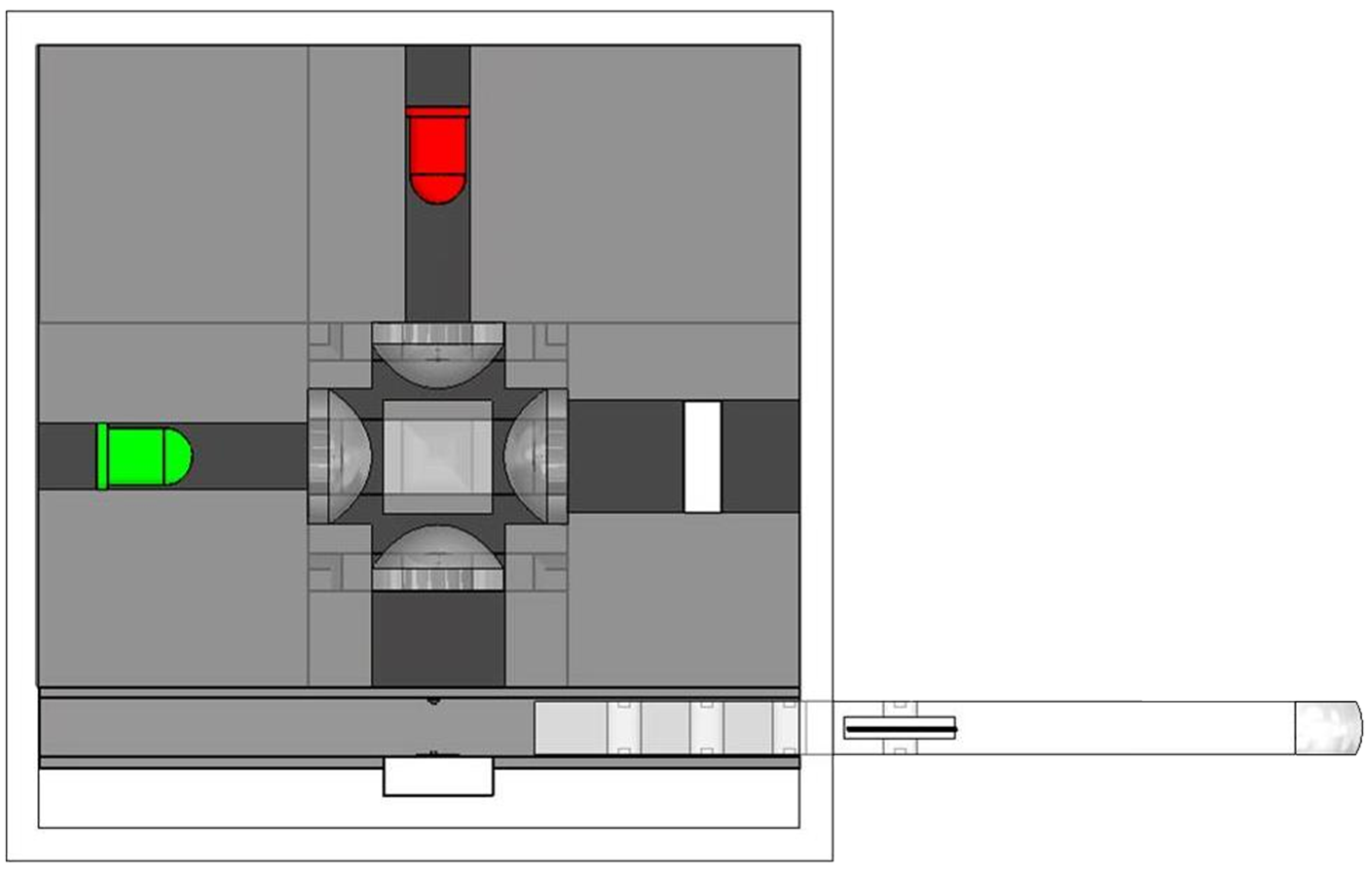
Paper-based Anemia Diagnosis for Use in Low-Resource Settings
Laura Barg-Walkow, Carlos Elguea, Lina Hu, Miel Sundararajan, Jeffrey Yeh, Aron Yu
Depts. of Bioengineering, Electrical and Computer Engineering, & Psychology, Rice University
tru.Hb.lood@gmail.com
Background
AnemiSpec: Filter Paper-Based Spectroscopy
Testing Results
Anemia is a deficiency in the concentration of hemoglobin, a molecule that transports oxygen in the blood
Can impair physical, mental, social development
Can be exacerbated by malaria, TB, and HIV
Anemia affects 1.62 billion people worldwide
67% of pre-school age children, up to 50% of women in WHO regions of Africa, SE Asia
Anemia is treatable when diagnosed, but many developing nations lack the resources required to accurately assess hemoglobin concentration
Three readings from each LED were normalized against a reference and averaged; the difference between readings from the two LEDs are plotted below against hemoglobin concentrations measured by HemoCue 201+
Testing results demonstrate a 94% linear correlation between AnemiSpec and HemoCue 201+
1. Sample Acquisition
2. Sample Preparation
10 µL of blood is drawn from the finger via lancet and capillary tube
Blood is delivered to filter paper test strip and dried for 15 minutes
3. Sliding Loading Dock
4. Physical Interface
OBJECTIVE: Design a portable, usable, low-cost device to accurately assess hemoglobin concentration in low-resource settings
Stage clips to hold sample in place
The final [Hb] in
g/dL is output on a
7-segment display
Magnetic catch for
precise positioning
HemoCue 201+
Pro: 98% accurate, gold standard in WHO regions
Con: Expensive cost per use ($0.76)
Complete Blood Count
Pro: Most accurate
Con: Offsite, expensive (>$3000)
WHO Color Scale
Pro: Easy to perform, low cost
Con: Subjective (60% sensitivity)
Centrifuge
Pro: 90% accurate, moderate cost
Con: Requires consistent power, slow diagnosis
Current Solutions
The blood spot is centered over the hole and is held in place using stage clips
The loading dock slides into the device and the analysis is performed by pressing a button
Benefits of AnemiSpec
Benefits include:
Quantitative, objective hemoglobin measurement
Affordable (filter paper costs <2¢ per test)
Portable (7.5 in x 4.5 in x 2.5 in)
Low power requirements
Sustainable for low-resource settings
- Materials can be easily restocked and stored
Preliminary surveys and cognitive walkthroughs yielded positive responses on product usability
5. Optics
LEDs emit specific wavelengths at high frequencies sequentially
Beam splitting cube divides light onto both photodiodes
Lenses collimate light
577 nm
HemoCue 201+
>680 nm
Sample photodiode collects light transmitted through the blood sample
Reference photodiode receives signal from LEDs
The wavelengths 577 nm and 680 nm were chosen because research showed that the optical density of the blood remains relatively stable over long periods of drying time
Future Work
Acknowledgements & References
Continue to refine the device and analysis algorithms through testing
Perform controlled testing for environmental factors (exposure to humidity, light, heat, etc.)
Refine calibration methods of the device
Conduct more in-depth surveys on product design
Conduct field testing with actual patients
This design project was supported by a gift from Mr. and Mrs. Hunter Armistead to the Oshman Engineering Design Kitchen and through Beyond Traditional Borders.
We would also like to thank the following for their help and support: Dr. Z. Maria Oden, Dr. Gary Woods, Jasper Yan, Garrett Spiegel, Dr. Rebecca Richards-Kortum, and Dr. Philip Kortum.
Nestel, P. and H. Taylor. “Anemia detection methods in low-resource settings: manual for health workers.” PATH (1997): Web Accessed 7 October 2010.
(Unpublished) Yan, J.S., C.A. Elguea, J. Wright, M. Oden, R. Richards-Kortum. “Filter paper as a low-cost medium for accurate spectrophotometric detection of blood hemoglobin concentration.” 2010.
The raw data is normalized and averaged, correlated to a hemoglobin concentration, and the final result is displayed on the 7-segment display
Raw data is collected from both photodiodes at each of the wavelengths and stored temporarily in the memory of an MSP430 microcontroller
*Note: the device remains turned on but in a low-power state for duration of field usage

