Slide 1



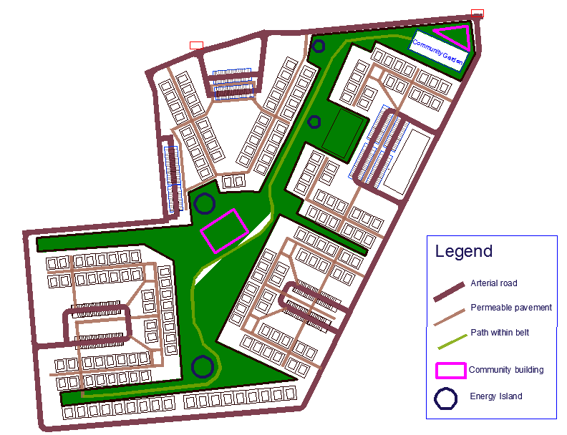
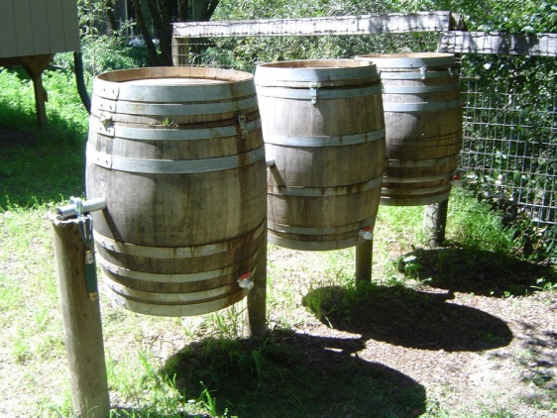
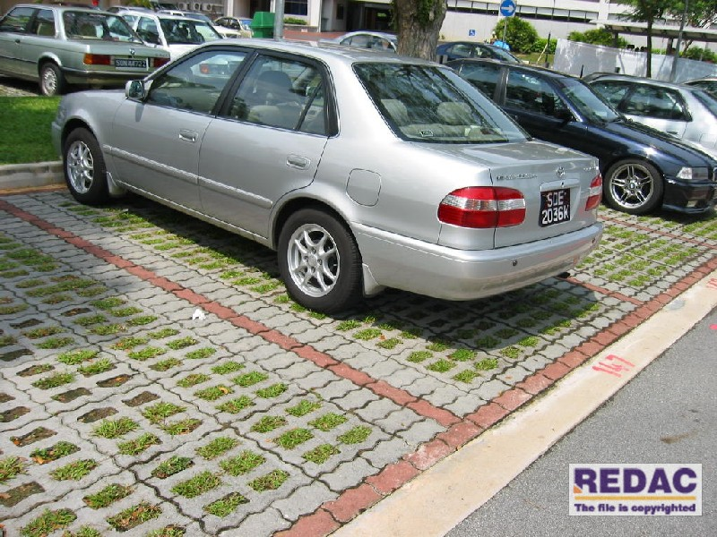

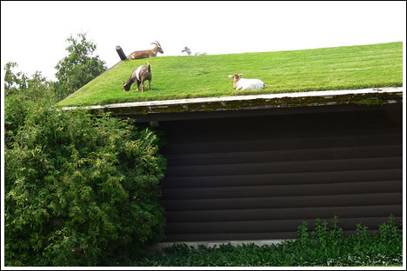
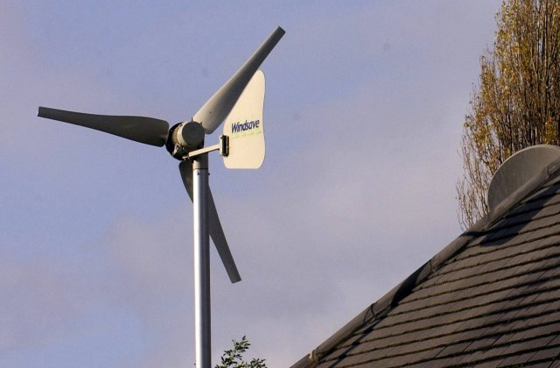
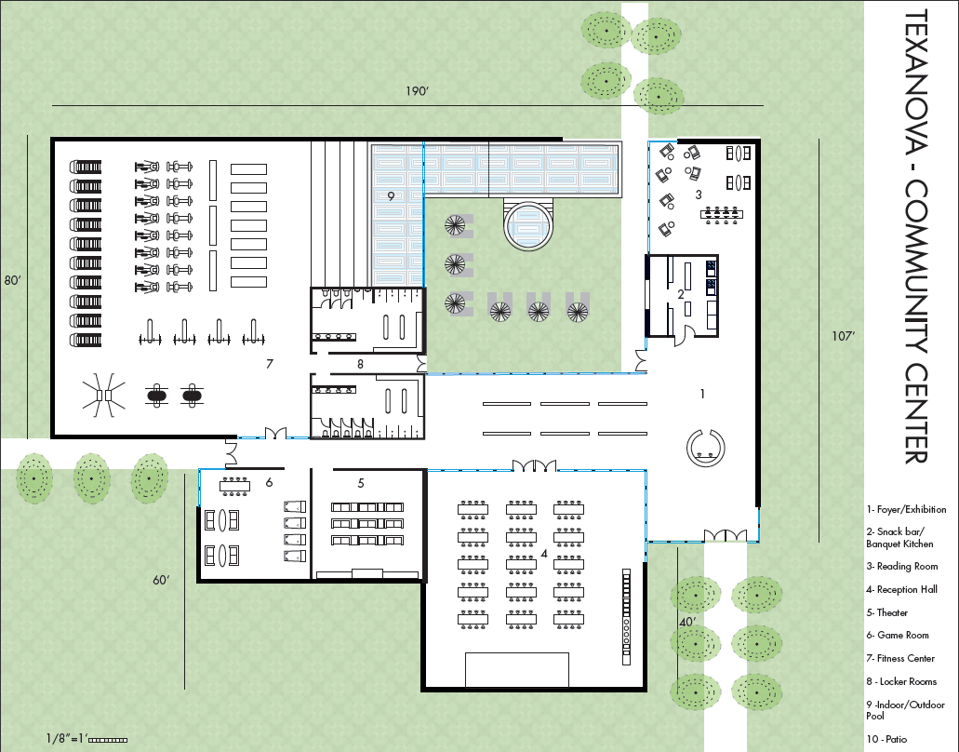
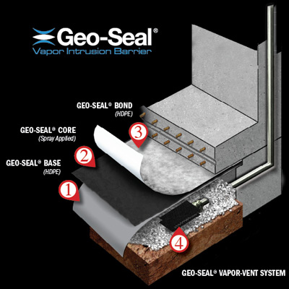
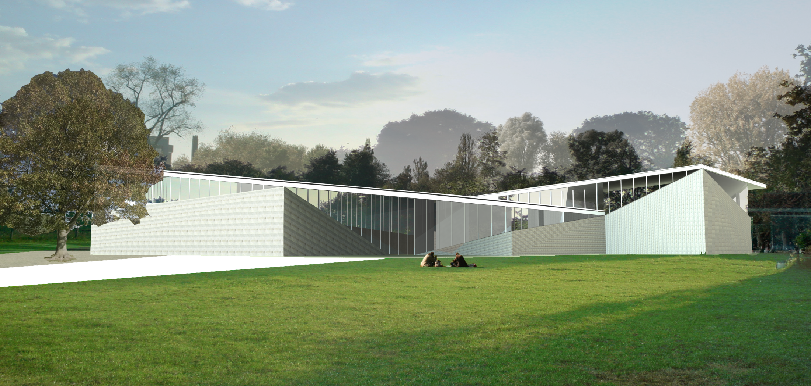

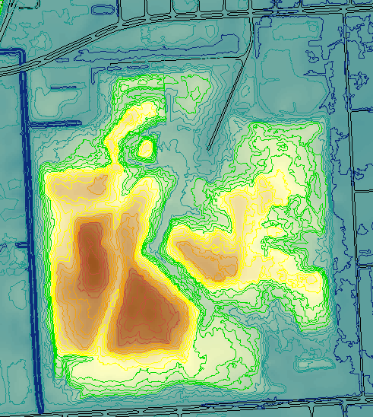
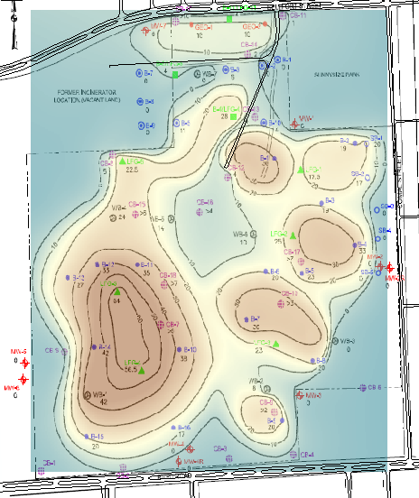
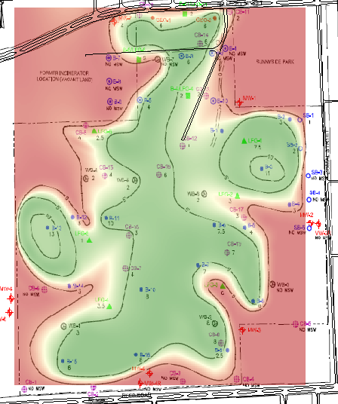
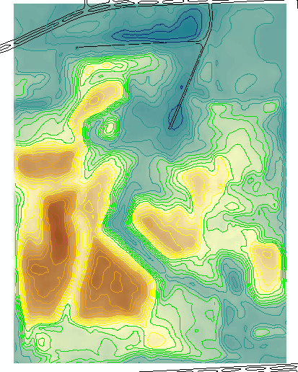
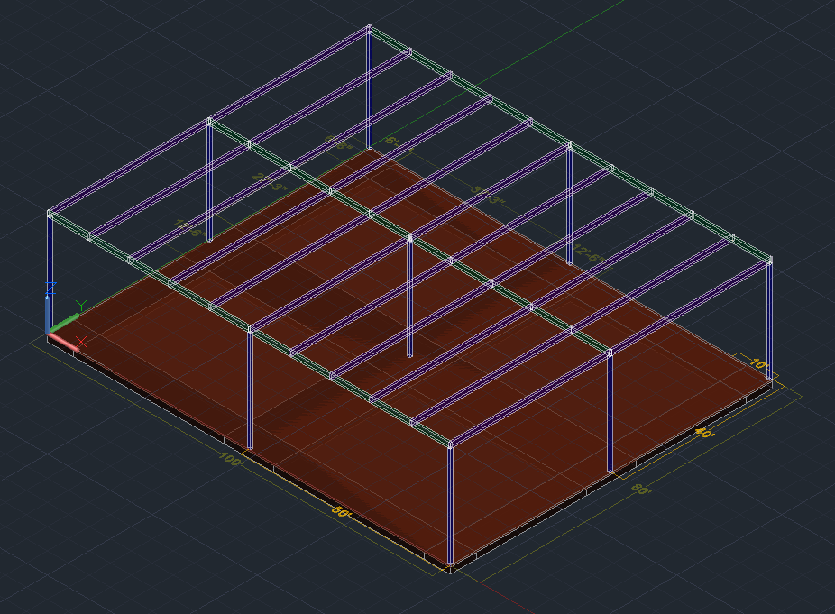
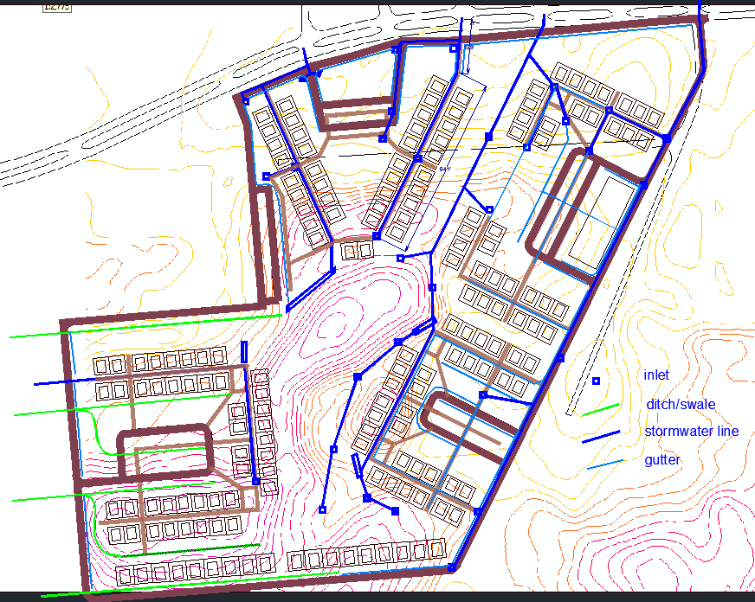
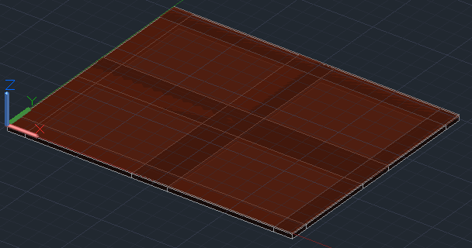
Bellfort Garden Oaks Subdivision
Janhvi Doshi, Lizbeth Gonzalez, Nicole Kwan - Department of Civil and Environmental Engineering
Matthew Austin, Giorgio Angelini - School of Architecture
TexoNova
Outline
Reinventing the suburbs
TexoNova has designed a residential subdivision to be built over an actual former municipal landfill on 3300 Bellfort Avenue, 8 miles south of Downtown Houston.
The plot is a registered Brownfields site with in a low-income suburban neighborhood. Our design approach consisted of: Predicting soil settlement, developing a remediation plan, drawing up a site plan as per the architect’s vision, designing the structural and foundation elements of the community design, and establishing the utilities layout.
Vision: a subdivision that is community-based, family-friendly, sustainable and affordable.
170 single family units with a community center
Considerations:
Highly uneven topography, minimum required house density, walking distance to parking lot
Bought by City of Houston 1937
Used as domestic waste landfill
1937-1970
Soil and demolition debris dumped 1970-1977
Not been in use
Since 1977
Path breaking Initiatives
Centralized parking (2.2 spots/home) for most homes
Green belt without roads connects all houses
Energy Islands - renewable energy stations connected to the community grid for educational purposes: solar panels, compost pit, a wind turbine
High Potential for Low impact development
Green roof on community building
Grass swales for drainage
Pervious pavements and parking lots
Few driveways
Small house footprints
Building on a landfill
Designing functional buildings
Remediation
Community Building
Brings members of the neighborhood together to engage in activities. Includes fitness center, game room, indoor/outdoor pool, lounge area, and a reception hall.
Potential Risk | Remediation Plan
High concentrations of methane in one of its 29 monitoring wells | Permanent gas monitoring stations to control methane emissions. Geo-Seal Vapor Intrusion Barrier to be used under structure foundations
Uneven engineered soil cap | A uniform cap of with a 3 ft. minimum thickness
Incinerator Ash | Cap should seal the little amount present.
A few VOCs and metal compounds were over the Protective Concentration Level (PCL) in soil and groundwater samples | Groundwater will not be used as potable water, thus apply for Municipal Setting Designation (MSD) waiver.
Smaller ‘huts’ will also be built throughout the site to encourage smaller group gatherings.
Earthwork
We used ArcGIS to determine the final topography by considering the predicted waste settlement and additional cap needed.
Current Topography
Waste thickness * 15%
Cap Needed
Final Topography
Structural
A steel frame structure was chosen due to its durability and
ability to create large open spaces. It also allowed for the vision of the architect to carry through. The AISC Steel Design Manual was used to design the beams, girders, and columns.
-
+
=
Utilities & Drainage
The design of storm sewer lines as well as water and wastewater lines was necessary for the site. The gravitational flow of water had to be determined throughout the site, which involved a study of the terrain. Afterwards, the minimum pipe length and trench depth was determined by calculating flow capacity.
Foundation
The community building will be on top of 6’ cap, 23’ waste, underlain by stiff clay. Additionally the groundwater table is at 16-20’ depth. Therefore we chose a raft foundation that can be shallow, minimize trenchwork and semi-structural (span at least 15’).
Acknowledgments: School of Engineering, School of Architecture Jedediah Greenfield from the City of Houston, Environmental Site Investigation prepared by Terracon, Phase II Environmental Site Assessment report prepared by Stell Environmental Enterprises, Inc., Charles Penland, Dr. Bedient, Dr. Ward, and Professor Varadarajan.

