Slide 1
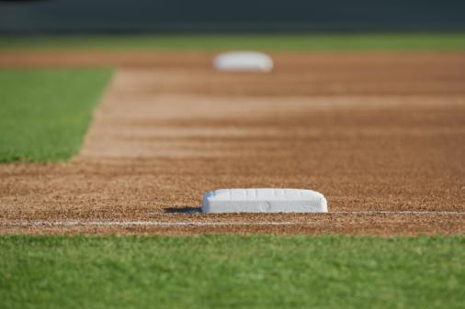

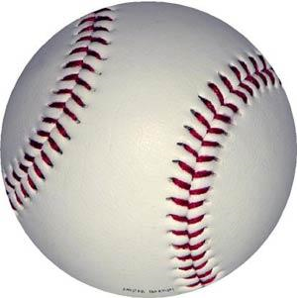
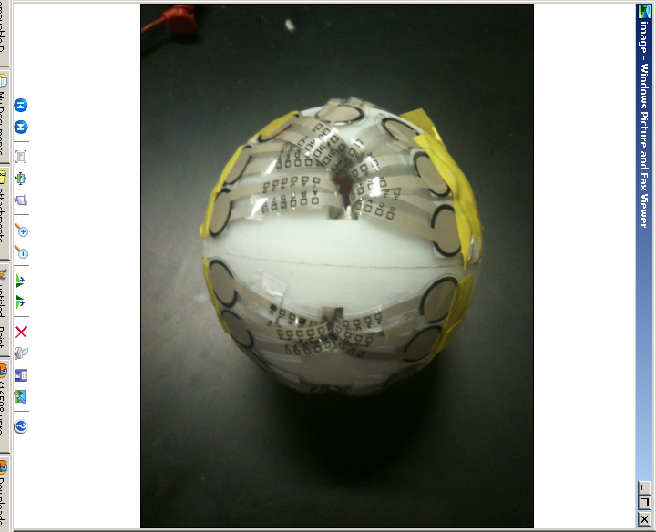
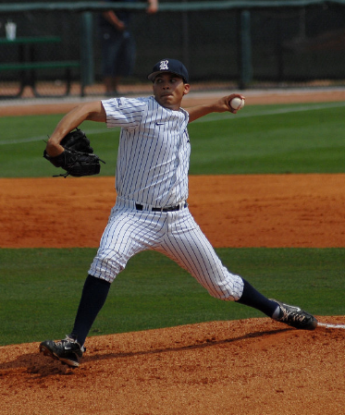
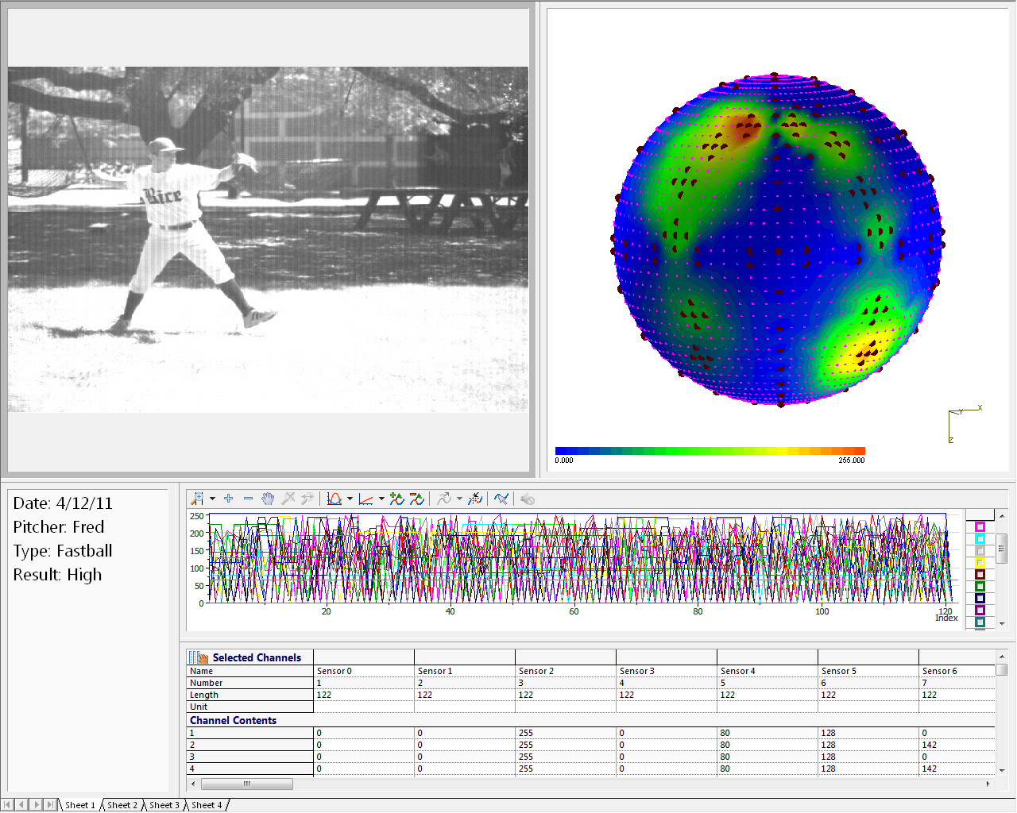
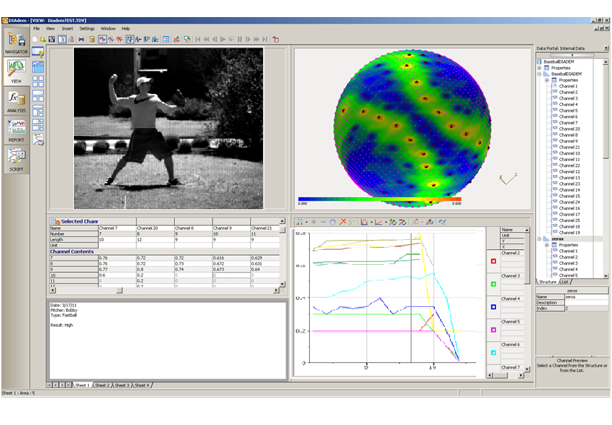
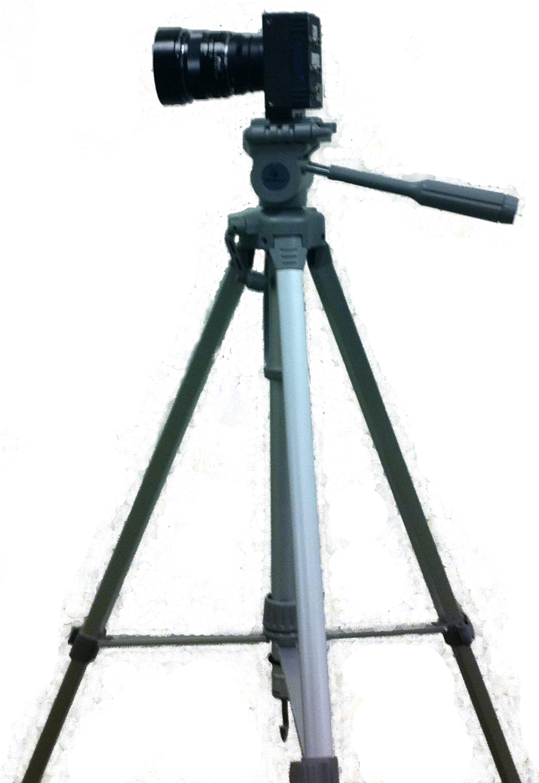
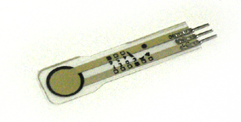
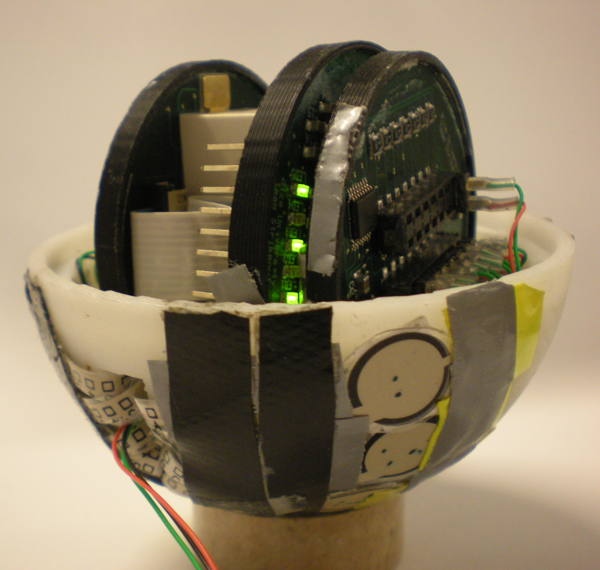
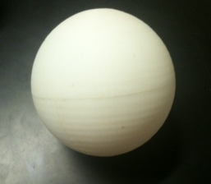
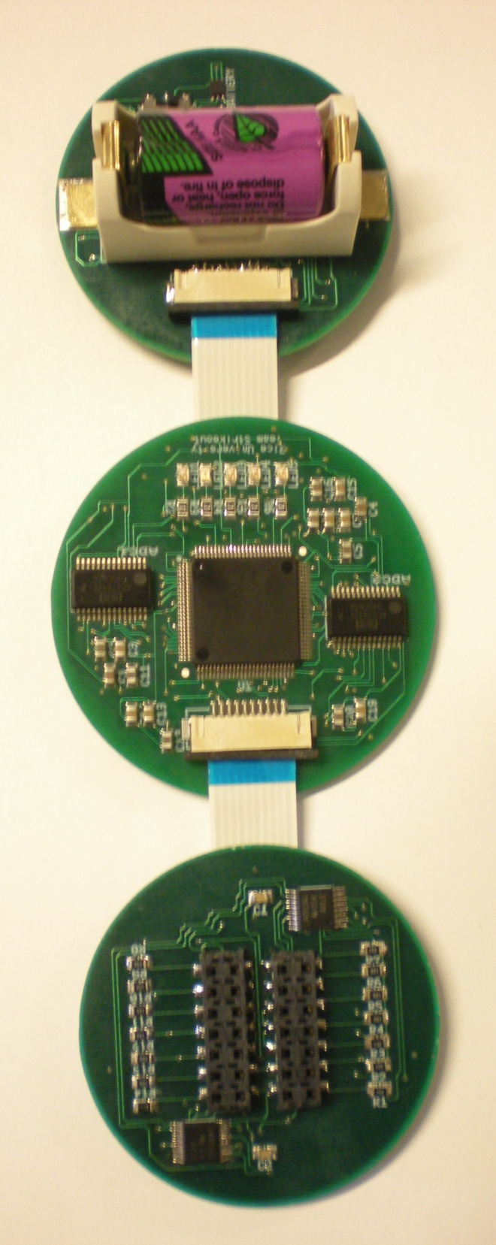
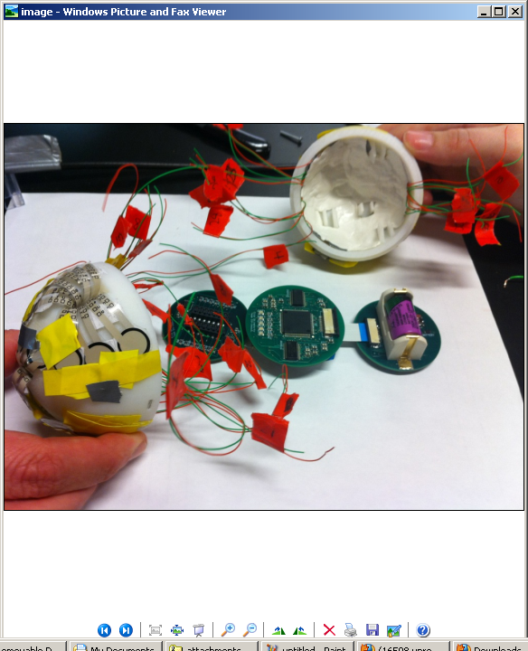
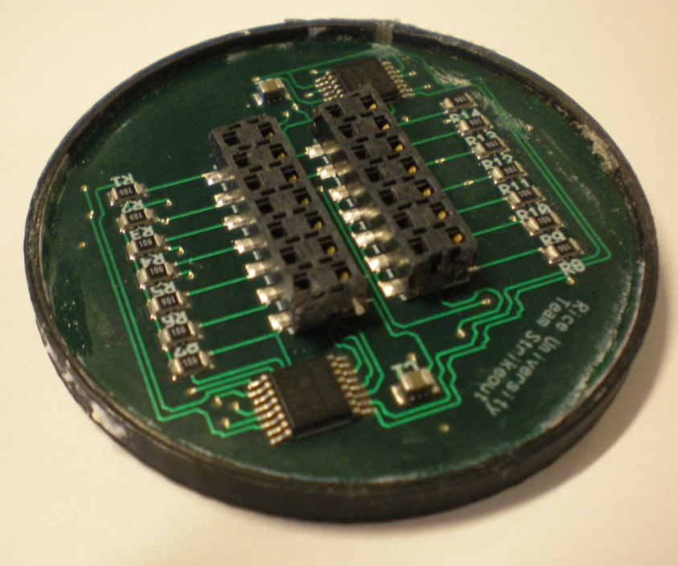




PitchPALS
Pressure Analysis & Logging System
A tool for quantitative baseball pitch grip analysis
Sharon Du (ECE) ● Ashley Herron (ECE) ● Peter Hoagland (ME) ● Jenny Sullivan (ME) ● Henry Zhang (ECE)
teamstrikeout@gmail.com
Problem
Solution
Applications
Grip is an essential part of pitching technique. However, current video-based analysis does not provide detailed grip information. A method is needed to uncover the exact position and force of the pitching hand with respect to the ball.
A replica baseball that contains force sensors to record the exact contact points between the pitcher’s hand and the ball as well as the amount of force exerted throughout the entire pitching motion.
Instruction: Train young pitchers to master ideal grip.
Error Diagnostics: Identify errors in grip technique.
Fatigue Detection: Use data to detect pitchers’ fatigue points to better anticipate pitcher substitutions.
System Overview
Testing
Pitchers threw PitchPALS Baseball into net from distance of 40 feet at approximately 50 mph. Camera was used to capture pitcher's full body motion.
After each pitch, data was transmitted to computer using UART via USB connection.
Video Camera captures full pitching motion.
Force data is presented in 3D color map.
28 force sensors record force and position data during the pitching motion.
Force sensor data file and video footage are synchronized in GUI.
Results
Force data was successfully collected during pitch and uploaded to on-site computer.
Video captured full pitching motion and synchronized with force data map.
Observed significant force changes on baseball during the pitching motion.
Ball remained undamaged during field test.
Electrical and Mechanical Baseball Design
Sensors: 28 piezoresistive sensors are placed along baseball seams.
Force Input: Voltage divider circuit turns force value into voltage signals.
Digitization: Voltages are converted to digital data.
Memory: Data is stored in the MSP430 Micro-processor.
Transmission: Data is transmitted to computer using UART via USB connection.
Made of ABS Plastic. Weight accurate to 4%. Diameter accurate to less than 1%.
Lined with putty to hold wires in place.
Angled ledges for supporting and spacing PCBs.
Plastic rings placed around PCBs for added stiffness.
Future Developments
Integrate wireless communication.
Increase sample rate for higher resolution.
Test and improve durability for speeds up to 90 mph.
Sew leather skin onto ball for realistic feel.
Special Thanks To:
Dr. Gary Woods, Advisor , Rice ECE
Naren Anand, Rice ECE
Siddarth Gupta, Rice ECE
Brent Runnels, NI
Rice Varsity Baseball
Rice Club Baseball
Notes:
Market Potential
PitchPALS is a valuable tool for baseball teams of all levels, from little to professional teams. It is able to uncover grip data and provide analysis that cannot be found anywhere else. Being the only true solution to the grip analysis problem, PitchPALs creates a competitive edge for any team that uses it. If one team in a league beings using PitchPALS, every team in the league will need to have it as well.

