Slide 1
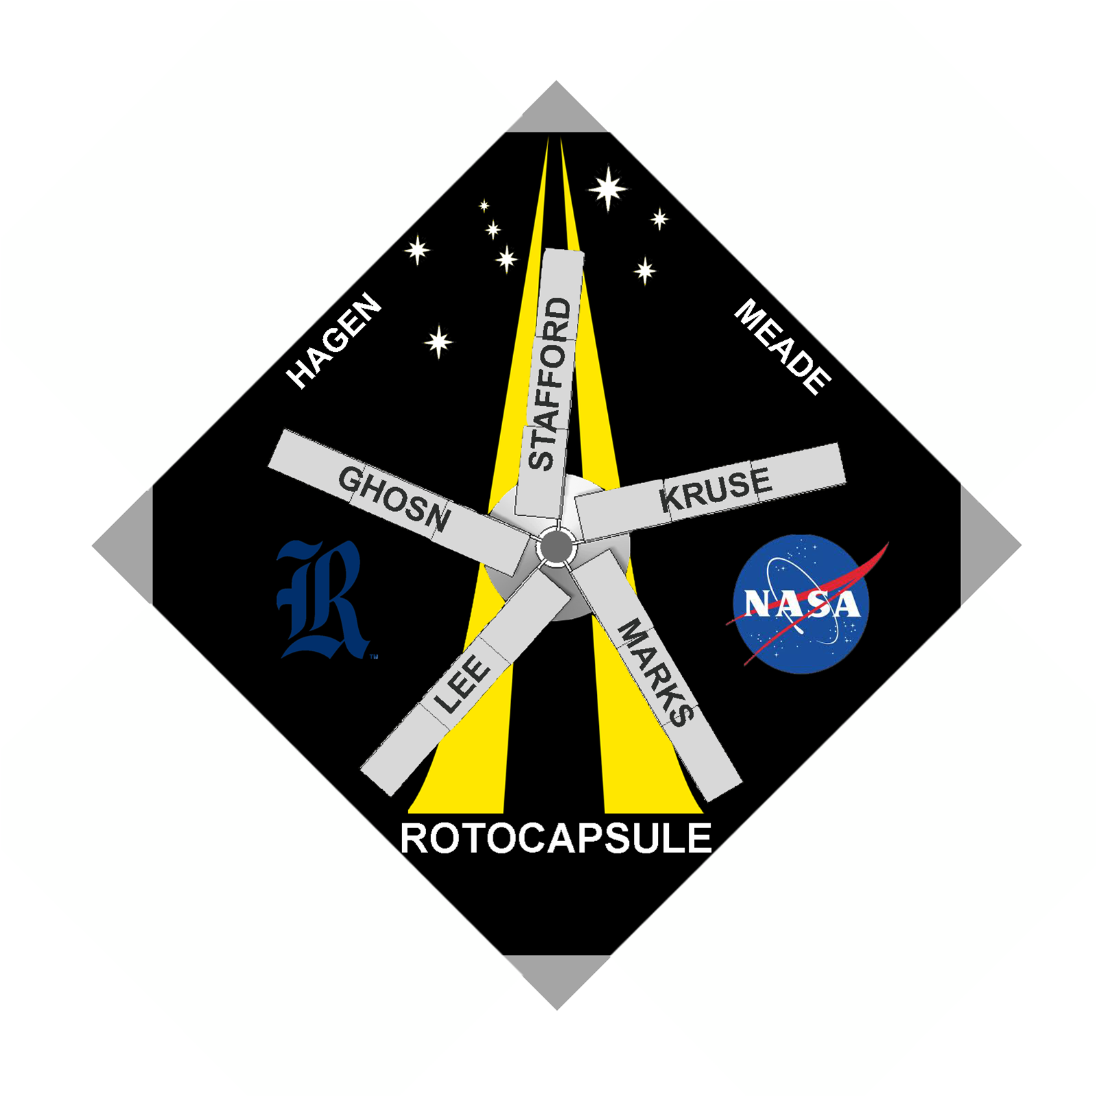
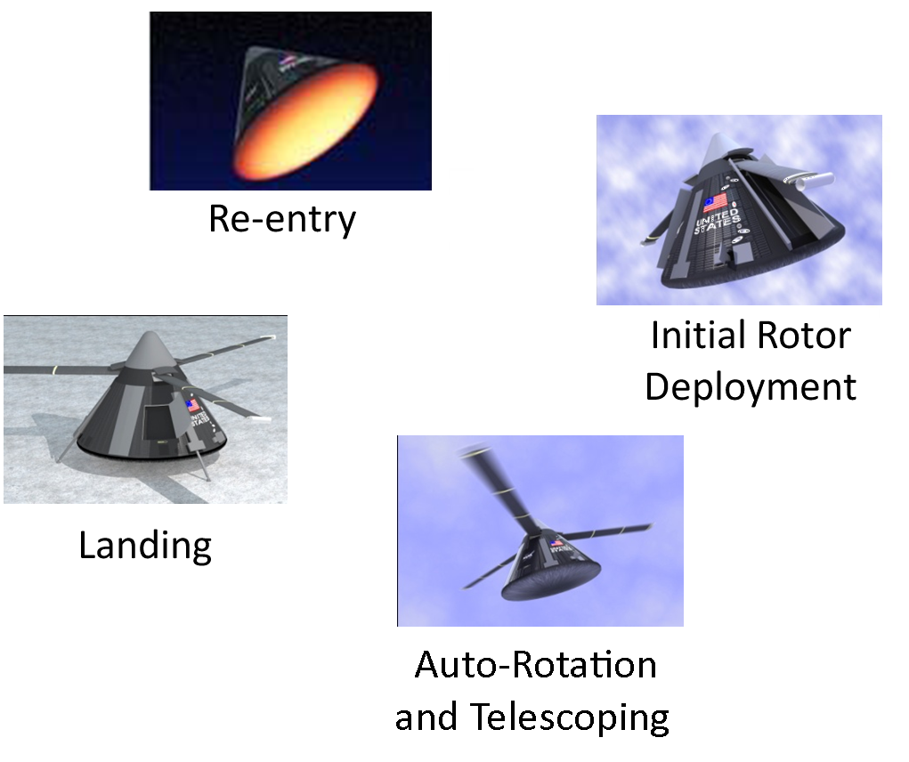
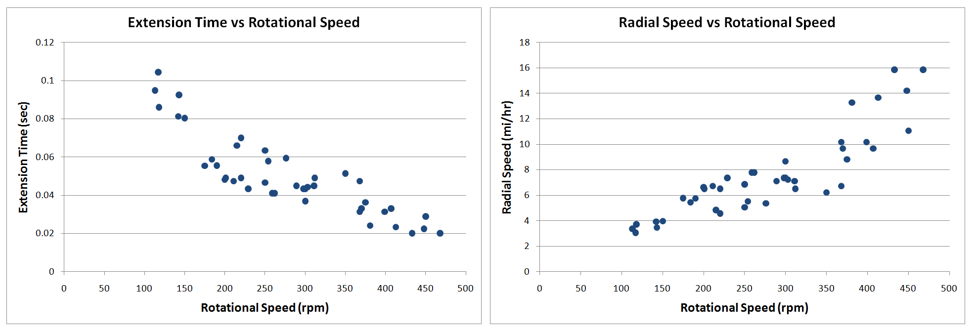
Telescoping Rotor Blade System for Space Capsule Descent
Christina Ghosn, Ryan Kruse, Alex Marks, Garrett Stafford
Department of Mechanical Engineering, Rice University, ags2@rice.edu
Splashdown Concerns
Prototype Assembly
Hub
Driveshaft
Two Groove Pulley
NASA’s current parachute landing system for the Apollo type reentry capsule has many challenges:
Structural damage due to impact of splashdown at a vertical speed of approximately 30 mph
Uncontrolled landing due to unpredictable weather conditions
Logistical challenges of an ocean recovery
High cost of spaceflight due to single use capsule design or semi-reusable capsules which require extensive repair for future flight
A pair of dual section carbon-fiber rotor blades at ~1/15 scale
Stationary sections are firmly attached to the hub
Telescoping sections are designed to float inside the stationary sections
Simple symmetric NACA 0025 airfoils
Fig. 2. Blade Assembly and Two Groove Pulley
Testing
Fig. 3. Blades before telescoping
A chord is attached to the telescoping sections and wound through each groove of the pulley
A pin system stows the blades until the test rpm is achieved
From powered rotation, centripetal forces apply tension to the chord
When test rpm is achieved, the pin is removed
The blades begin telescoping, causing the pulley to unwind an equal amount of chord to each blade, ensuring simultaneous extension
Proposed Solution
Replace parachutes with helicopter-like rotor system to slow capsule’s descent with unpowered autorotation
Utilize telescoping blades to allow for stowage during descent
Achieve capsule reusability through a zero- velocity, targeted touchdown on land
Fig. 4. Blades half telescoped
Fig. 5. Blades fully telescoped
Results
Future Work
Different airfoils could be tested to achieve optimal flight performance
Collective, cyclic, and yaw control systems must be developed to allow for a targeted landing
Testing should be expanded to include increased numbers of blades and blade sections
Acknowledgements and References
Team RotoCapsule would like to thank the entire Johnson Space Center team, specifically Mr. Jeffrey Hagen, our mentor in the Rice faculty, Dr. Andrew Meade, our junior observer, Jeffrey Lee, and Team Electric Owl. We would also like to thank Mr. Joe Gesenhues and Mr. Carlos Amaro. Funding provided by the Rice Oshman Engineering Design Kitchen.
Fig. 1. Artist’s rendition of a fully integrated autorotation telescoping system
Powered telescoping is possible within the range of rotational speed tested
The prototype closely followed the equation of motion for extending blades
Guidance is required when telescoping to prevent jamming
The pulley system ensured simultaneous telescoping
Carbon fiber is a viable option for a fully integrated system
Hagen, Jeffrey. Rotor Landing Technology for Crew Exploration Vehicle (CEV) Earth-to-Orbit Crew Transport, Lockheed Martin Space Operations, Kemah, TX, AIAA-2005-2508, 1st Space Exploration Conference: Continuing the Voyage of Discovery, Orlando, Florida, Jan. 30-1, 2005
Levin, Alan D., and Ronald C. Smith. An Analytical Investigation of the Aerodynamic and Performance Characteristics of an Unpowered Rotor Entry Vehicle. NASA TN 0-4537. NASA Ames, 1968. Print.
Seddon, J., and Simon Newman. Basic Helicopter Aerodynamics. Reston, VA: AIAA, 2001. 4-9. Print.
Our goal is to design and fabricate a prototype demonstrating telescoping rotor blades under powered rotation.

