Slide 1



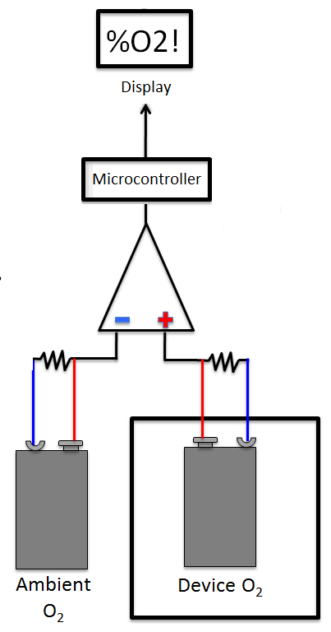
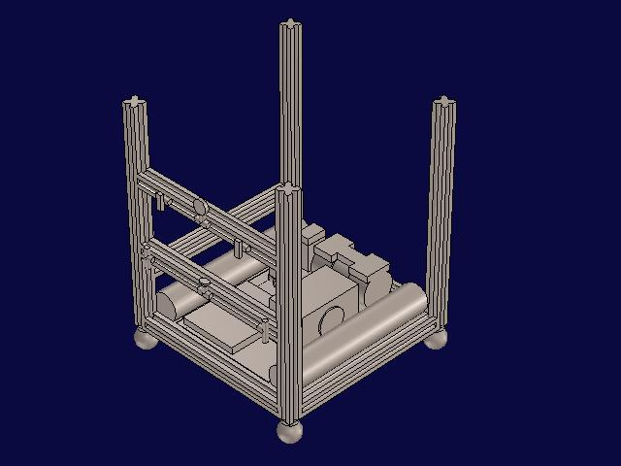
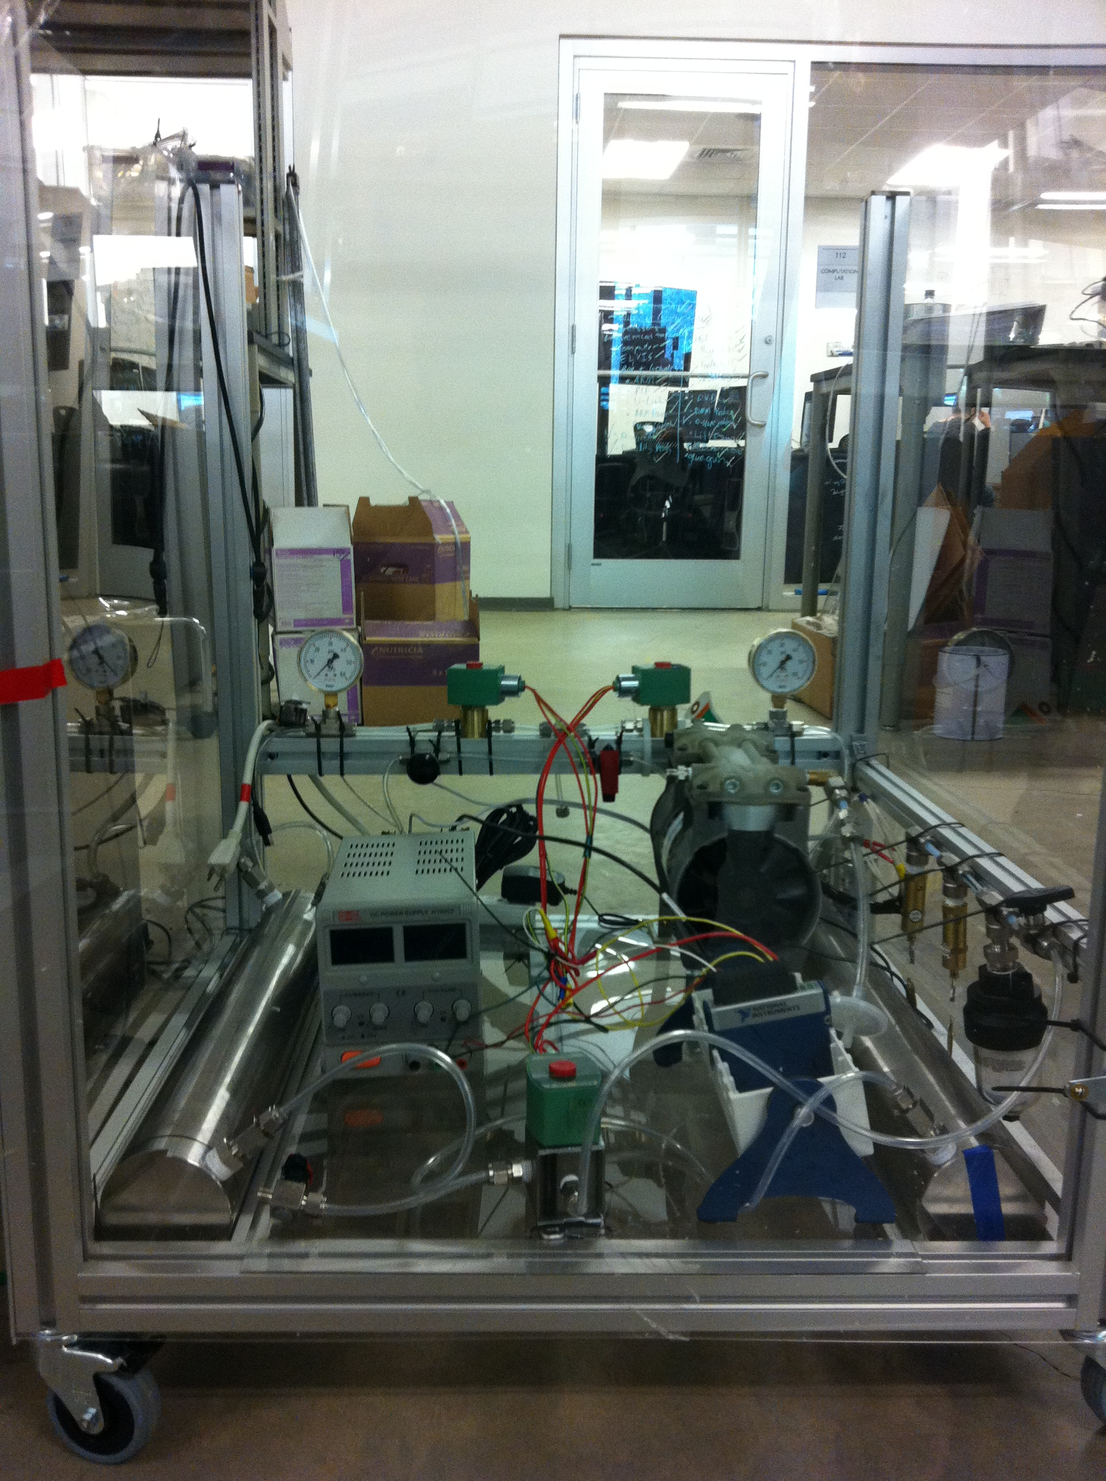
OxCart: Oxygen Concentrator and Analyzer for the Developing World
Matt Amdahl, Ryan Le, Dan Nelson, Jay Patel, Abe Segura
Department of Bioengineering, Rice University, Houston TX 77005
Team RedOx <redoxconcentrators@gmail.com>
Objective
Concentrator Design Objectives
Analyzer Design, Testing and Results
To design and build:
- A low-purity, high-flow oxygen concentrator. - A reliable, inexpensive oxygen analyzer.
Criteria | Goals
Oxygen Flow | > 15 L/min, 40% O₂
Power Consumption | < 400W
Longevity | > 5 years
Size | < 2.5’ x 2.5’ x 8’
Cost | < $1000
3 ways to relate battery voltage to O₂ concentration
Difference between final and baseline signal
Difference between final and initial signal
Amplified differential signal between 2 batteries
Analyzer calibrated and tested between 21% - 93% O₂
Logarithmic model relates voltage and O₂ concentration
Initial tests show analyzer capable of accuracy within 1%
Motivation for OxCart
2 million children die each year from acute respiratory illness.
98% of all deaths occur in developing regions.¹
Oxygen therapy reduces mortality from pneumonia by 35%.²
Current oxygen delivery methods in developing areas are
Prohibitively expensive (upwards of $1000)
Prone to malfunction
Fail to measure oxygen concentration
Sensor Design Objectives
Graph 1. The graph shows how closely our data for the differential voltage signal between two batteries correlates with a best fit log line.
Criteria | Goals
Range | 21 – 70% O₂
Accuracy | < 5% absolute error
Power Demand | < 10 W
Cost | < $50
Current portable oxygen analyzers cost upwards of $200.
Stand-alone component
Relies on existing zinc-air battery technology
Battery voltage dependent on ambient oxygen concentration
(Top) Graph 2. Comparison of our analyzer to commercial sensor
(Right) Fig 1. Circuit diagram of analyzer
Concentrator Design, Testing and Results
Conclusions
The OxCart uses a Pressure Swing Adsorption (PSA) system:
System contains several beds full of 5A Zeolite
5A Zeolite preferentially adsorbs nitrogen when pressurized
Thus purifying the air, allowing for higher
concentrations of oxygen
Depressurizing and purging zeolite regenerates it.
Pressurization Time (seconds) | Purge Time (seconds) | Maximum %O₂ Reached (%) | Average Pressure (psi)
30 | 10 | 40.1 | 16.3
30 | 15 | 38.0 | 18.3
45 | 15 | 41.0 | 26.0
40 | 10 | 34.9 | 23.1
5 | 5 | 29.9 | 5.0
Achievements
Prototype testing indicates both systems are
capable of achieving the design objectives.
Recommendations
A top-top equalization step might increase the
efficiency of the concentrator, helping decrease cost.
The analyzer may be modified to rely on smaller,
less expensive button zinc-air batteries.
Benefits
The OxCart will offer healthcare providers a cheaper
and more reliable respiratory treatment option than
current standards.
Closed
O₂
Closed
O₂
Table 2. The data represented here is only sample data. Multiple tests under similar pressurization and purge times have been run. However, there are varying results because of varying qualities of zeolite as well as pressure drops.
Varying cycle time leads to varying %O₂ concentrations.
As cycle time increases past a certain point, the output oxygen purity begins to decrease, but oxygen recovery will increase.
We are testing to find the maximum oxygen purity attained at each cycle time, time it takes to reach this maximum purity, and output flow
Air
Air
Air
Air
Acknowledgements & References
Fig 2. The Four steps of a PSA cycle.
We would like to thank Dr. Maria Oden, Dr. David Hilmers, Dr. John Graf, Dr. Gary Woods, Carlos Amaro, Joe Gesenhus the Oshman Engineering Design Kitchen (OEDK), Rice University’s Dept. of Bioengineering, Beyond Traditional Borders (BTB), NASA, Wyle Labs, Lockheed Martin, and the Bioastronautics Contract.
Step | Left Bed | Right Bed
1 | Venting/Purging | Pressurizing
2 | Venting/Purging | Producing
3 | Pressurizing | Venting/Purging
4 | Producing | Venting/Purging
(Top) Fig 3. CAD drawing of OxCart.
(Right) Fig 4. Current prototype of concentrator
Duke, T., et al. Improved oxygen systems for childhood pneumonia: a multihospital effectiveness study in Papua New Guinea. Lancet, 2008; 372:1328-33
Howie, S.R.C., et al. Meeting oxygen needs in Africa: an options analysis from the Gambia. Bull World Health Organ, 2009; 87:763-771.
Table 1. Bed states during each step of PSA cycle.

