Slide 1



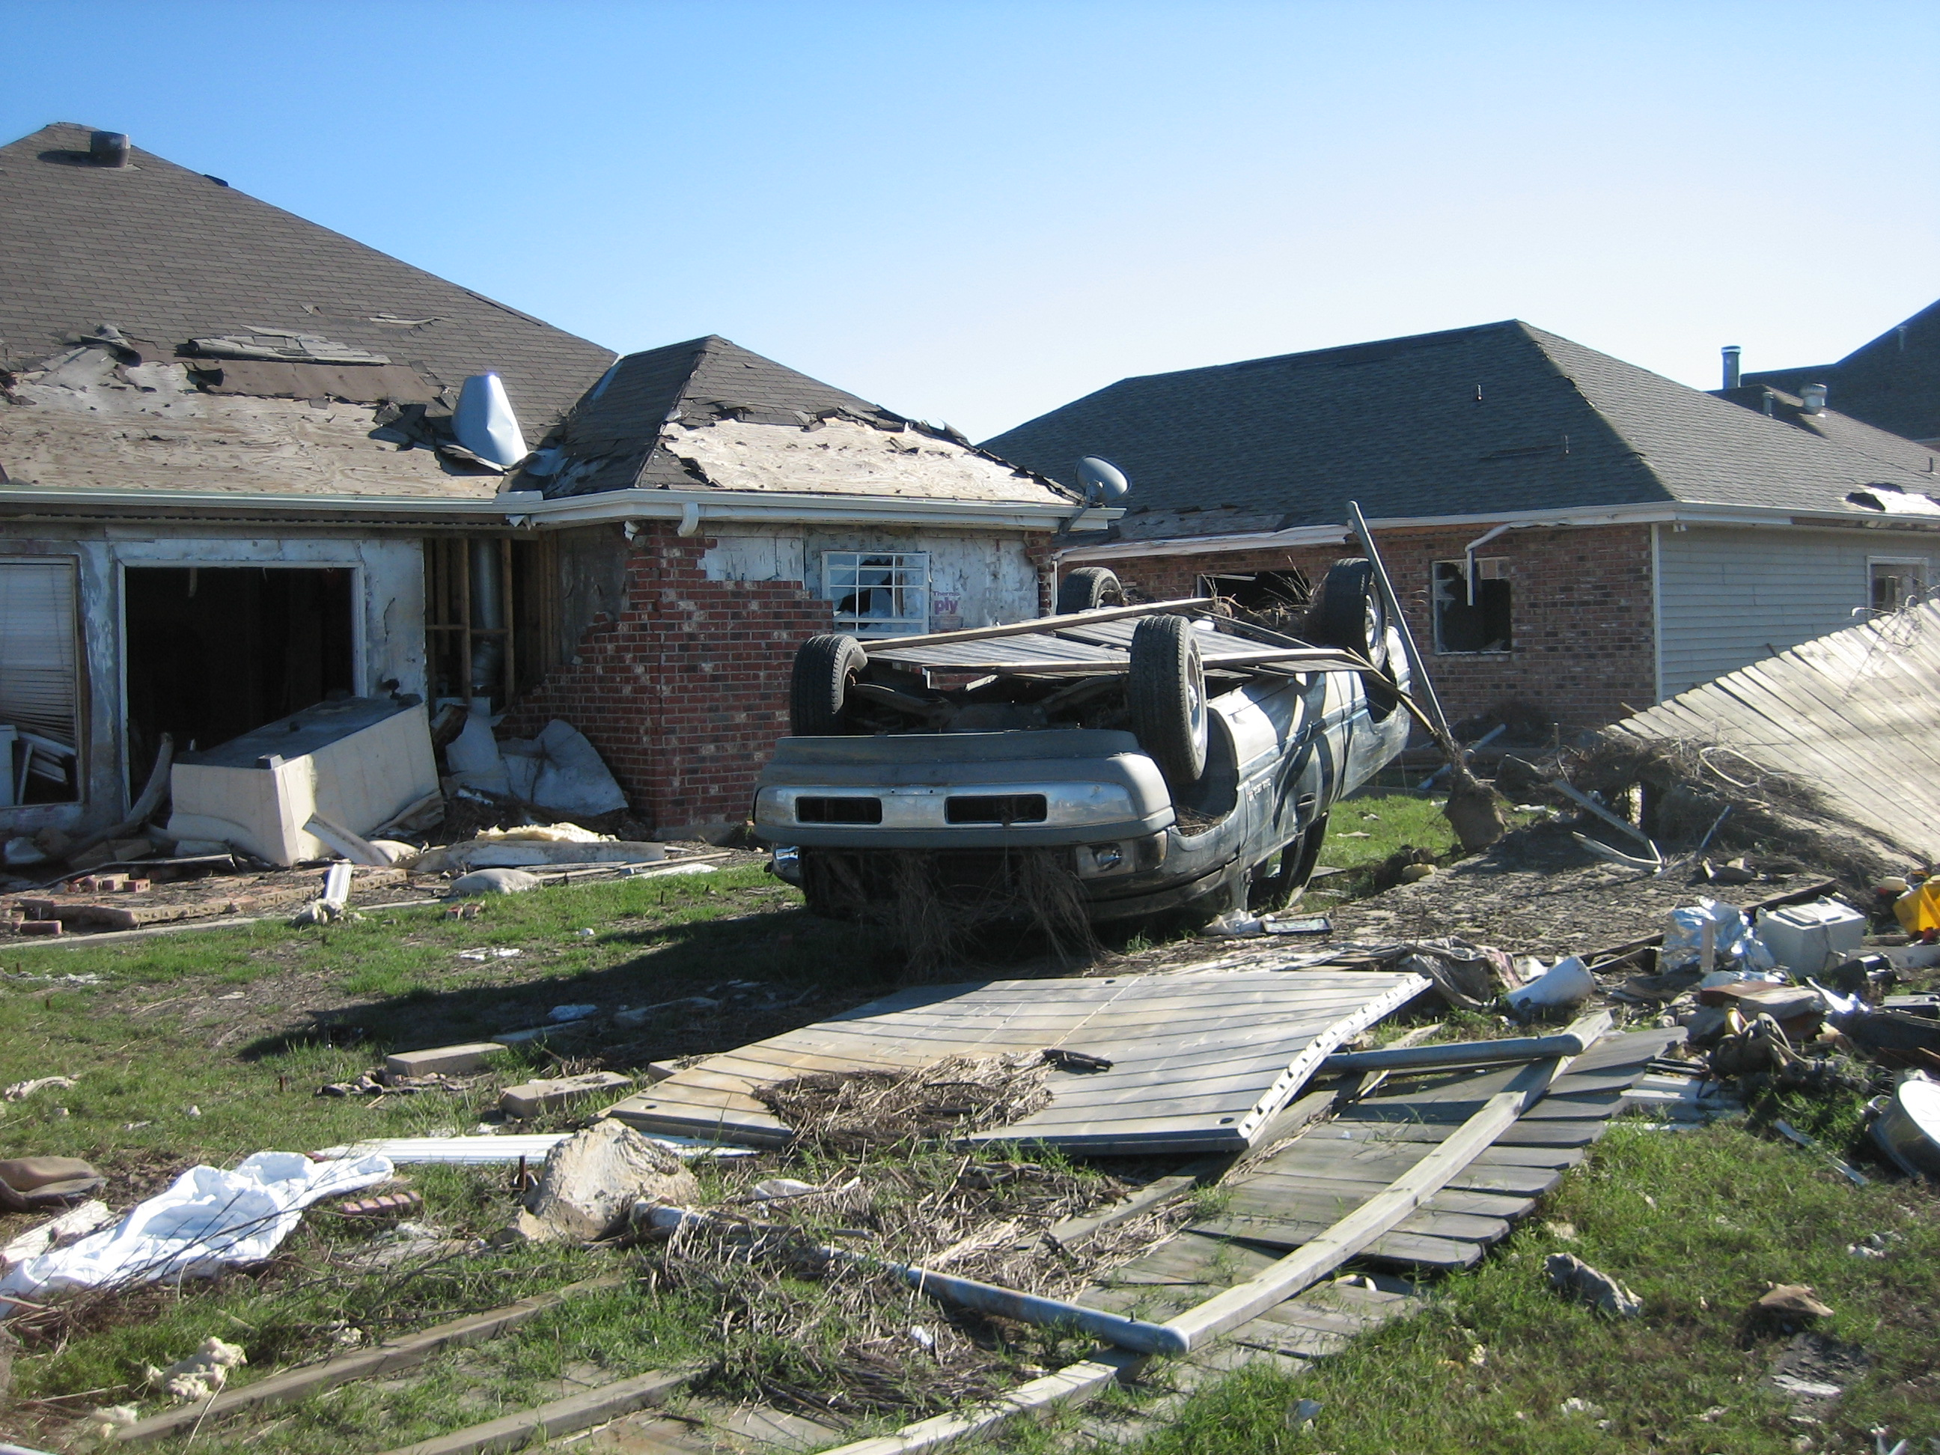

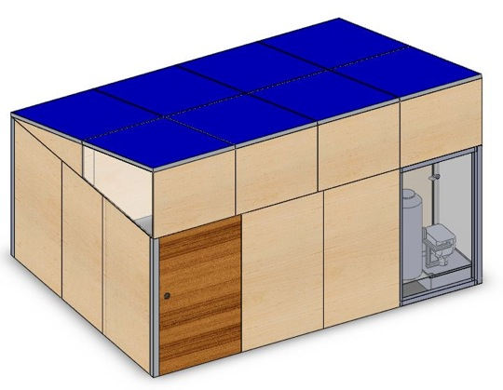

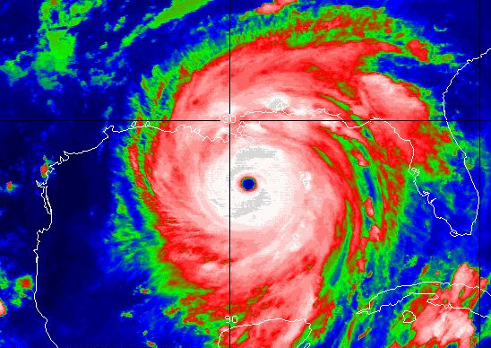
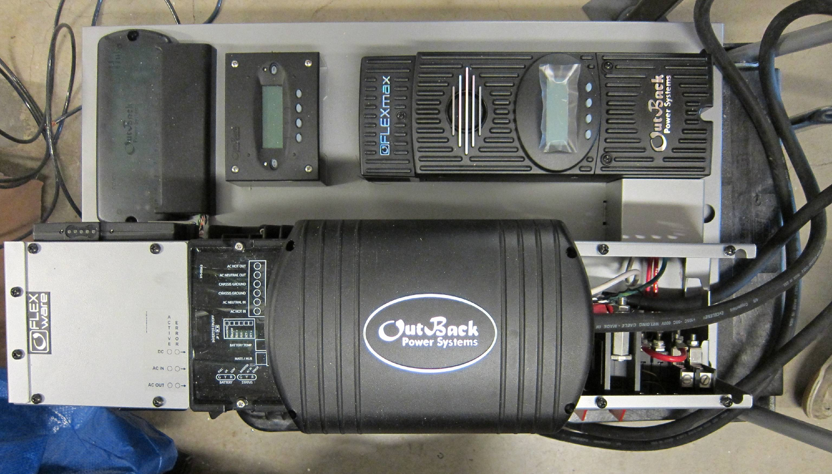
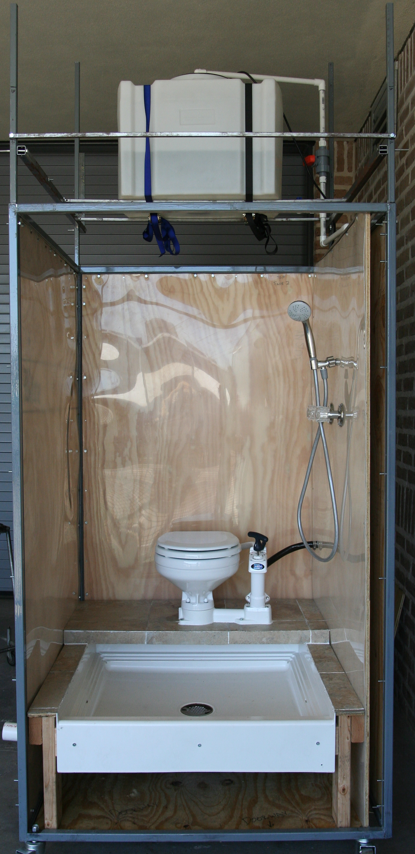
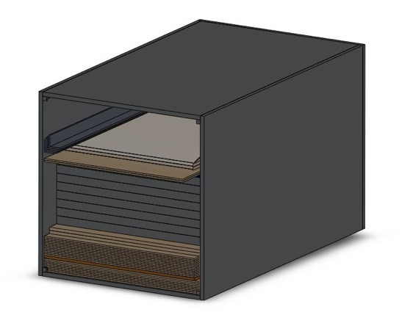
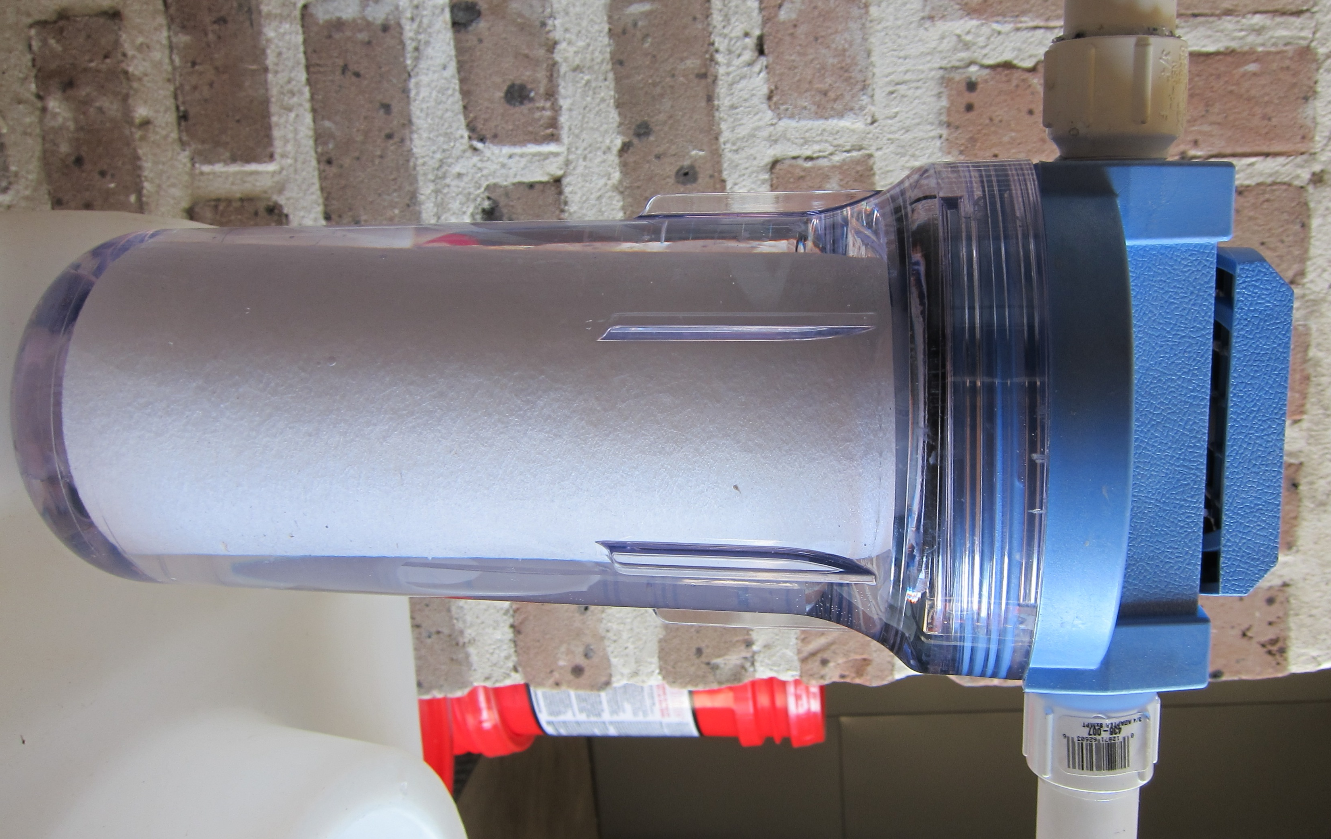
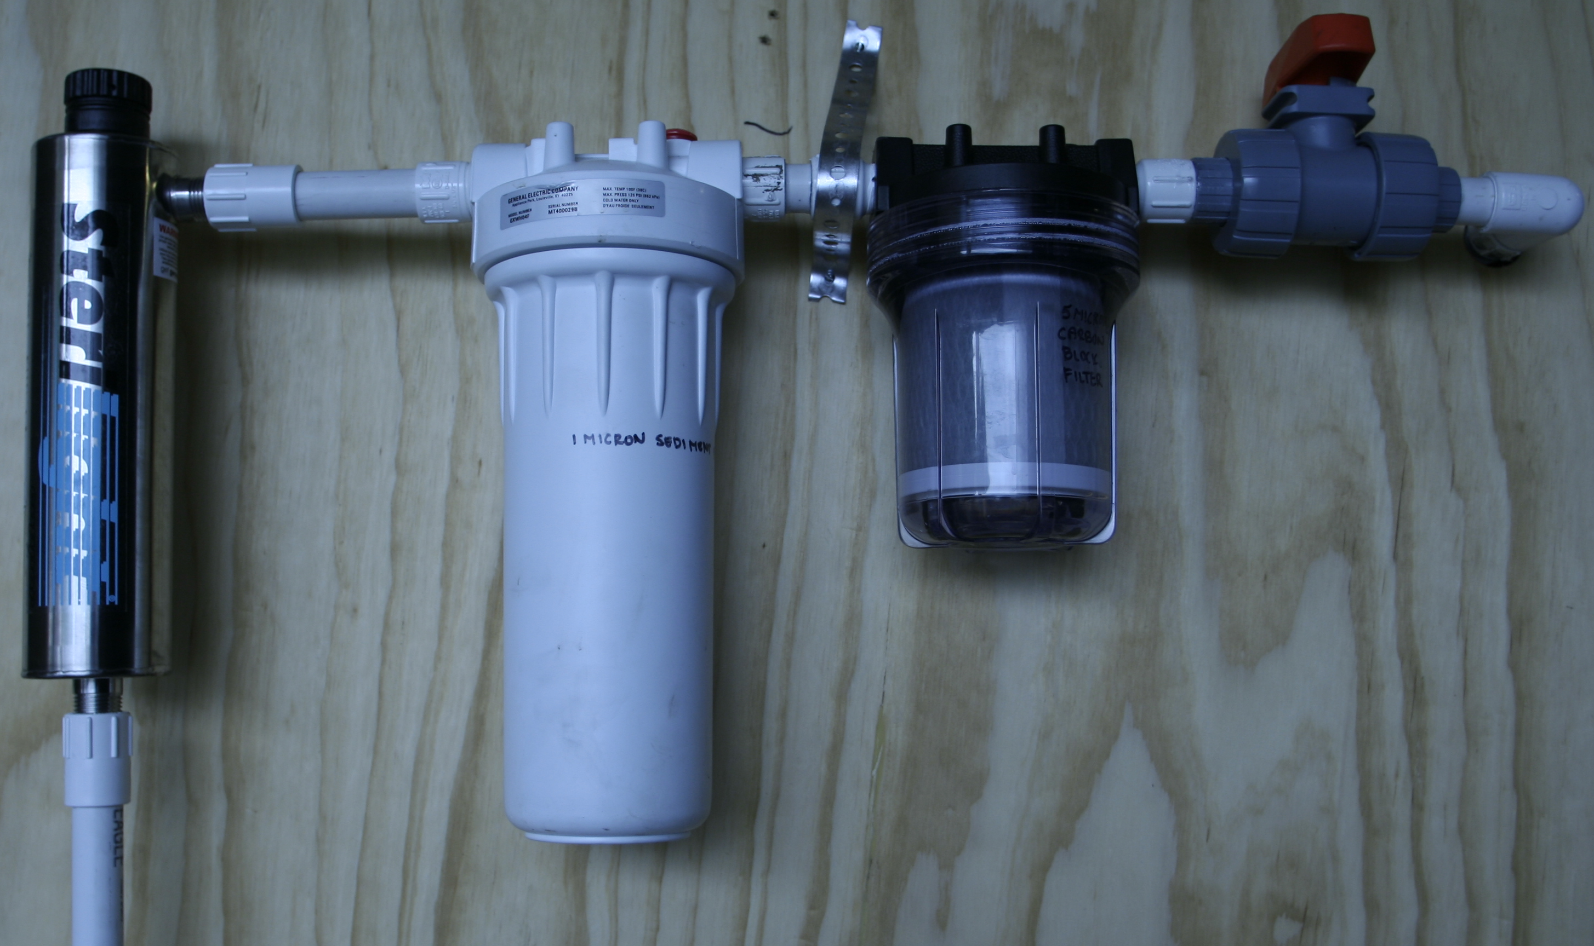
The Portable Off-Grid Sustainable Habitat
Michael Heisel, Young Suk Jo, Tomas Lafferreire, Jeroune Rhodes, Matt Sorenson, Stephanie Vu
Advisors: Michael Ewert and Dr. Brent Houchens
Department of Mechanical Engineering and Materials Science, Rice University
teamposh@rice.edu
Introduction
Energy: Off-Grid Photovoltaic System
Structure: Strong and Weatherproof
Motivation
A lack of affordable shelter with hygienic living conditions in:
Developing countries
Disaster relief zones
Goals
Build a portable and self sustainable house that provides:
Structurally reliable shelter for 2 people
Potable water production with 3 week storage capacity
Energy generation and storage
Air conditioning
Photovoltaic Modules
Six modules, 1380 Watt array provides energy for multiple household appliances
Tilted at 15 degree angle due South
Battery Bank
Eight, 225 Amp-hour flooded lead acid batteries store excess energy for cloudiness and nighttime
FLEXpower One Device
Inverter converts direct current into alternating current
Charge controller regulates electric current entering and leaving battery bank
Monitors energy production and consumption
Modular aluminum frame with plywood panels allows for different configurations
Solar panel array acts as rooftop and is raised by hand-crank telescoping poles
Simple bolt and nut connections through predrilled holes
Corrugated metal water barrier under roof
Waterproof plywood with added reflective sheeting on panels
Aluminum T-bars for rigidity
H-shaped bar allows for panel attachment
Steel Material Box Frame
Steel Wet Core
MATE2 Energy Monitor
Charge Controller
6.2’
8.9’
U-channel protects bottom edge of panels
Plywood Panels
10.6’
13.1’
Wet Core: Self-Contained Bathroom
Packed Configuration
Surge Protector
FLEXpower One System
FX Inverter
Services 1-2 habitats
Requires little on-site assembly
Provides potable water
Requires minimal energy to run UV sterilizer and water pump
25 gallon water tank sits on top to gravity assist water flow
Telescoping poles and steel frame aid in structural support of habitat roof
25 gallon water tank
Compacts into two 3.6’ x 3.6’ x 6.2’ boxes: Wet Core and Materials Box
Expansion ratio of 6:1
Contains all materials and tools
for 1 habitat
Boxes composed of steel frames
Filtration system provides clean water for entire house and a separate line for potable water:
House Filter
Potable Line
Telescoping poles to support roof
Majority of piping is contained in 1 wall and services:
Toilet
Shower
Potable water/faucet
Shower
Manual pump toilet
25 Micron Sediment
1 Micron Sediment
5 Micron Cartridge
Steel frame
Interior view of packed Materials Box
UV Sterilizer
Wet Core
Wet Core Evaluation
What’s Next?
The P.O.S.H. Advantage
Assumptions
Two people using Wet Core
Use toilet 4 times a day, 2 flushes per use
Shower 5 minutes, once a day
25 Gallon Tank
10 days of flushes
4 days of showering
Tests and Results
Time to empty 25 gallon tank via shower: 37.5 minutes
Number of flushes for 25 gallons: 160
Weight of Wet Core: 450 pounds
Adequate discharge of waste water
Structurally supports adult male (190 pounds)
Current Status
Wet Core is complete and functional
All structural components are manufactured
Roof and walls are under construction
Future Plans
Construction complete by April 22, 2011
Thermal, structural, and electrical testing complete by May 2011
Water purification tests complete by May 2011
Human testing complete by May 2011
Current commercially available technologies are either portable or sustainable. Our solution bridges the gap between the two to provide a truly unique design that is:
Self-sustainable through energy production
Portable
Quick and easy to deploy
Modular and can be built in different configurations depending on need
Cost-effective ($13,000)
Competitively priced with other disaster relief housing
Acknowledgements
We would like to acknowledge our mentors at NASA, the Department of Mechanical Engineering and Materials Science, the Oshman Engineering Design Kitchen, Jim Davis, and Rice University for their time, money, and guidance. Additionally, we want to extend our gratitude toward Joseph Gesenhues, Carlos Amaro, Christine Gardner, Amy Kavalewitz, and Tracy Volz.

