Slide 1
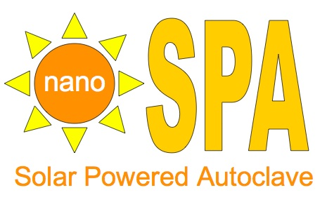


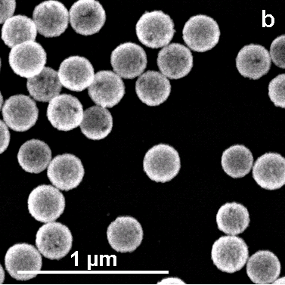
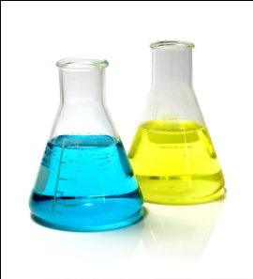
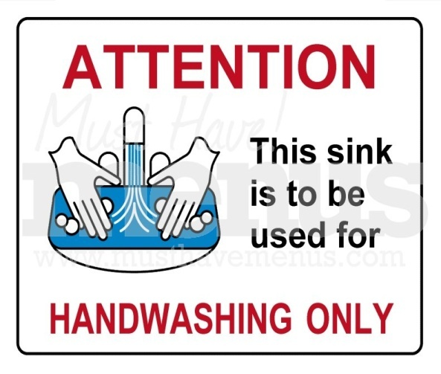
Solar-Powered Autoclave Using Nanotechnology for the Resource-Constrained Setting
Eric Kim¹, Benjamin Lu¹, Kevin Schell², Mary Quinn¹, Shea Thompson¹, Catherine Flaitz⁴, Oara Neumann³, Z. Maria Oden¹, Naomi Halas³
¹Dept. of Bioengineering, ²Dept. of Mechanical Engineering,³Dept. of Electrical and Computer Engineering, Rice University, Houston, TX 77005
⁴Dental Branch, The University of Texas Health Science Center at Houston, Houston, TX 77030
Contact: TeamNanoSPA@gmail.com
Problem
System Criteria
Nanoparticles Harness Solar Energy
Prototype Testing
Rural dental and medical clinics require means of sterilizing tools for procedures.
No sterilization technique is optimized for resource-constrained settings.
  Limited power supply and funds
  Unreliable supply chain
  Untrained technicians
Improper sterilization results in increased risk of infection within developing countries.
  Goal: To develop a cost effective, robust, and portable solar-powered autoclave for resource-constrained settings
Absorb entire UV, visible, and NIR spectrum
Sustain temperatures 40% higher than required for sterilization
4x more efficient than solar panels
Appropriate for resource-constrained settings
No power requirement
No noxious chemicals
Reusable
Absorption Spectrum of Gold Nanoshells
SEM Image of Gold Nanoshells
Conducted safety testing
Hydrostatic pressure testing
Finite element analysis
Thermal testing
Conducted full-cycle thermal testing
Achieved : 119 ̊C and 12 psig
Sterilization validated with thermally resistant bacteriological indicators
Plan to conduct additional thermal testing and durability testing.
Solar-Powered Autoclave Design
Thermal Testing Results
Pressure gauge
Pressure relief valve
4
Air purge system removes unsterile air from sterilizing vessel.
3
Steam moves from module into sterilizing vessel.
Current Solutions
5
Condensed water returns to module via hydrostatic pressure.
Advantages
Drawbacks
Ambient Temperature
Bottom Thermocouple
Goal Temperature
Heat
Autoclaving
Dry heat
Clean,
Robust
Power requirements,
Complexity
Ball valves
1
Fresnel lens focuses light on nanoparticle module.
Implementation Plans
2
Check valve
Create standalone, robust, modular sterilization system
Automate cycle
Simplify user interface
Distribute to dental and medical outreach groups that work in resource-constrained settings
Decrease risk of infection and disease transmission
Enable work in more remote areas
Nanoparticle solution in module generates steam.
Chemical
Ethylene oxide
Low power,
Low temp
Toxicity,
Logistics
Hand
Washing
Simple,
Inexpensive
Does not sterilize
System Criteria
Achieved:
Additional testing required:
Maintain 115 ̊-140 ̊C and 10-20 psi
Require only solar energy for operation
Redundant fail-safe operation
Cost < $1500
Capacity for tools required daily in mobile medical or dental clinics
Durable to transport on rugged terrain
Operation cycle < 2 hours
Acknowledgements
  Our solution: Incorporate novel nanoparticle technology that efficiently absorbs solar energy to create a solar-powered autoclave
This project was funded by Mr. and Mrs. Charles Fox and Beyond Traditional Borders, which is made possible by a grant to Rice University from the Howard Hughes Medical Institute through the Undergraduate Science Education Program. The design work for this project was supported by the Oshman Engineering Design Kitchen.

