Slide 1


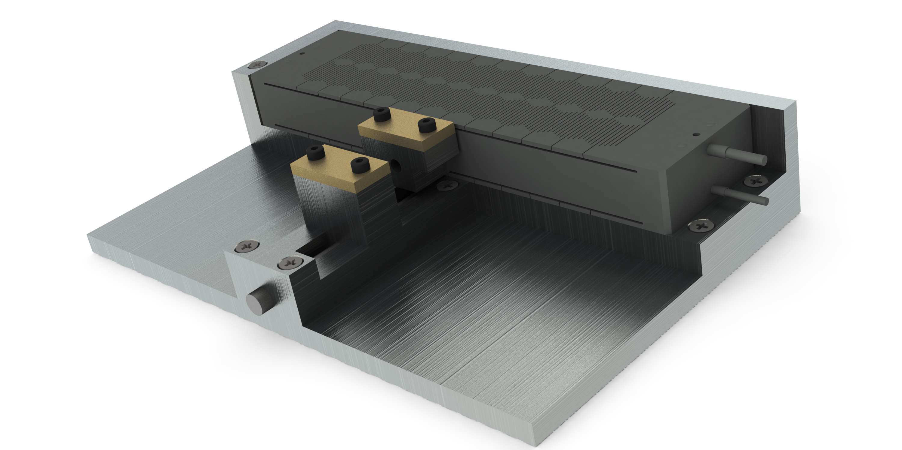
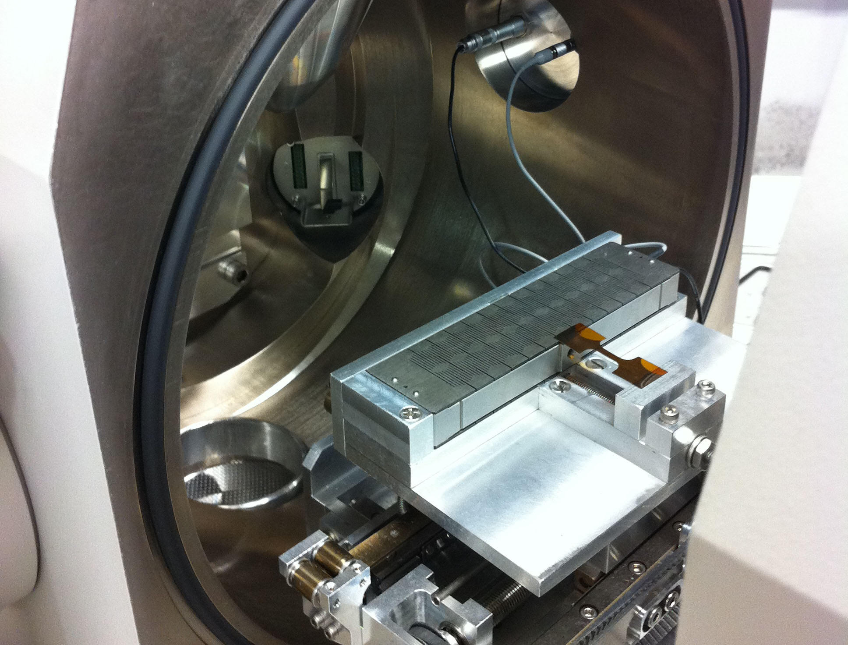
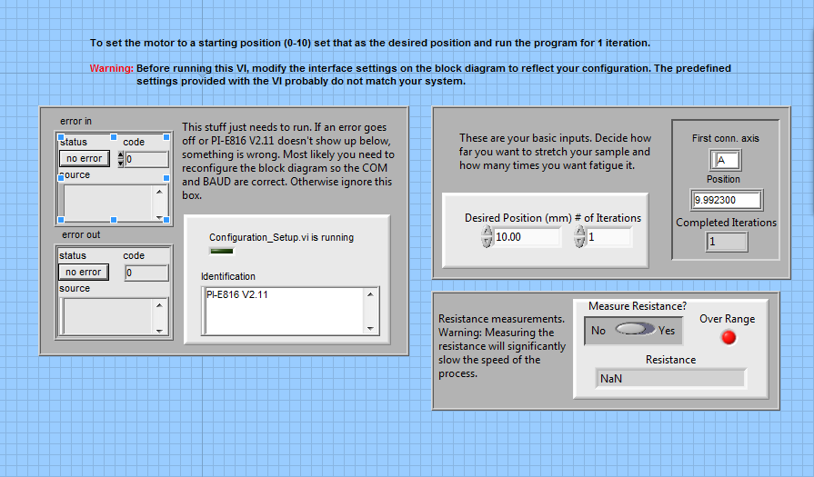
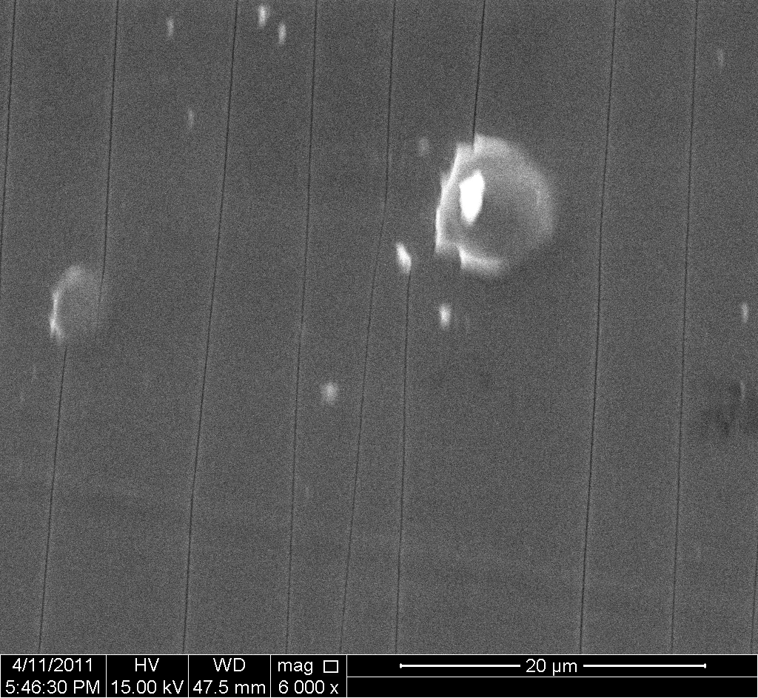
Micro Tensile Fatigue Tester
Matt Fritze (MEMS), Dan Bianculli (MEMS), James Kohli (ECE)
Departments of Mechanical Engineering, Electrical Engineering, and Material Science, Rice University, Houston, TX
jwk2@rice.edu
Design Problem
Problem: Testing thin films (materials of less than 1 µm) adhered to a thicker substrate is mechanically and conceptually difficult.
  However, the material properties of thin films are important because durable thin films are required for the creation of flexible electronics. Monotonic tensile testers are currently in use for testing the properties during a uniaxial tensile test, however the results of fatigue testing are still an unknown.
  Because these materials are used in devices expected to undergo long term, high frequency, low impact strains, fatigue is an important factor of whether or not these products become viable.
NaNfat in Action
Left: NaNfat loaded into the Rice SEM.
Below: The NaNfat GUI ready to run in
NI Labview.
Goals
To effectively fatigue test a sample, our design had to meet the following requirements:
  Displacement of a sample up to 1mm at 13Hz
  Fit within the operating constraints of JEOL 6500F
  Scanning Electron Microscope (SEM)
  Operate and record all data of interest in real-time
  Easy to use, easy to expand user interface
  Modularity to address testing scenarios not currently
  being tested for (e.g. three point bending test, temperature gauge)
Capabilites
The NaNfat system is designed to have maximum flexibility. It takes the following inputs:
  Number of iterations
  Desired displacement
Piezo Motor
Replaceable Clamps
It then outputs the following:
  Current motor location
  Number of iterations completed
  Electrical resistance
Adjustable Staging
Electrical Leads
Hardware
The final NaNfat design features the following hardware:
  PI P602.8sl actuator
  PI E625 controller
  Custom designed aluminum stage
  Replaceable clamps for multiple types of testing
  Custom feedthrough plate to allow computer inputs inside SEM chamber
Results and Acknowledgements
The NaNfat system works successfully on the Rice SEM. The image at the left was taken of the cracks that appear in samples when fatigued by our device. The stage has been created with future modules in mind, so we hope to implement new clamps and tests soon. At this time, however, it is a functional in situ fatigue tester.
The NaNfat team would like to thank Dr. Jun Lou, Cheng Peng, Rice ECE
and MEMS departments, & the Oshman Engineering Design Kitchen for their
help in the creation of NaNfat.

