Slide 1



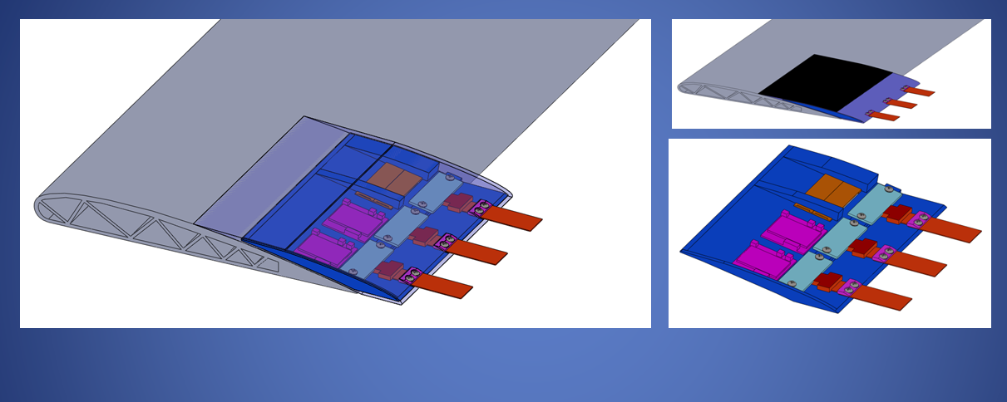
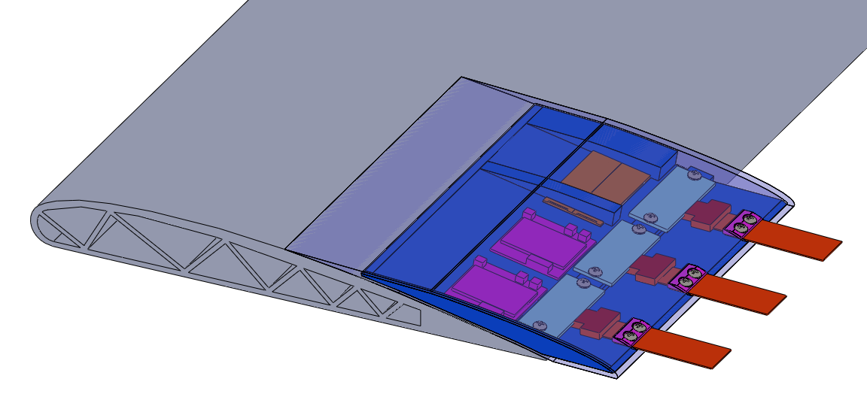
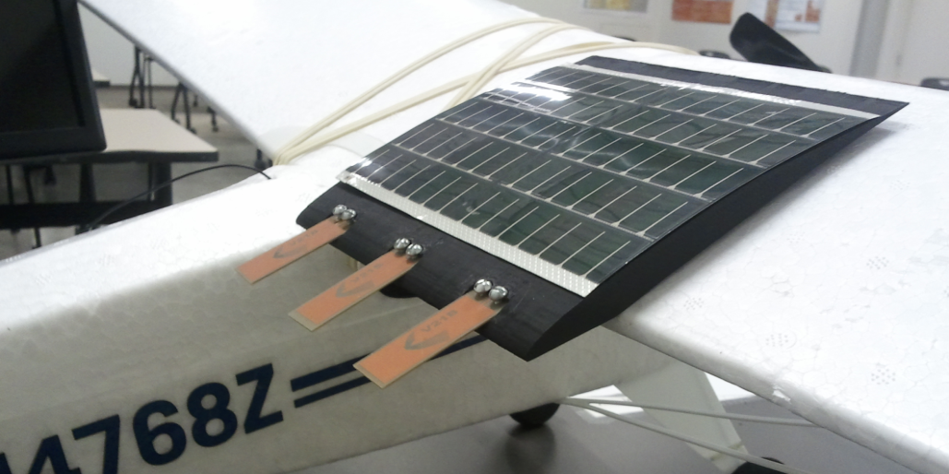
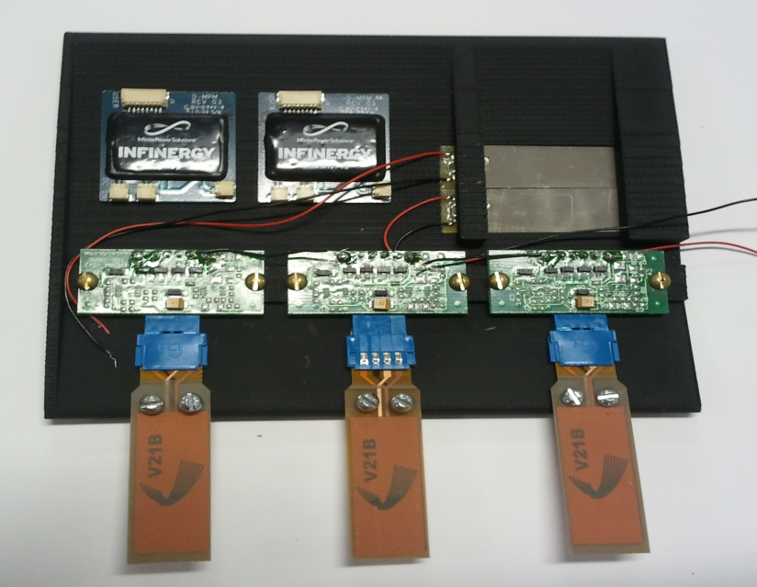
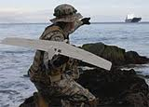
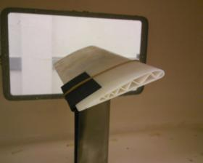
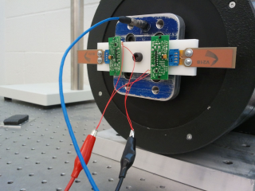
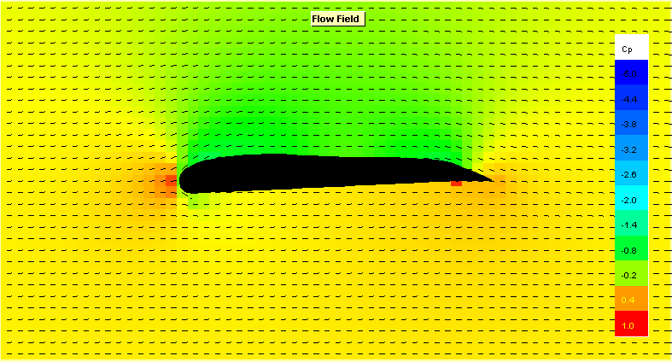
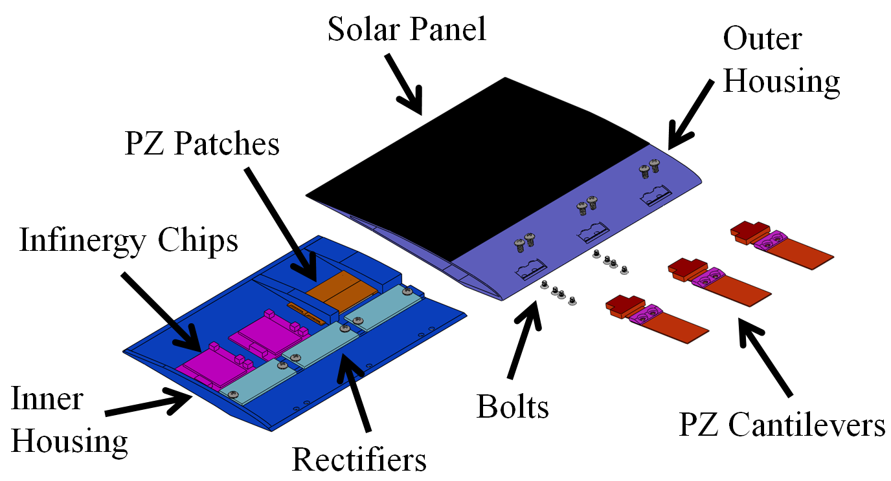
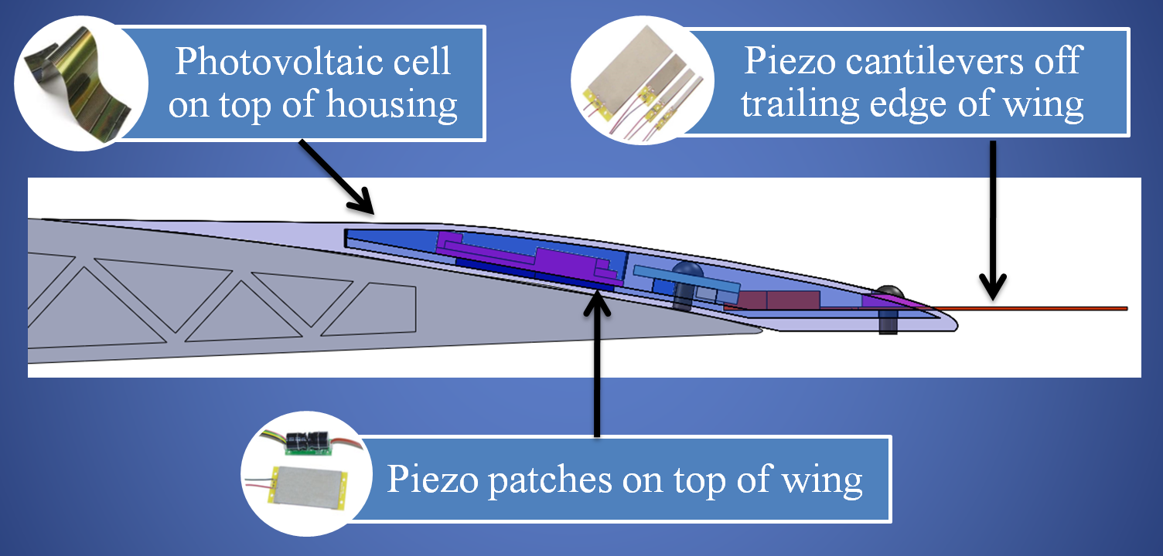
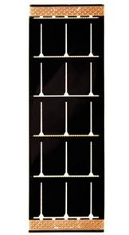
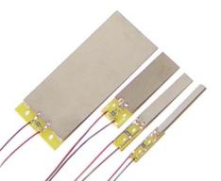

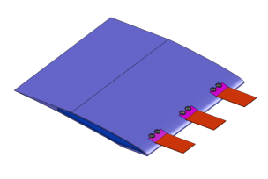
Energy Harvesting
for Micro-Air Vehicles
Rhodes Coffey, Christopher Cromer, David McMahon, Stephen Williams
Rice University
Department of Engineering
teamMAVerick2011@gmail.com
Summary of MAVs
Design Solution
Testing
The US Air Force has developed Micro-Air Vehicles (MAVs)
  Allow for remote observation of hazardous environments
  - Use cameras, GPS, and sensors to perform missions
Battery technology is currently restricting the mission life of MAVs.
Potential harvesting technologies include: electromagnetic induction, triboelectricity, piezoelectricity, thermoelectricity, and others.
Shaker Test: used shaker machine to simulate different frequencies of vibration and measured power output of piezoelectric cantilevers.
CFD Analysis: simulated the air flow over the wing profile of an MAV.
Wind Tunnel Testing: compared coefficients of lift and drag at different angles of attack of the wing profile and the wing.
Car Testing: simulated flight conditions by attaching prototype to RC plane while driving at various speeds.
Goal: Develop a mechanism to harvest ambient energy from the environment during flight of an MAV that would work to refill energy storage devices and enable longer missions.
Above: CAD Model Side: Device on RC Plane & Internal Setup
Design Criteria
MAV being launched.
Wind Tunnel Testing
Shaker Test
CFD Analysis
Power Output
Category | Details
Volume and Weight | Smaller than 5 in³ of volume Minimizes effect on drag and lift of the MAV
Power generation | Generate a minimum energy of 250 mJ in 30 seconds (on average 8.3 mW of power) Functions in parallel and independent of existing power source Scalable in system size and power generation Contains energy harvesting and energy storage components
Operating Conditions | Functions in both laminar and turbulent air flow regimes Functions in low to mid altitude ranges up to 35,000 ft.
Tip Mass
Time
Design Components
Thin Film Photovoltaic Cell
  - Solar energy
  Operating parameters: 4.8 V, 100 mA
Piezoelectric Patches and Cantilevers
  - Convert vibrational strain to energy
  - Max outputs of 2.3 mW
Infinergy Energy Harvesting Chip
  - Inputs: AC or DC, can function in series
  - Outputs regulated voltage
  On-board 1 mAh storage: micro-energy cells
Housing Component
  Rapidly prototyped using ABS plastic
  Designed to minimize drag on wing
Harvesting Technologies
Conclusions and Future Work
Electrical Circuit
Exceeds the requirement of 8.3 mW power in daylight and produces 3 mW power at night.
Majority of the energy harvesting comes via the solar component.
The piezoelectric elements provide constant low power.
Challenges: volume constraint, parallel and series configuration of harvesting mechanisms.
Next step: testing the device on an RC plane in flight.
Solar Cell
Piezoelectric Patches
Piezoelectric Cantilevers
Piezoelectric cantilevers rectified from AC to DC and combined in series for DC input
Piezoelectric patch as an AC input
Solar Panel as a separate DC input
Infinergy chips output regulated voltage and work in series to power device
All potential energy harvesting technologies were evaluated on criteria of feasibility, efficiency, scalability, energy output, and other design constraints.
Piezoelectricity and photovoltaics performed the highest on the Pugh Analysis and therefore were chosen as the main mechanisms in the solution.
Infinergy Chip
Infinergy Chips
Acknowledgments
References
Output
Dr. Andrew Dick, Rice University
Dr. Gary Woods, Rice University
Dr. Jason Foley, Air Force Research Labs
Oshman Engineering Design Kitchen
Anton, S.R. “Energy Harvesting for UAV’s” Virginia Tech (2008)
Hurd, W.R. Naval Postgraduate Thesis (2009)

