Slide 1

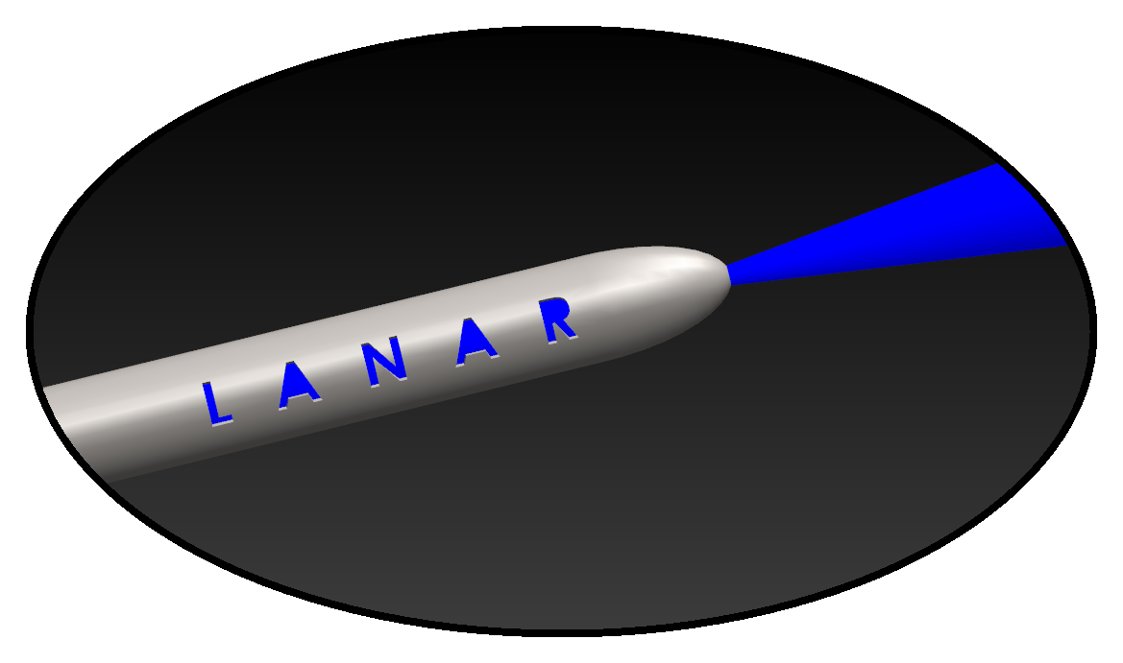
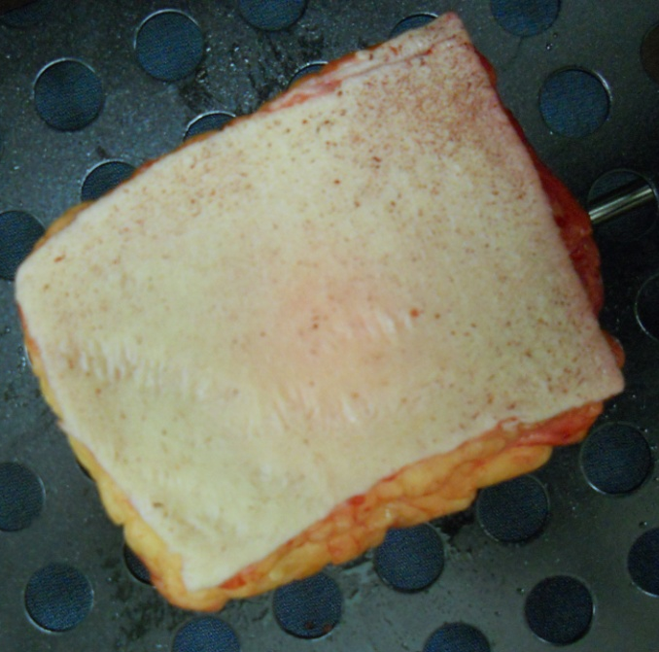
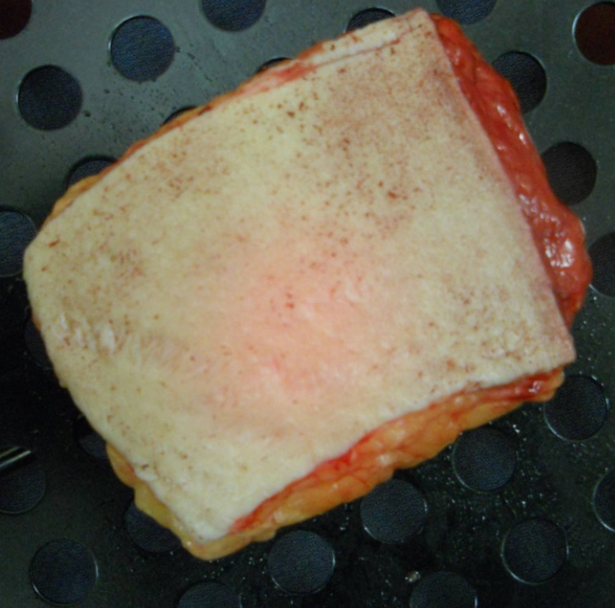
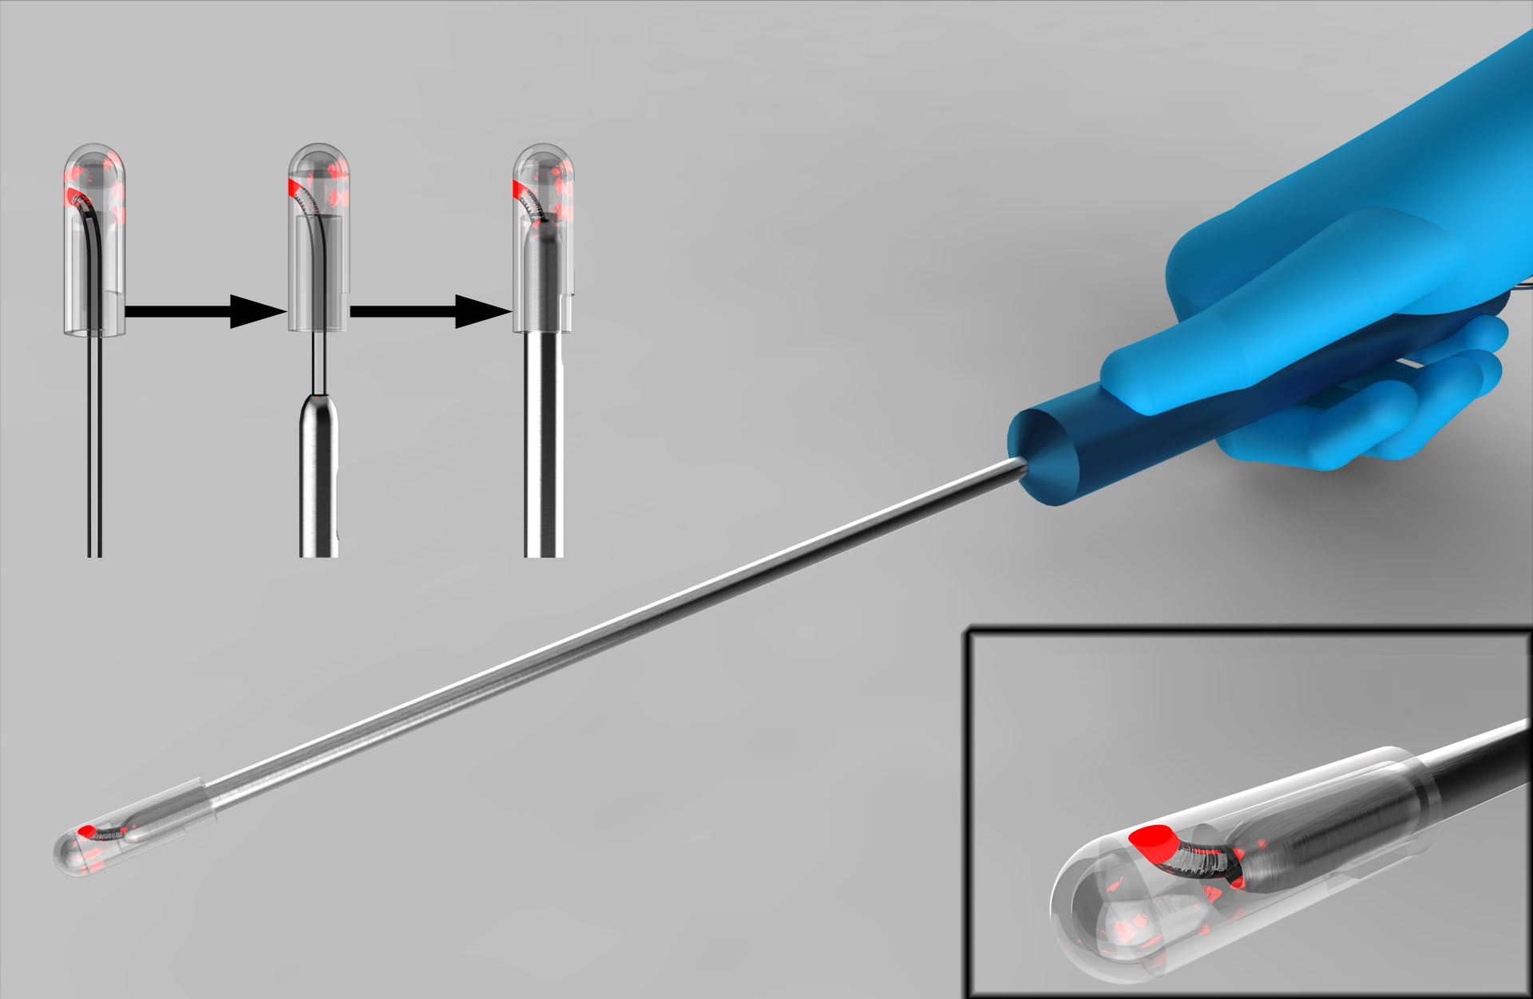
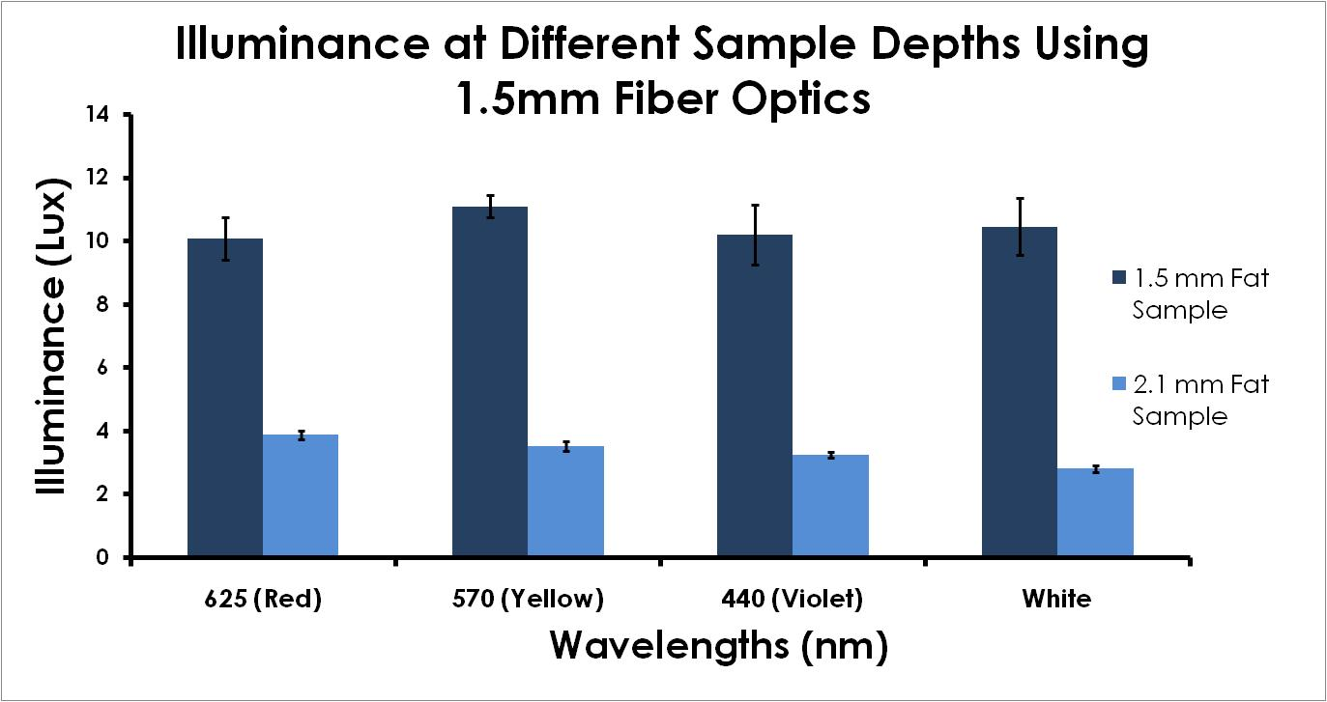
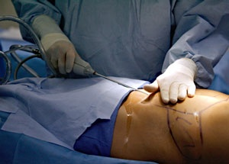
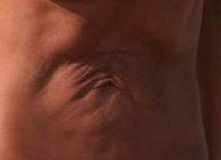
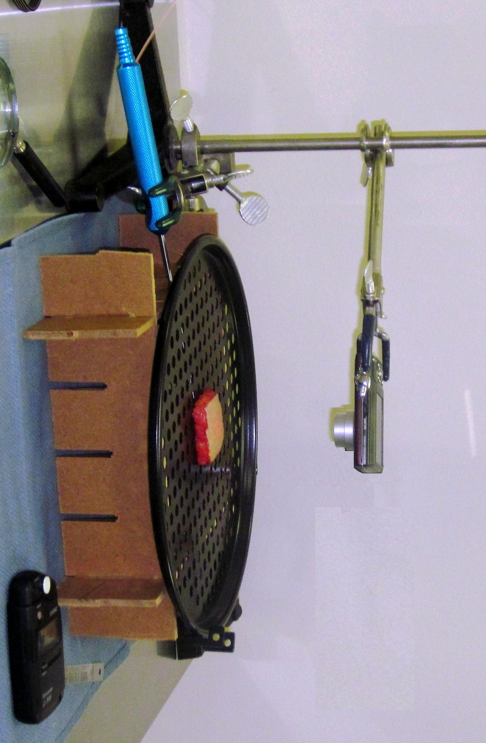
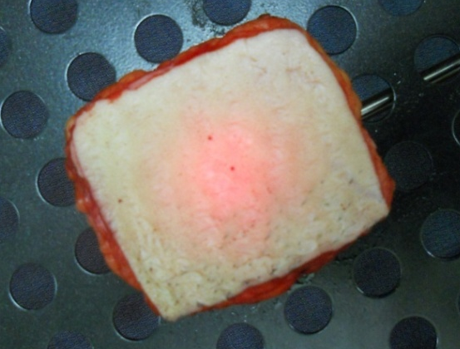
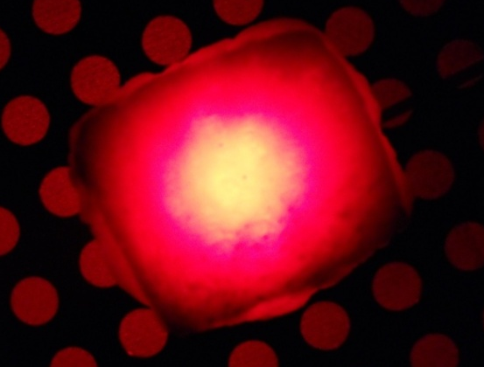
A Surgical Light Device to Gauge Depth &
Position of Surgical Cannula
Catherine Augello, Hector Muñoz, Barbara Thorne-Thomsen & Michael Zhao Department of Bioengineering Rice University (TeamLANAR@gmail.com)
MOTIVATION
LIPOLUMINATOR
RESULTS
Plastic surgeons rely on ‘touch and feel’ methods
when performing liposuction (Figure1)
    Procedures essentially blind
    Heavy reliance on experience
No practical way of visualizing the internal
placement of surgical instruments within the body
Consequences of misplacement include tissue
scarring, hematomas, deep bruising, and contour
deformities (Figure 2)
What It Is: A one-time use polymer tip with an embedded fiber optic that transmits light through abdomen and is visible on surface of skin
Figure 5 Illuminance of Lipoluminator through 2.1cm of fat using (a) 1mm fiber optics and (b) 1.5mm fiber optics
  Tight-fit, bullet-shaped cap allows for easy, secure attachment
(a) (b)
Fiber optics provides powerful, concentrated light
Figure 1 Surgeon using touch and feel method
Figure 2 Scarring and uneven contouring resulting from instrument misplacement
The 1.5mm fiber optics using red wavelength produced highest average illuminance at greatest depth
Figure 3 Lipoluminator design
OBJECTIVE
TESTING
CONCLUSIONS
Team LANAR has developed a device designed to attach to a standard surgical cannula that transmits light through fatty tissue and onto the skin to gauge the cannula’s depth and position.
Ring stand holds camera in place
Camera captures images of light on the sample in (a) ambient light and (b) dark room
Need: Method to visualize internal positioning of
surgical instruments during plastic surgery
Solution: Light integrated device capable of
transmitting through human fat to indicate
instrument position and depth
Benefits: Minimizes human error to reduce post operative complications and improve aesthetics
(b)
FUTURE WORK
DESIGN CRITERIA
Modify design to accommodate different sizes
and patterns of cannulas
Test instrument in human cadavers and during an
actual procedure
Achieve light penetration depth of at least 2.5 cm
Equally or less invasive than current liposuction tools
Simple to use and incorporate seamlessly into
the procedure
Unit price less than $50
Adipose fat sample
Cannula with Lipoluminator placed directly below sample
ACKNOWLEDGEMENTS & REFERENCES
This project was sponsored by Illumineer Medical, LLC
We would like to thank Dr. Maria Oden, Mr. David Gaskin, Dr. William Futtrell,
Dr. Mark Schusterman, and the Rice Bioengineering Department
Haeck, Phillip, and et Al. "Evidence-Based Patient Safety Advisory: Liposuction." Plastic Reconstruction Surgery 124 (2009): 28S-44S.
Light meter measures illuminance on sample
Figure 4 Test set up

