Slide 1


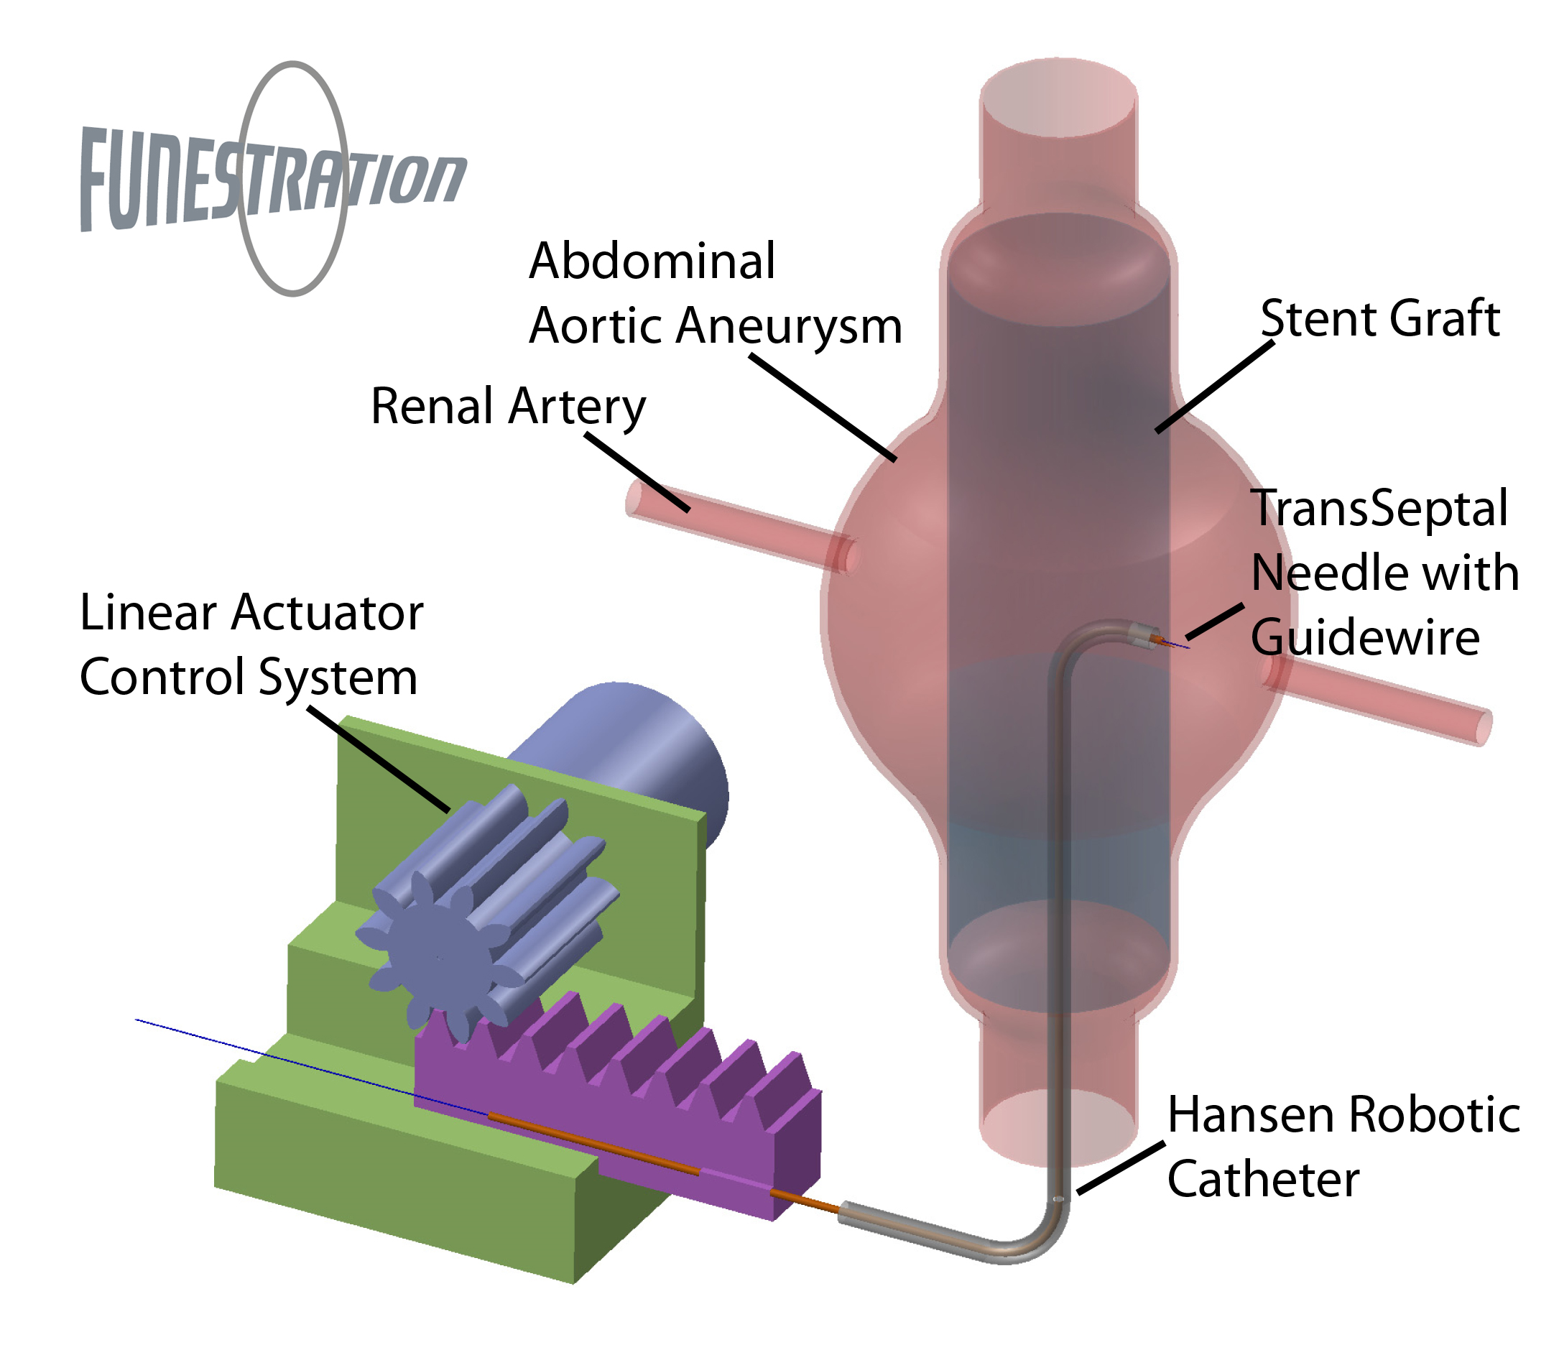

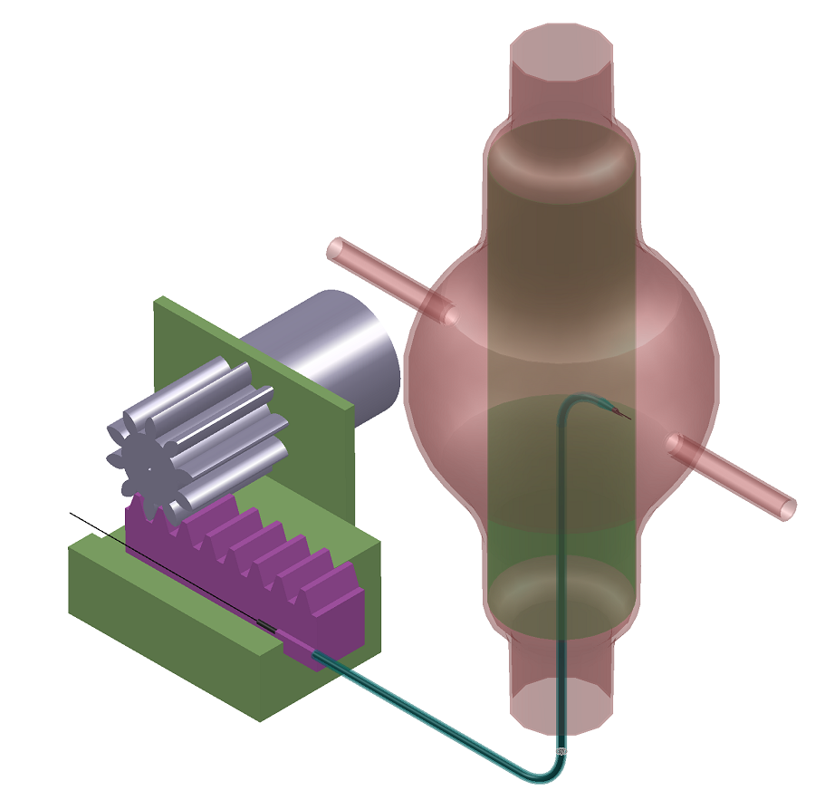
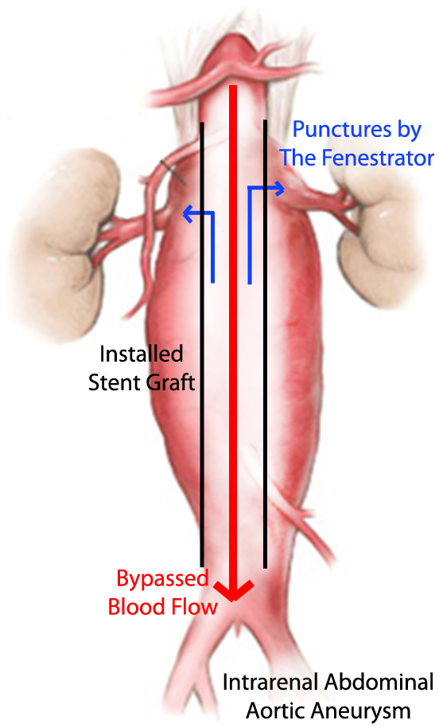
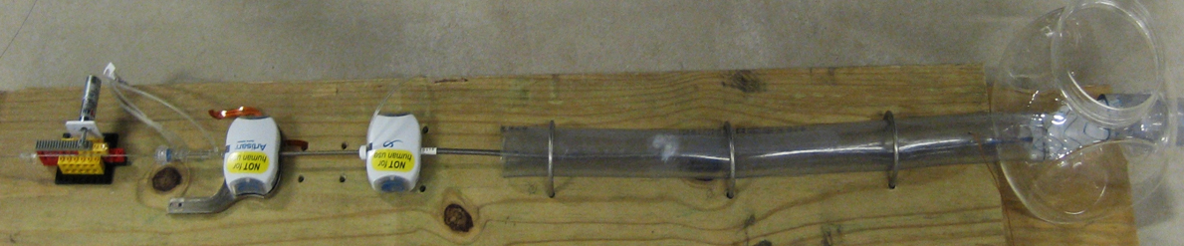
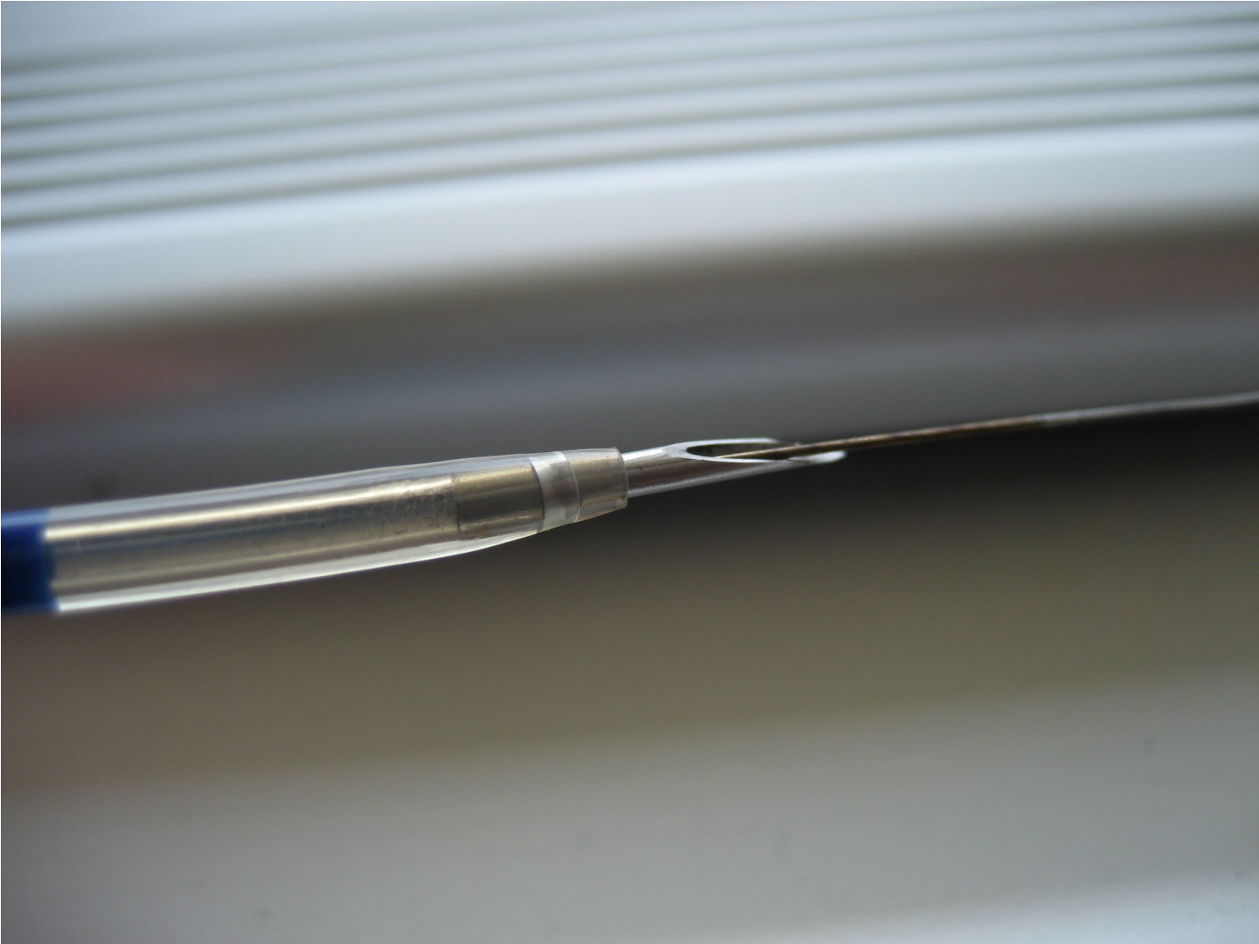
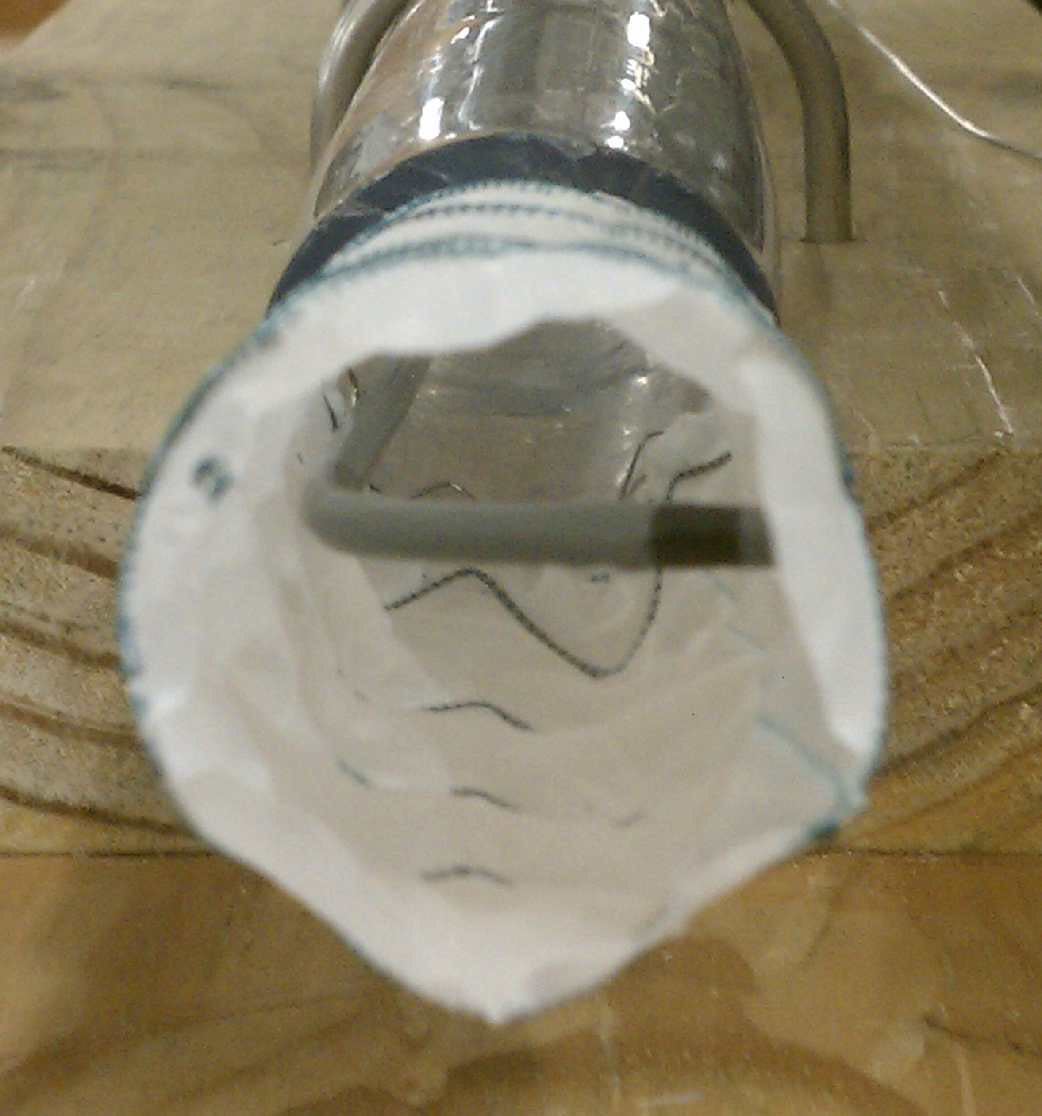
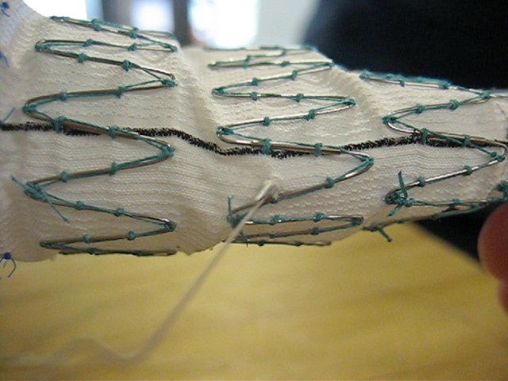
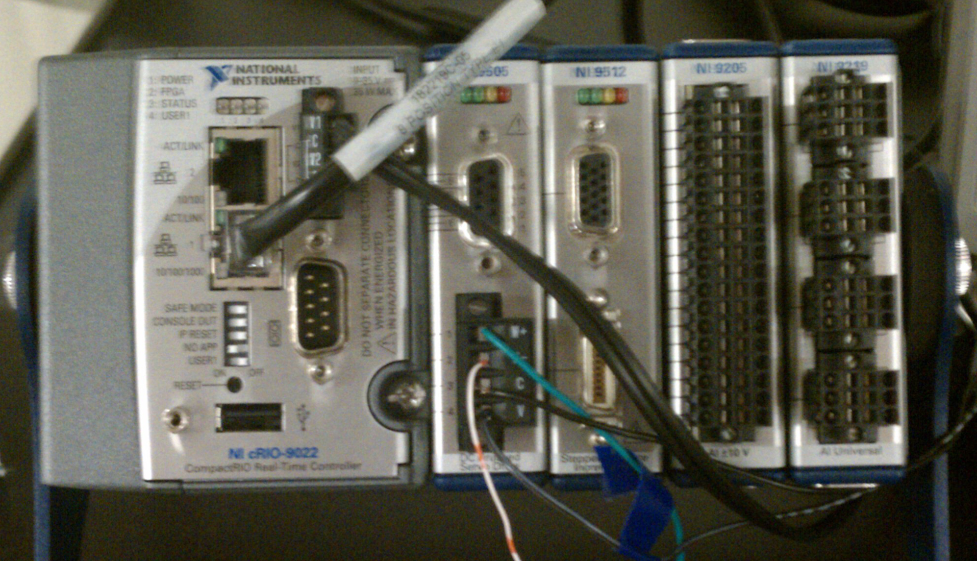
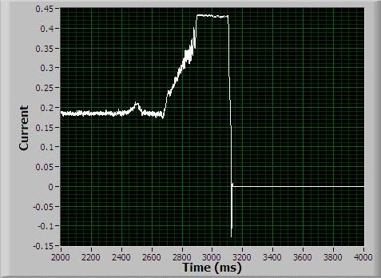
The Fenestrator: In Situ Fenestration of Endoaortic Stent Grafts
Rachel Clark, Evan Gilmore, Ronnie Ren, David Skrobarczyk, Wendy Zhang
Dept of Bioengineering and Dept of Mechanical Engineering, Rice University, Houston, Texas , FUNestration@gmail.com
Problem: No Minimally Invasive Treatment for Intrarenal AAAs
Abdominal Aortic Aneurysm (AAA) is a bulge in the abdominal artery
Minimally invasive treatment uses catheter insertion of stent graft into aneurysm
Intrarenal AAAs are at located the branching of renal arteries (Fig. 1)
Inserted stent graft would block blood flow to the kidneys
Only available treatment is high-risk open surgery
The Fenestrator is a Controllable, Needled Tube that Makes Holes on a Stent Graft
Implementation with Current Treatment Protocol (Fig. 3)
Hansen robotic catheter installs the stent graft within the aneurysm
The Fenestrator tube is inserted into the same Hansen robotic catheter
The catheter places the needle at the proper location on the stent graft
The linear actuator pushes the needle against the stent graft until puncture
Guide wire is passed through the newly made hole
Surgeon restores renal blood flow using the hole and the guide wire
Intrarenal Abdominal Aortic Aneurysm
1. Stent Graft
3,5. Fenestrator Needle with Guide Wire
Design Objectives
Create holes, or fenestrations, during surgery following the insertion of the stent graft
Accurate placement of the holes, assisted by 3D imaging and Hansen robotic catheter system
Suitable for stent grafts of various materials
Prevent vascular damage from overpenetration of the cutting tip
Holes can be expanded to restore renal blood flow
Testing in Simulated Aneurysm
4. Linear Actuator
Linear Actuator
Computer-controlled motor system that pushes the Fenestrator tip forward. When the stent graft has been penetrated, the motor stops.
Hansen Artisan Robotic Catheter
Surgeon-controlled robot that houses the Fenestrator tube and controls its position and direction within the graft.
Simulated Vessel
and Aneurysm
Vinyl tubing and a plastic jar were used to construct an aqueous testing environment.
Stent Graft
Graft bypasses blood flow through the aneurysm but blocks flow to the renal arteries. It must be fenestrated to restore flow.
6. Renal Artery
Kidney
2. Fenestrator Tube inside Hansen Robotic Catheter
Renal Artery
Figure 3: Concept drawing of the Fenestrator making a hole in a graft inserted in an intraregnal AAA.
Figure 1. Concept drawing of intrarenal AAA with inserted stent graft.
Figure 2: This bench-top set up was used to approximate the surgical condition and to test the effectiveness of the Fenestrator. Two tests were performed: 1) Assessment of the needle’s ability to make holes, and 2) Assessment of the actuator’s ability to find a measurable change in resistance against the needle during puncture.
Figure 4: Tip of the Fenestrator tube. Fenestrator tube consists of an 18g + ¼” needle attached to a flexible tube called a dilator. The guide wire is shown passing through the lumen.
Puncture Testing
Conclusion
Open catheter tip is aligned against the graft wall
Dilator-needle is housed inside the catheter (Fig. 5)
Need: A device which enables the minimally invasive treatment of intrarenal aneurysms.
Solution: A catheter assisted dilator-needle system which fenestrates the stent graft at the location of the renal arteries using current-sensing depth control.
Next Steps:
Optimization of motor control to enable precise depth control.
Testing in aqueous environments and animal tissue
In situ operation during endovascular surgery in a living pig.
Implications: The Fenestrator enables the minimally invasive treatment of aneurysms located on branched arteries, thereby reducing the mortality of such aneurysms.
Dilator-needle is pushed from the proximal end
Graft penetration success rate ~80% (Fig. 6)
Needle tip
Guide wire
Figure 5. Catheter is shown making a turn of ~90º toward the wall of the graft.
Figure 6. Successful penetration is defined by the ability to pass a guide wire through the hole.
Depth Control
B
Changes in motor current used to control depth of needle penetration (Fig. 7)
Contact with graft wall stalls the motor, increasing motor current (Fig. 8 A)
Post-puncture, current decreases and triggers LabVIEW program to stop motor (Fig. 8 B,C)
A
B
A
C
C
Figure 7. National Instruments CompactRIO system is used to communicate between the computer and the motor. It acquired signal from the motor (e.g. current) and translated LabVIEW commands to the motor (e.g. stopping the motor).
Figure 8. A) Increase in current corresponding with initial encounter with stent graft wall.
B) Current drop when stent graft is punctured. C) Motor is stopped.
Acknowledgements
Many thanks for the support of Dr. Jean Bismuth, Mr. Dan Wallace, Mr. Daryl Schulz, Dr. Maria Oden, Dr. Marcia O’Malley, Hansen Medical, and the Oshman Engineering Design Kitchen.
References
Sakalihasn N, Limet R, Defawe OD. Abdominal aortic aneurysm. Lancet. 365(9470):1577-89, 2005.
Notes:
Add picture for introduction panel
Add email
Add references
Fix Conclusions
Figure labels
New picture in Fenestrator panel showing transseptal needle inside the dilator.
Fenestrator Panel: Add colored box and caption for aqueous testing environment.

