Slide 1
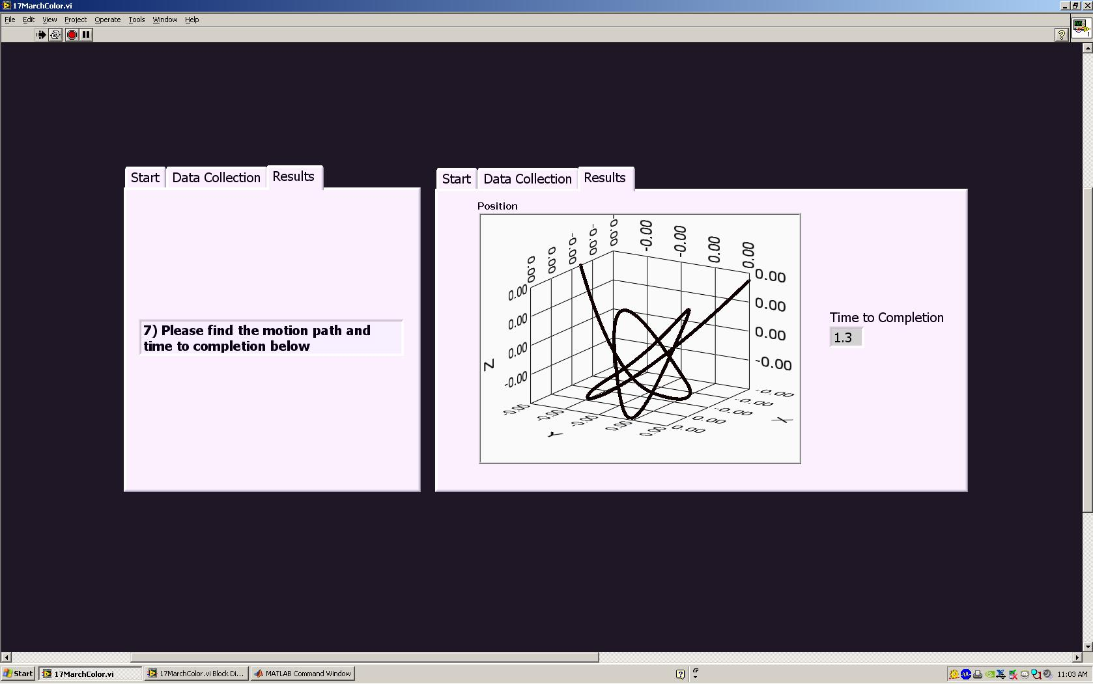
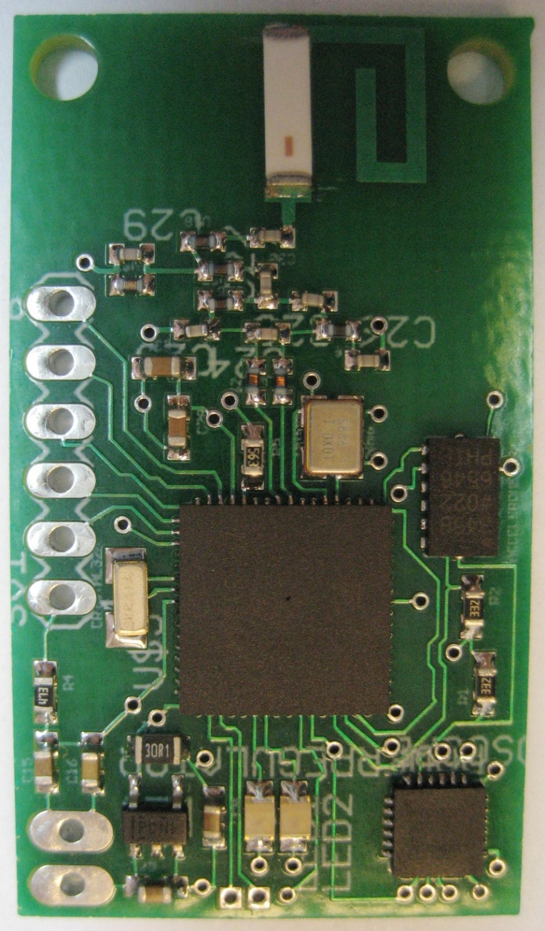
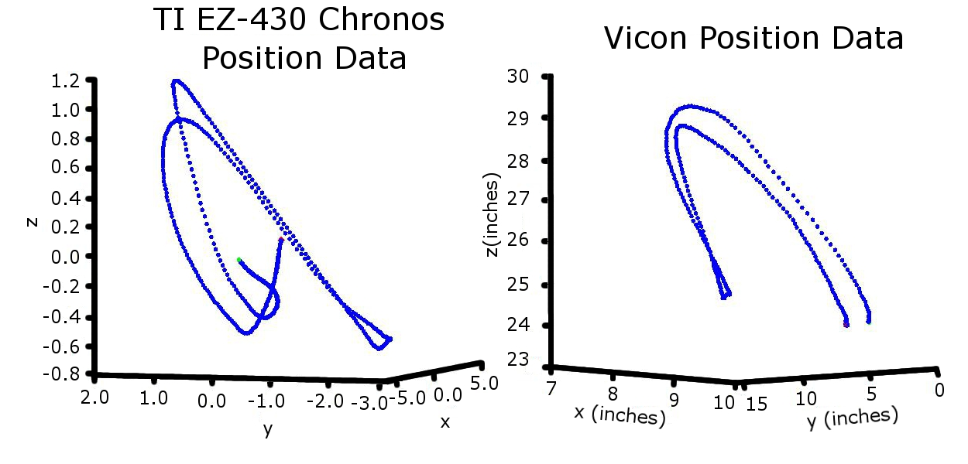
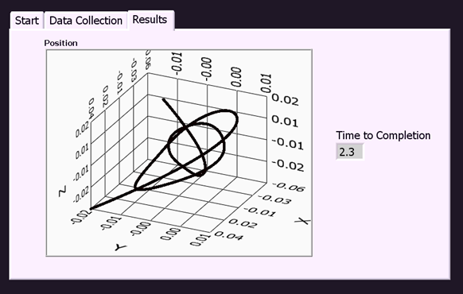
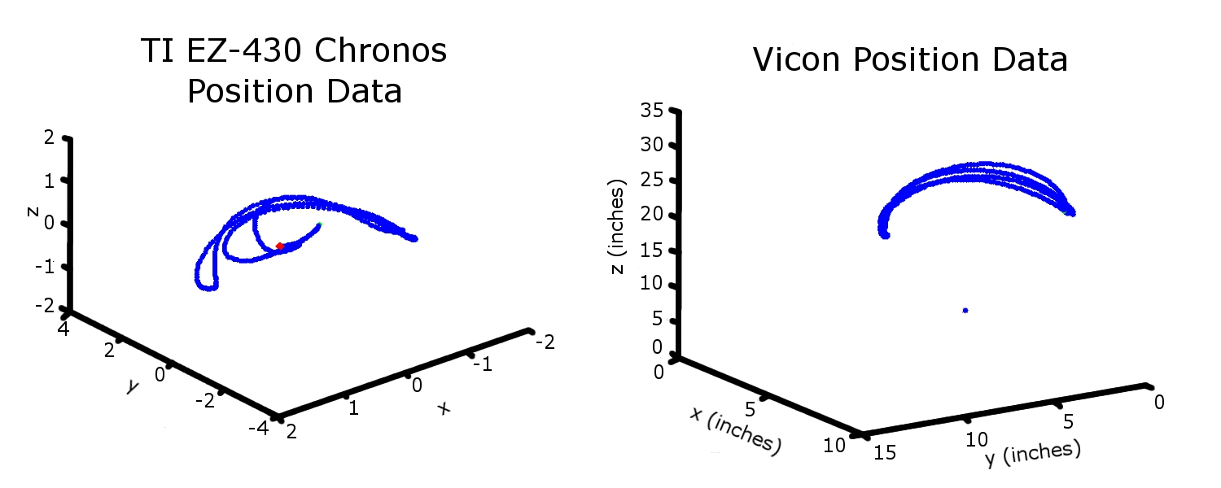
A Novel Device for Tracking Motion Path in Three Dimensions Using Accelerometers, Gyroscopes, and Software Schemes
Avery Cate¹, Dillon Eng¹, Rachel Jackson¹, Alli Scully², Jessica Scully²
¹Department of Mechanical Engineering, ²Department of Bioengineering, Rice University
Real World Problem
The DexTest:
An Automated Dexterity Test
1
800,000 children in US affected with cerebral palsy
  Permanent damage to cerebral cortex
  Inhibited motor control
  No cognitive impairments
  Video Analysis current gold standard for CP patients
  Videotape child performing day to day tasks
  8 hours to reach a qualitative conclusion
Vicon- current standard of motion capture
  8 video cameras
  Very time intensive
Peg
Patient moves peg
2
2) Data transmitted wirelessly
4
Goal
CC1111: USB RF receiver
  Track motion of cerebral palsy patients in three dimensions to assist in the assessment of improvements of dexterity throughout treatment with a portable and wireless device
ADXL 345
Triaxial accelerometer
+ 16G full scale range
3
MSP430
Microcontroller
RF transceiver
3) Data collection and post processing
Design Criteria
Portable and wireless
Safe and low cost
Durable, robust and precise
Provides a visual output
ITG-3200
Triaxial gyroscope
+ 2000 °/s full scale range
4) Motion path and time to completion displayed
Testing
Software Components
Summary of Results
Comparisons between prototype and state-of-the-art Vicon motion capture system shows close similarities in position data
MATLAB
NI LabVIEW
Comparison with Vicon: proof of principle device gives similar position data
Incorporation of gyroscope will further decrease error
Software components accurately manipulate data and interface with user
LabVIEW shows 3D motion path calculated in Matlab
Pegs and pegboard manufactured to allow easy manipulation and data collection
Pegs incorporating all electronics successfully created
Purpose: Mathematically find position from acceleration data
Purpose: Store, save and display data on a graphical user interface
  Reads data from USB receiver
  Times the length of the task
  Sends data to Matlab to be processed
  Plots 3D graph of motion path
  Saves motion path data
Initial Acceleration Data (1)
Integrate
twice
Initial Position Data
Fit polynomial
Initial Position Data Polynomial
Differentiate
twice
Corrected Position Data (3)
Integrate
twice
Corrected Acceleration Data
Subtract drift (2) from initial data (1)
Acceleration Drift (2)
Conclusions
  Prototype data similar to gold standard
Fit polynomial
Initial plots show feasibility of solution
Prototype showed similar results to Vicon motion capture
Accurately collects and stores data
Finds approximate position from acceleration data
Future Work
Decrease drift and increase resolution
Analyze other metrics
  Smoothness, peak velocity, jerk, total distance traveled
Determine standard test with clinicians
Test efficacy in patients with cerebral palsy
Corrected Position Polynomial (4)
Subtract corrected position polynomial (4) from corrected position data (3)
Final Corrected Position
Acknowledgements and References
Yang, 2006, “A Simple Approach to Integration of Acceleration Data for Dynamic Soil-Structure Interaction Analysis”, Soil Dynamics and Earthquake Eng
This design project was sponsored through a gift from KBR to sponsor an interdisciplinary team. The design work for this project was supported by resources of the Oshman Engineering Design Kitchen.
  Note: EZ-430 data is in raw form and are not spatially calibrated
If you would like more information about our device, methods or future plans, please contact Jessica Scully at jas7@rice.edu

