Slide 1

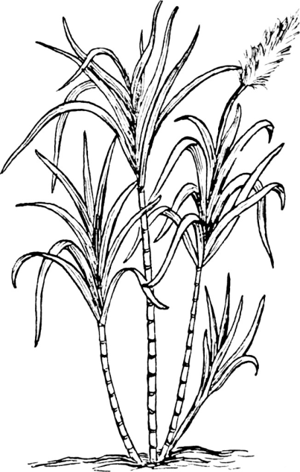
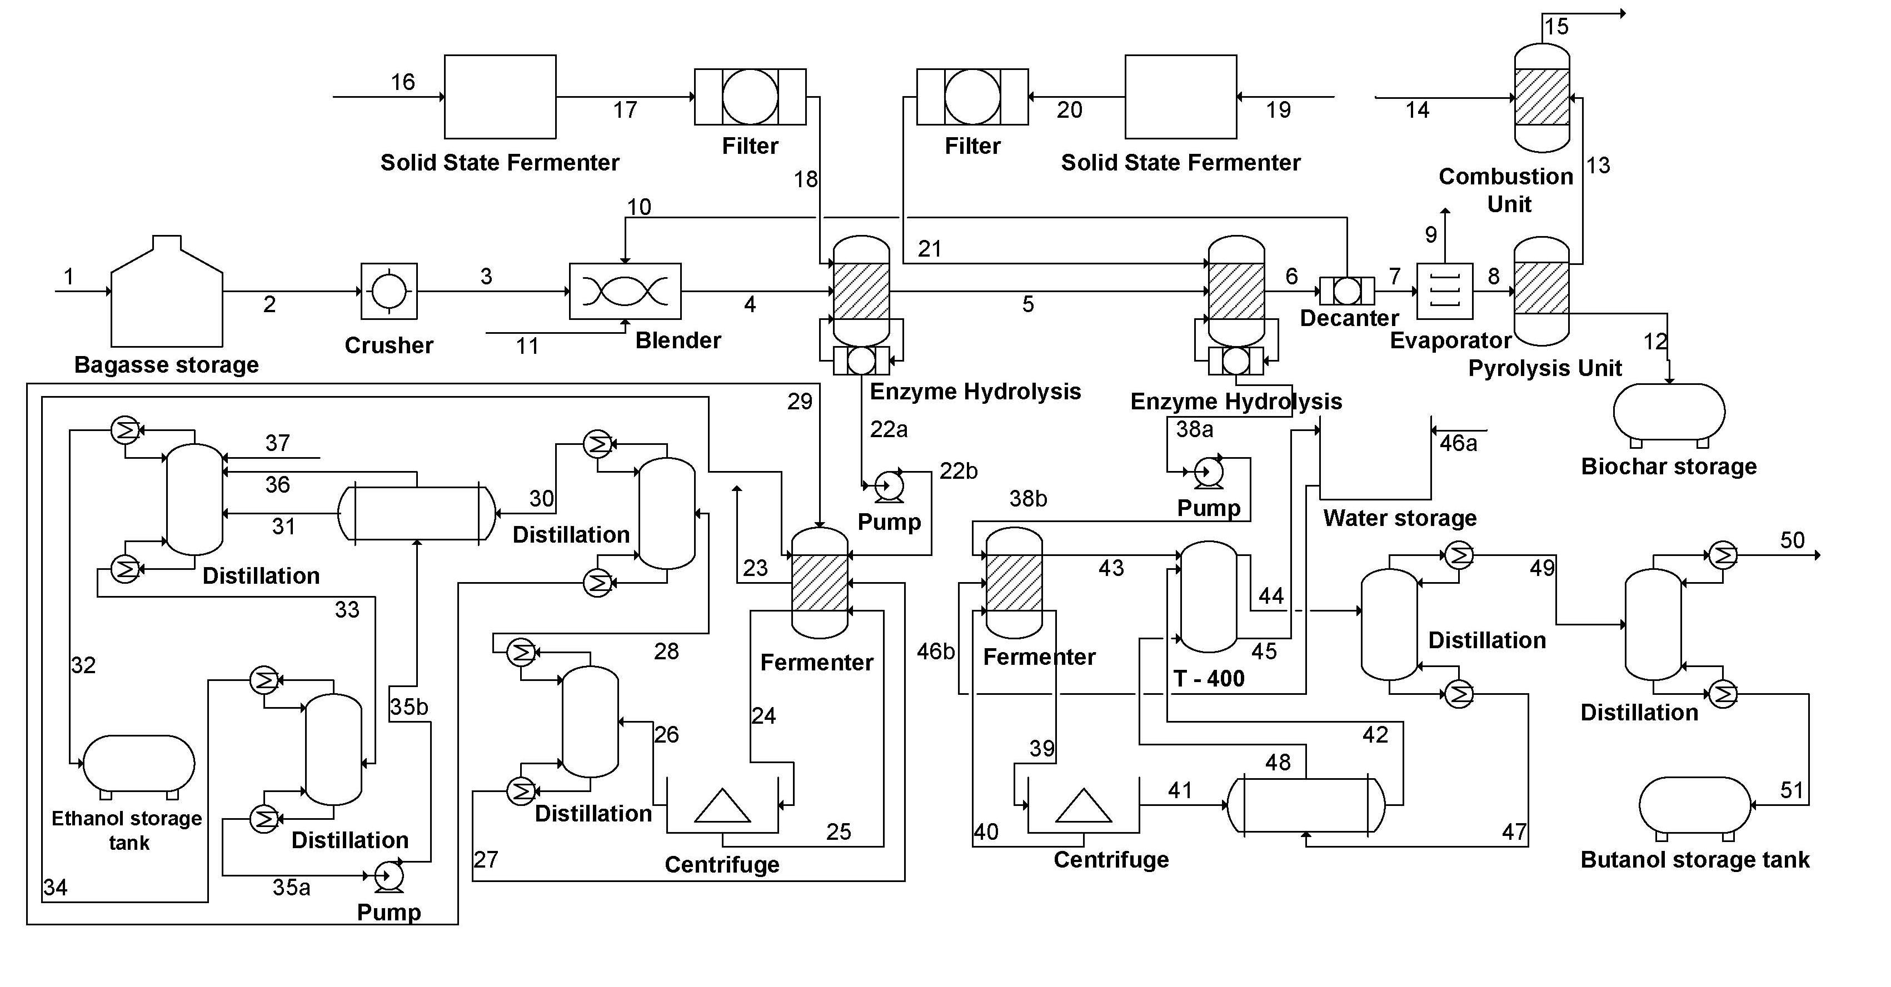
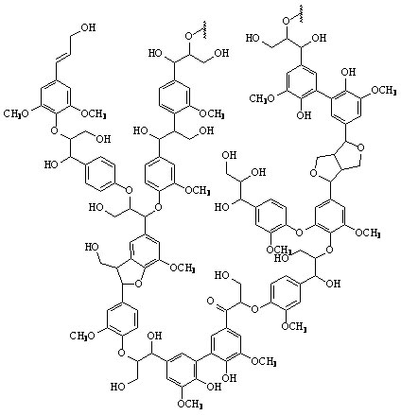
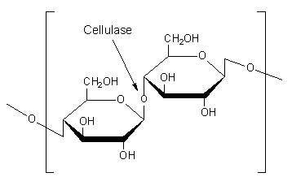
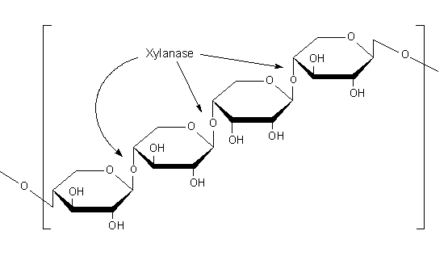
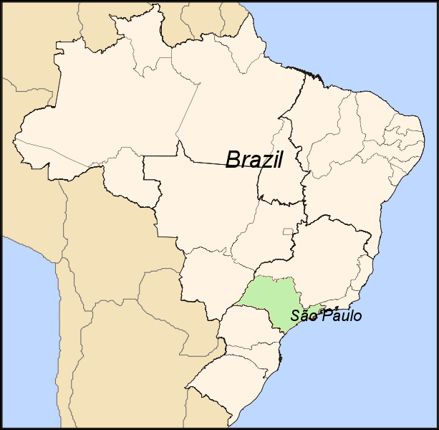
Conversion of Sugarcane Bagasse to Butanol and Ethanol via Solid State Fermentation
Department of Chemical and Biomolecular Engineering
Rice University, Houston, TX
James Carpenter - Barney Cruz
Austin Lipinski - Laura Tanenbaum
Michael Taylor
The Sugarcane Industry Wastes Considerable Energy
The current sugarcane market in Brazil produces an excess of unused resources. Following sugar extraction, the remaining sugarcane bagasse is burned as fuel for on-site sugarcane mills. Although the bagasse is recycled, the current process does not optimize the high energy potential of the cellulosic components of bagasse. The proposed design seeks to convert cellulose and hemicellulose into ethanol and butanol to substantially increase the profitability of the system. The application of bioreactors will also minimize the associated energy requirements of our design.
Converting Sugarcane Bagasse into Ethanol and Butanol
Sugarcane bagasse
Lignin
Cellulose
Hemicellulose
Cellulase
Xylanase
Creating Green Energy from An Otherwise Unusable Energy Source
Design an industrial size plant while optimizing cost and
sustainability
Transmute sugarcane bagasse into profitable energy sources
Ethanol
Butanol
Biochar
The Chosen Location, Feedstock, and Products Allow for Maximum Profitability
Why São Paulo, Brazil?
- Greatest availability of feedstock from sugarcane
processing company Cosan Limited²
- Familiarity with sugarcane bagasse treatment¹
Why bagasse?
- Waste product in large excess
- Room to maximize energy usage and profitability
Why ethanol and butanol?
- High-value chemicals with substantial market in Brazil
Process Specifications
What are the benefits of this design?
Optimization of cost
- Production rather than purchase of enzymes
- Mild reactor operating conditions
- Minimal transportation costs
- Economy of scale
Reduces carbon footprint by 47.4% through conversion
of lignin to biochar
The plant will break even in 15 years
Process Stream | Mass Flow (kg/h)
Bagasse (Feed) | 1000
Ethanol | 46.2
Butanol | 7
Biochar | 56
Process Stream | Heat Flow (kW)
Required | 1500
Generated | 1216
Input | 284
Bioreactors Offer An Innovative Industrial Scale Design
Solid state fermentation (SSF)
- Cell growth on surface of solid substrate produces
extracellular enzymes, avoiding high purchase cost
- Optimize reactor conditions to direct metabolism of
specific enzymes⁵
Enzyme hydrolysis of cellulosic components to fermentable
simple sugars
- Cellulase converts cellulose to glucose⁴
- Xylanase converts hemicellulose to xylose³
The Plant will Break Even in 15 Years
References and Acknowledgements
1 http://newenergyalternative.com
2 http://www.mz-ir.com/cosan/limited/index2.htm
3 Kheng, P.P. and Omar, I.C. Journal of Science Technology 2005, 325-336.
4 Mekala, N.K., et al. Applied Biochemical Biotechnology 2008, 121,131.
5 Petiot, E. Ethanol Producer Magazine 2008
We would like to acknowledge Dr. Kenneth Cox, Dr. Tracy Volz, Dr. George Bennett, Dr. Ann Saterbak, and Megan Weeks for their assistance on our design project
Interst rate = 10%
IRR = 11%
NPV = $106,000

