Slide 1


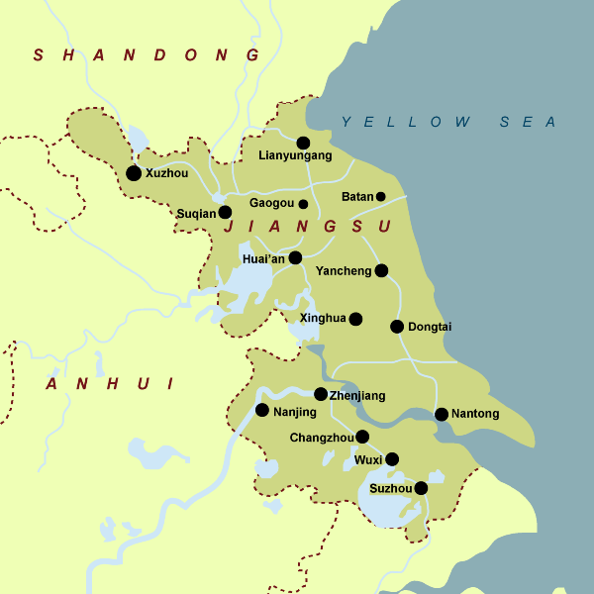

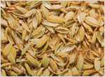
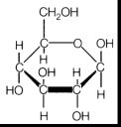
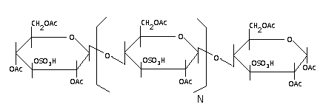
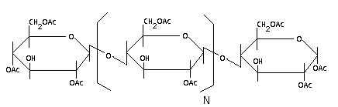

Termites: The Green Solution
Travis Bradshaw, Bill Eggert, Elyse Landry, Leo Logan, Sean Murray
Motivation:
Background/Goals:
Feedstock:
Energy Crisis:
Due to the global population growth, there is high demand for a renewable fuel. Current energy oil consumption is 31 billion barrels per year and only 2962 billion barrels remain. With consumption growth of 2% per year the reserves are expected to last for 68 years.
China’s Economic Growth:
China exports over $24 billion dollars worth of textiles. As their industries continue to grow more synthetic fibers will be needed.
Carbon Footprint:
Current industrial processes produce greenhouse gases that contribute to environmental consequences.
Location:
Nantong, China
Primary rice producing area
Two harvesting periods per year
Cellulosic Biomass:
The waste material present in all plant material including corn stover, rice husks, and saw dusk
Goals:
Cellulosic Biomass Valuable Products
Reduce energy demand and carbon footprint using an innovative design
Reduce energy cost and carbon footprint
Rice Husk
20% of rice harvest by mass is husk
Commonly thrown in refuse heaps/burned to produce energy
Grown easily in China
Basis size
Plant will accept rice husks from 50,000 acres (~80 mi²)
Husks will be stored during the year to allow a constant feed rate
Feedstock composition
56% Cellulose/Hemicellulose
16% Lignin
18% Ash (Primarily SiO₂)
10% Moisture
Major Unit Costs:
Using Nature’s Power: Waste to Value
Innovation:
Pressure Vessels
Pretreatment Reactors: $107k
Enzymatic Reactors: $865k
Fermenters: 8x125k=$1,005k
Heat Exchangers
5 S/T Exchangers: $150k total
Furnace: $644k
Separators
Molecular Sieve Tower: $1250k
Liquid/Solid Separators (4): $2500k
Storage
Will need 7 silos to store rice husk at peak harvest time :7x110k=$770k
Termite Enzyme:
Versatile cellulose digester that can react with any cellulosic feed stock
Dilute Acid Pretreatment:
Increases the efficiency of the termite enzyme digestion
Cellulose Acetate Production
Non-reacted cellulose created into valuable synthetic fiber
Heat Integration
Remaining lignin and cellulose burned to fuel plants energy needs
EtOH, AcOH,
Succ Acid
EtOH
Fermenters
Distillation
Electricity/Steam
Glucose
1100 lb/hr
Cellulosic Biomass
3.6 x10⁶ BTU/hr
H₂SO₄
Heated Pretreatment
Lignin
Glucose
Furnace
8000 lb/hr
Cellulose, Lignin,
Hemicellulose
Acid Pretreatment, Acytelation,
Filtration
Unreacted
Celluloses, Lignin
Cellulose
Acetate
Termite Enzymatic Reactor
Sold as .
Synthetic Fiber
400 lb/hr
Dilute Acid Pretreatment/Termite Enzyme Saccharifcation
Fermentation
Cellulose Acetate Production
Air
Waste from Enzymatic Hydrolysis
Batch:
AcOH, (CH₃CO)₂O,
CH₂Cl₂,
H₂SO₄
Cellulose Acetate intermediate
Solid/ Liquid Separation
Milled Husk
Ambient T
Milled Husk
121 C and 1 atm*
H₂SO₄ Pretreatment
Primary
Fermentation
23 ⁰C
Secondary
Fermentation
35 ⁰C
EtOH, AcOH, Succ Acid, CO2
Milled Rice Husk
Glucose
8000 lb/hr
45 C 1 atm
Batch :
Chloroform
Solid/ Liquid Separation
Solid Residue: lignin
To Furnace
Unreacted
solids
CO₂
Solid Residue
Enzymatic Reactor
Solid/ Liquid Separation
Glucose, Water
To Fermentation Process
Filtration
Vapor : CO₂
Knock-out
Pot
Molecular
Sieve
Dehydration
Liquid Filtrate
Glucose, Water
Liquid Filtrate:
EtOH, AcOH
EtOH
Liquid Filtrate
Evaporation
Cellulose Acetate
Solid/ Liquid Separation
Unreacted Celluloses, Lignin
To Cellulosic Acetate Process
Solid Residue
Calcium Succinate
*Not Shown: Heat exchanger with steam in series to achieve target temperature
Acknowledgements: Dr. Kenneth Cox, Dr. Strait

