Slide 1


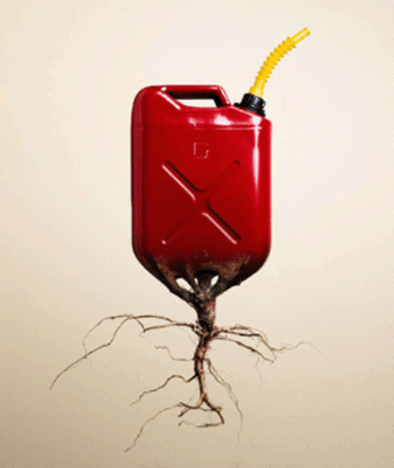
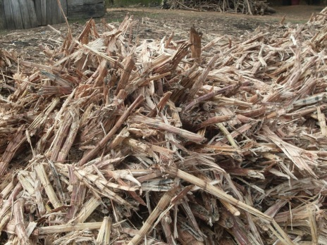
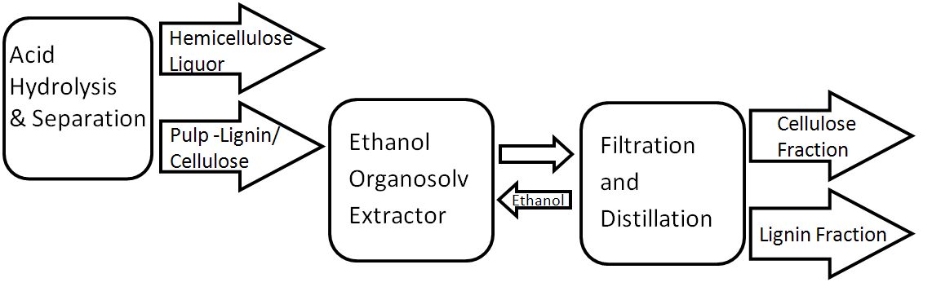
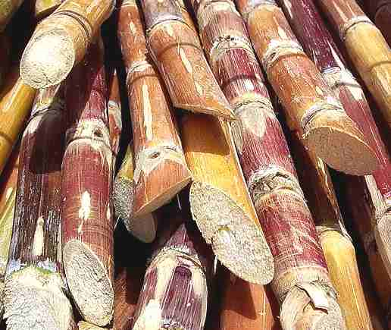
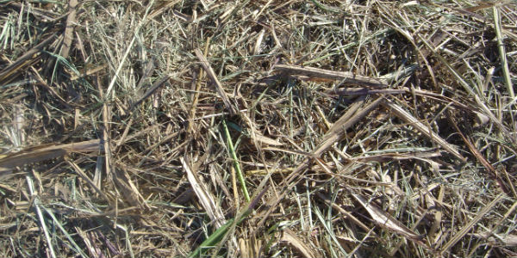
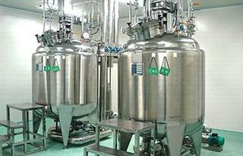
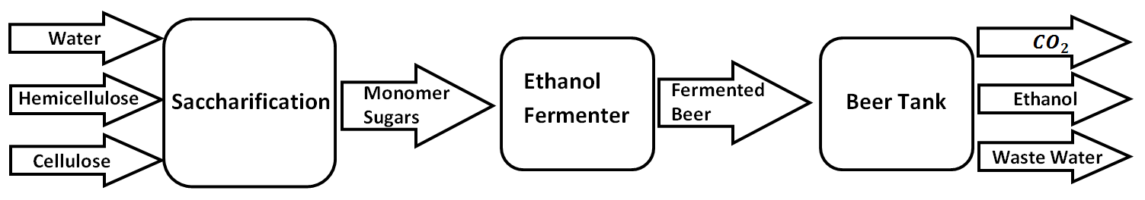
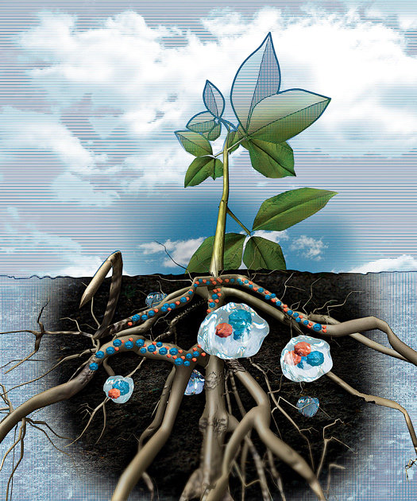
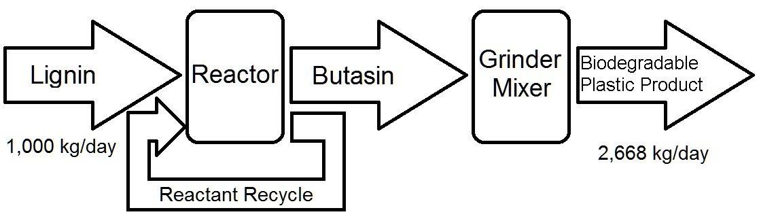
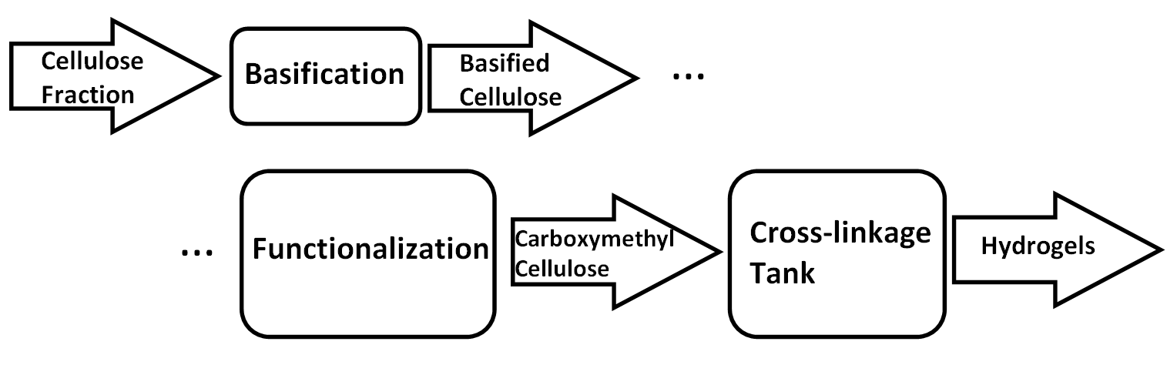
Cellulose to Cellulose and Beyond
Complete Processing of Sugarcane Bagasse
Sarah Agara, Robert Andries, Nicholas Hoeft, Victor Hogen, David Jahnke
Sugarcane Destiny - Food or Biofuel?
Product and Process Description
Conceptual Design & Innovation
15 tons/day sugarcane leaves 5 tons/day bagasse
Bagasse currently burned
50% Cellulose, 25% Hemicellulose, 20% Lignin
Fermentable glucose present, simply locked in cellulose and hemi-cellulose
Australian sugarcane along northeastern coastline
Interior unused, soil water retention limiting factor
Pretreatment & Separation:
Mechanical Processing → Desiccation & Milling
Homogenous particle size for quality control
Acid & Enzyme Hydrolysis → Reaction Pretreatment
Strategic solubility differences and depolymerization
Glucose and Pentose Fermentation →Ethanol Yield
Maximize cellular conversion to valuable molecules
Laboratory Bench Scale-up → Continuous Processing
Reagent and solvent recovery systems
To Saccharification
To Saccharification
or Hydrogel Formation
Bagasse
11,000 kg/day
54% Water
To Lignin Processing
Saccharification and Fermentation:
Cellulose, Hemicellulose from Pretreatment & Separation
Hydrogel Solution: Semi-Arid to Arable
Modify cellulose creating water retaining hydrogels
Hinders water evaporation and run-off
Opens inland resources
Enzymatically degradable
Expanded agriculture not food competitive
Sugar towards ethanol + more bagasse
Integrated with ethanol and bioplastic processes
Environment and Sustainability
Lignin Processing:
Hydrogel Depositing
Expands local agriculture potential
Uses carbon before eventual oxidation
Sustainable Ethanol Production
Expandable agriculture potentially self-sustaining
Hydrogel product amplifies other products
From Pretreatment & Separation
Bagasse
Lignin
Bio-plastic
Cellulose
Ethanol
Feedstock
Components
Additional Feedstock
Hemi-cellulose
Hydrogel
Ethanol
Sugarcane
Products
Hydrogel Formation:
Economics
Estimated $7.7 million in annual revenues
Estimated Capital Costs - $9.2 million + Installation and Piping Markup
Estimated Operating Costs - $2.5 million
Break-even in year 13
NPV = $5.4 million ; IRR = 16.09%
Sustainability allows long-run mindset and future growth potential
From Pretreatment & Separation
2,500 kg/day
3,240kg/day
Acknowledgements
Dr. Kenneth Cox | Dr. Richard Strait

